Slide 1
ACEs and Resiliency
West Shore School District
Jeannette Fodness & Ellen Smith

Slide 2
Overview
I. Adverse Childhood Experiences (ACEs)
Definition and Scoring
Brain Effects
Outcomes of High ACEs
II. Resilience Movie
III. Small Group Discussion
IV. Wrap Up

Slide 3
At any point in our discussion today, if you feel uncomfortable please feel free to get up, step outside, take a quick break, whatever you need until you feel you can rejoin the group.

Slide 4
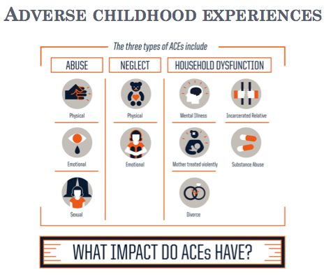

Slide 5
Adverse Childhood Experiences Study 1992(ACEs)
17,000 middle-class, mostly college educated, with insurance in California
ACE score of
6 + = 20 yr. decrease in life expectancy

Slide 6
Can you name any of the other ACEs?
Bullying
Discrimination
LGBTQ
Witnessed violence
Severe weather
War
ELL/Transient populations
Poverty
Medical conditions (child or family)
Deployed family member

Slide 7
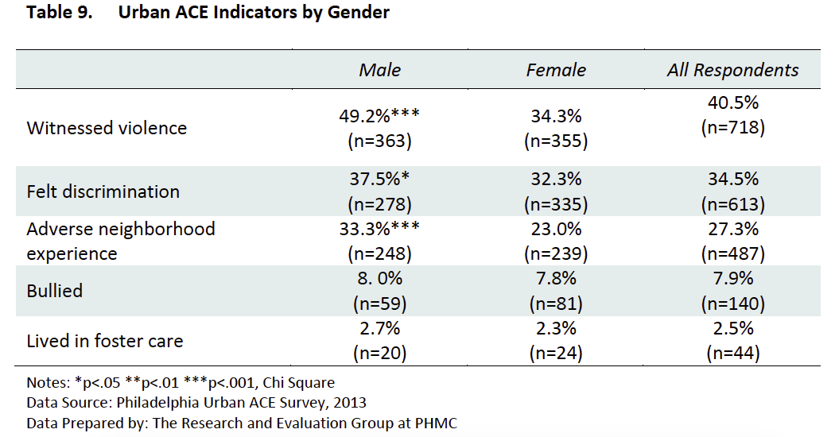
Notes:
From the Philadelphia ACE study—additional “ACEs” including observing violence, discrimination, adverse neighborhood experience, bullying and foster care.
This obviously hits many more people now.
Others have been considered and included in some studies:
Racism, war, religious and other persecution, severe weather events, serious accidents and terrorism (9/11).
Pottsville and Crawford County

Slide 8
Notes:
How do ACEs affect us?
The Pyramid itself from bottom to top.
Left—conception to death (may not need to say that).
Epigenetics—our genes are changed with persistent/toxic stress which is then passed on through our genes
Intergenerational Transmission—partially epigenetics and partially stories/ways of seeing the world. Consider survivors of the holocaust, slavery and 9/11,poverty, as well as “smaller” things like the Sandy Hook shooting, Orlando Gay club shooting and various terror attacks here, as well as war, poverty and terror elsewhere.

Slide 9
Adverse Childhood Experiences (ACEs)
ACE Score Worksheet
•Think of two students who you have worked with in your career. See if you can estimate their ACE score to the best of your knowledge.
•Calculate your own ACE score or maybe a family member.

Slide 10
Think about your two students
How do the students behave who have a higher vs. a lower ACE score?
How do their academic success(es) compare?
Share your thoughts with your neighbor

Slide 11
Survey Monkey
https://tinyurl.com/y8vtlhsp

Slide 12
So now that you know what ACEs are…
What are the long-term impacts of these ACEs?
Why should it matter to me if a child has a high ACE score? (Universal precautions)
Traumatic things have happened in my life, why can’t they just get over it?
The next slide has a dozen health concerns for those who have ACE scores of six or more.

Slide 13
Lifelong Consequences of ACEs http://c.ymcdn.com/sites/nasw-heartland.site-ym.com/resource/resmgr/IA_Brochures/ACEs_handout.pdf
Notes:
0 vs. 4 + ACE
12 X higher risk of ever attempting suicide
5 x higher risk of 2 + or more weeks depressed mood in past year
5 X risk of ever using drugs
10 X risk of every injecting drugs
3 X higher risk of 50 + sexual partners
2 X higher risk of heart disease, cancer, stroke and DM
4 X higher risk of Emphysema
6 + ACE score vs. 0—life expectancy decreased by 20 years
The original ACE score came out of a weight loss clinic-they saw lots of people who lost a lot of weight and then gained it back. Almost 100% of them had high ACE scores.

Slide 14
Educational Outcomes with ACES
Learning Delays
1 ACE < 10 % chance
4 ACEs 40 % chance
6 + ACEs nearly 100 % chance
Higher ACE scores increase likelihood of grade failure, lower scores on standardized tests, language difficulties, being suspended or expelled.
Notes:
Children with 4 ACEs were more than 40 percent likely to have a learning delay, compared with less than 10 percent for children with one or two ACEs. Children with 6 or 7 ACEs were nearly 100 percent likely to have a learning delay.
Response to trauma can include anxiety, attachment issues and emotional swings that can hinder a child's ability to learn. Students with higher ACE scores are more likely to be designated to special education, fail a grade, score lower on a standardized test, have language difficulties, be suspended or expelled and have poorer health.

Slide 15
ACE effects on the Brain
Nadine Burke Harris speaks about “How Childhood Trauma Affects Health Across a Lifetime”
Benjamin Perks speaks about “How Do We Stop Childhood Adversity from Becoming a Life Sentence” in a TED Talk
John Rigg “The Effect of Trauma on the Brain and How it Affects Behaviors” TEDxAugusta
Notes:
https://www.youtube.com/watch?v=4-tcKYx24aA&t=305s
Trauma and the Brain—starts as interview with suspect
https://www.youtube.com/watch?v=95ovIJ3dsNk Nadine Burke Harris
https://www.youtube.com/watch?v=qp0kV7JtWiE Benjamin Perks Video
https://www.youtube.com/watch?v=m9Pg4K1ZKws John Rigg video

Slide 16
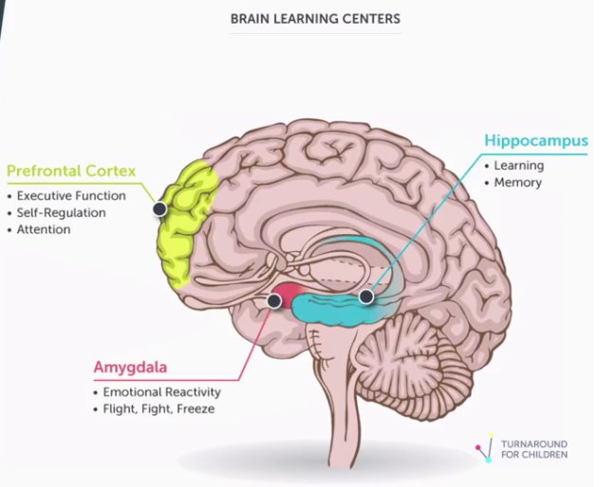
Notes:
Amygdala is the reptilian brain—it keeps us alive—flight, fright, freeze, basically patterned and habituated instincts (breathe, walk, run, chase prey, run from predators)
Hippocampus—learning and memory –knowledge, information
Prefrontal Cortex-develops later, affected by trauma—executive function, self-regulation, attention (or lack of attention, regulation)---wisdom, choices, evaluating situations,

Slide 17
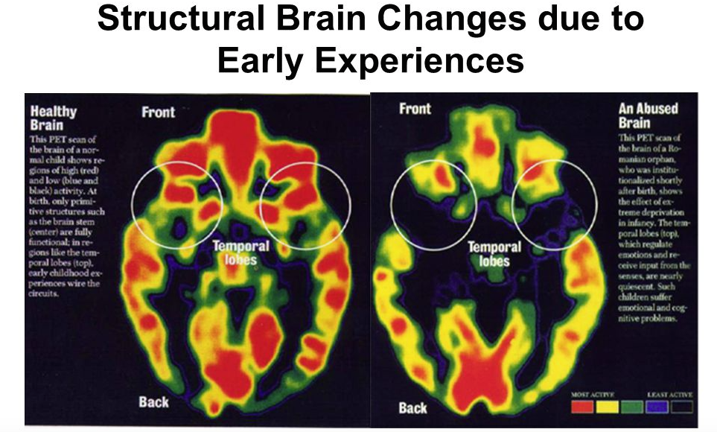
Harvard Center for the Developing Child,
http://developingchild.harvard.edu/topics/science_of_early_childhood/
toxic_stress_response/
Notes:
Temporal and Frontal lobes are responsible for emotional regulation and receive input from the senses
This is a Romanian orphan who was abused and neglected.

Slide 18
ACE Effects on the Brain
How are Brains Built?
4:05 video about how stressors impact the growing brain
How Brains Are Built
Notes:
This is the brain building and serve and return video. Keep if possible.
http://brightcove.vo.llnwd.net/e1/uds/pd/957733635001/957733635001_2735159101001_189717440.mp4

Slide 20
Statistics of Trauma
In a 2006 study by Egger & Arnold, 52% of children ages 2-5 have already experienced a life stressor
A report of child abuse occurs once every ten seconds (ChildHelp, 2013)
Poverty impacting ability to parent or to focus on schoolwork

Slide 21
Correlation Between Number of ACEs and ABCs.
 | Attendance | Behavior | Coursework | Health
3+ ACEs | 4.9 | 6.1 | 2.9 | 3.9
2 ACEs | 2.6 | 4.3 | 2.5 | 2.4
1 ACE | 2.2 | 2.4 | 1.5 | 2.3
No Known ACEs | 1.0 | 1.0 | 1.0 | 1.0
(Souers, K., (2015, p. 21)

Slide 22
What Fight, Flight or Freeze looks like in a classroom:
Fight may look like :
Acting silly/Acting Out
Engaging/over engaging with other students or teachers
Exhibiting defiance
Behaving aggressively
“Teasing” others
Notes:
Withdrawing
Fleeing class
Skipping class
Daydreaming
Acting silly
Seeming to sleep
Avoiding others
Hiding or wandering
Being disengaged

Slide 23
What Fight, Flight or Freeze looks like in a classroom:
Flight may look like
Fleeing class
Skipping class
Hiding or wandering
Acting silly
Notes:
Acting out
Behaving aggressively
Acting silly
Exhibiting defiance
Fleeing class
Skipping class
Hiding or wandering

Slide 24
What Fight, Flight or Freeze looks like in a classroom:
Freeze may look like :
Exhibiting numbness
Refusing to answer
Hoodie on
Giving a blank look
Appearing unable to move or act

Slide 25
Protective Factors
Power of Protective Factors may be more valuable than ACEs
Some children seem to overcome extreme odds while others do not.
Two types of protective factors
Internal Factors
Environmental supports
Notes:
Power of Protective Factors may be more valuable than ACEs
Some children seem to overcome extreme odds while others do not.
Two types of protective factors
Internal Factors
Environmental supports/ opportunities/conditions
Write down the protective factors that are most helpful/least helpful to you

Slide 26
Protective Factors
Trusted adult
Involvement in activities (music, scouts, athletics, faith-based organizations, etc.)
Intrinsic Factors such as optimism, Growth Mindset, determination, grit, and perseverance

Slide 27
Think back to the people you identified in your ACE score calculation
What protective factors did these individuals have to help them be more resilient?
Share with your neighbor/group
Notes:
“Promoting resiliency in schools includes the importance of increasing the bonding that takes place between students and adults in the school. One way to cultivate resiliency is to establish connections. A sense of security, safety, and acceptance can support one’s feeling of connectedness and engagement in the learning.”

Slide 28
Resiliency in a student
Think of a time when you have observed resiliency in a student; share this with another individual.
How did this impact or influence you?
Consider when you have become one those trusted adults and the impact it has had on you and/or that individual?
Notes:
Outliers---- It is important that we pay attention to these outliers because we can learn from them.

Slide 29
Now sit back and experience
The film Resilience

Slide 30
After the movie
What are your immediate impressions, thoughts, and/or feelings after the movie?
Please record your thoughts on the reverse side of the paper where we calculated the ACE scores.
You can use these points as we discuss ACEs and resilience in our smaller groups.

Slide 31
At this point we will move
to the locations you were provided with to discuss with your facilitators from your buildings.

Slide 32
Discussion & Questions

Slide 33
Ideas in our schools
Google docs or team lists to identify where students are involved or not
Team meetings- checks for concerns (Thumbs up/Thumbs down)
What are other thoughts or ideas?

Slide 34
Where are we going from here?
Would you be willing to be involved if we brought Resilience to the community at your school?
Be sure to indicate your willingness on the staff evaluation that comes from Dr. Whye.
For more in-depth discussion join us at WSSD ACEs academy from 8am-noon on Monday, June 26th or Monday, July 24th.

Slide 35
Thank you
It has been our pleasure to come and speak with you today. Our passions for ACEs come from a lifelong commitment to health for all individuals.
Pottstown and Crawford County ACEs Communities at ACEs Connection.com
Peace4SouthCentralPA on Facebook
Dr. Ellen Smith ellen.smith6@verizon.net
Jeannette A. Fodness jfodness@wssd.k12.pa.us

Slide 36
Reference Films
Films you may find useful and want to bring to your town. We are planning to bring them to Harrisburg. Paper Tigers Resilience Portraits of Professional Caregivers: Their Passion Their Pain All are on Tugg.com where you can see the Trailers. If you show them, be sure to have a debrief session afterwards.

Slide 37
Educational Videos
Maya Video: Full title Removed
https://www.youtube.com/watch?v=qp0kV7JtWiE&spfreload=5-
Nadine Burke-Harris TED talks
https://www.ted.com/talks/nadine_burke_harris_how_childhood_trauma_affects_health_across_a_lifetime?language=en#t-547887

Slide 38
References:
acesconnection.com
www.acesconnection.com/g/aces-in-education
ACEsTooHigh.Com
ncjfcj.org/sites/default/files/FInding%20Your%20ACE%20Score.pdf (ACE SCORE FORM)
cdc.gov/violenceprevention/acestudy/
http://www.traumainformedcareproject.org/resources/iowa_aces_360_pdf_web_new.pdf

Slide 39
Wellness Committee
Suzanne Tabachini

Slide 40
Closing Remarks
Dr. Jamie Whye
Dr. Todd Stoltz

