Slide 1
Game Day:
Thursday, April 20, 2017 Messiah College
Meet in RL Lobby at 8:15am
(Rain Date: Tuesday, April 25)

Slide 2
What to Wear:
Dress Comfortably
For colder days, dress in layers
Your Games t-shirt should be the top layer
What to Bring:
Backpack/Bag
Driver’s License or a Photo ID
2 Bottles of Water - for you and your athlete
Sunscreen
Tissues
Notes:
Water is available in the orange Gatorade coolers at the First Aid stations. There are 4 First Aid stations at the track, 1 at the Softball Throw, and 1 in Olympic Village. It is recommended for you to bring a bottle water for yourself and your athlete to start off the day. If it is a hot day, please encourage your athlete to drink water.

Slide 3
Colors of the Day
2016 T-shirt Colors:
  Athlete = Purple
  Buddies = White
  Game Management = Sapphire Blue
  Event Competition = Sports Grey
  Zone Monitors - Orange
  Medical = Red
Combo for the day
Athlete
Buddy
+
Best People
to ask for
assistance
Competition
Questions
Zone Monitors:
Provide
additional
assistance
Medical,
First Aid,
Water
Notes:
There are several locations to get your questions answered:
At the Information Table located at the center of the track field
At the Information Table located on Anderson Field
At the Information Tent located in Olympic Village
Management Team members in Maroon T-shirts or sweatshirts.

Slide 4
Buddy & Athlete Pairing
You will be paired with your buddy at Red Mill, Newberry or Red Land. A Yellow wristband indicates that your buddy cannot have their picture taken. Please be aware of this throughout the day.
Use the buddy card and the schedule in your program to help figure out a plan for the day.
Find out what time your athlete will be leaving and a location to meet at the end of the day.
Notes:
Prior to taking your athlete for the day, it is important to meet the teacher to find out:
Where the teacher will be for the day
What time will they be leaving and the location to meet at the end of the day
If the teacher plans to have the students meet in a certain area to have lunch together.
If you have an adult athlete please ask their chaperone for a meeting place.
If the athlete is having a bad day, find the teacher or caregiver to turn the athlete over to them for the day. It’s not YOUR responsibility if
the athlete is having a bad day. Sometimes a few words from the teacher or caregiver will give them the encouragement needed to enjoy the
rest of their day.
If the Athletes' family is there and you don’t feel that you are being of any help to the athlete , please find a management team member to
let them know you are available to be reassigned.
Once you are paired with your athlete, there is no need to go through any additional registration.
Messiah College First year students will most likely be paired with an upper classman in order to ensure that each volunteer is paired with a buddy.
Community Volunteers may be paired up as well depending on our numbers.
Warm up aerobics will be held between 9:15 and 9:30 and Opening Ceremonies will begin shortly after aerobics are completed.
Head straight to the track after you pick up your athlete as events will start right away.

Slide 5

Special Olympics PA – Area M
2015 Area M Games
JAMES HEFFERNAN
Athlete Number: 429
CUMBERLAND VALLEY
Group: Male Senior
Birth Date: 10/25/1989
Event Name
Heat Lane Start Point
100m Dash – Male Senior
4
2
Yellow
200m Dash – Male Senior
6
6
Green
Running Long Jump – Male Senior
Field
Medical Conditions: Medicine
SEIZURES; NON-VERBAL; SPECIAL DIET NEEDS
Notes:
Review the Buddy Card to make sure everything matches up properly:
The Athlete Number on the Buddy Card matches the number in the buddy bag
Verify the Group and Gender are correct
Use the Age groups listed in the program to verify the athlete is assigned to the appropriate age group.
If there are any discrepancies, please go immediately to Athlete Registration.
Medical Conditions – (dietary/allergies/medicine).
If Medicine is listed, find out from the Athlete’s teacher or caregiver if the athlete needs to take medication while at the games. If so, set up a time and place to meet the teacher
YOU are NOT responsible to give the athlete medication, but you are responsible to meet the teacher at the designated time.
If more information or assistance is needed during the day, ask a Sports Medicine volunteer (in red t-shirts)

Slide 6
Age Groups
Youth: 8-11 years old
Juniors: 12-15 years old
Seniors: 16-21 years old
Adults: 22-29 years old
Older: 30 years old and up

Slide 7
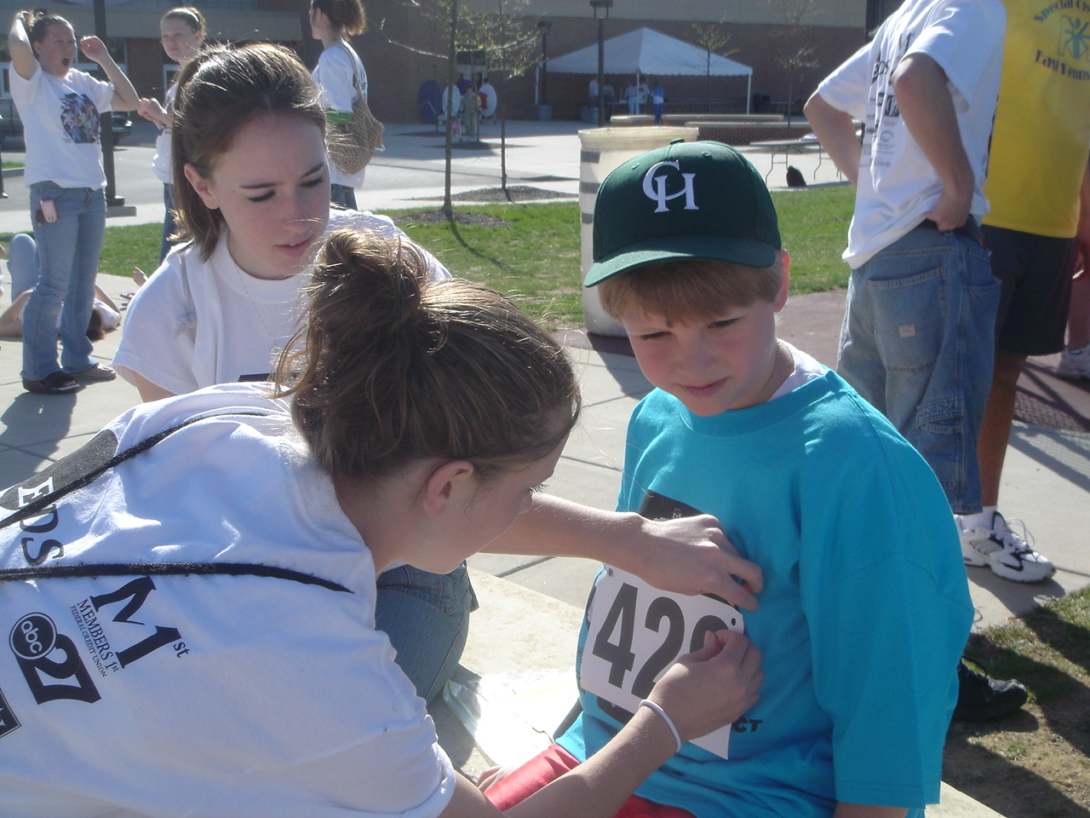
Athlete’s Number
on FRONT of t-shirts
Notes:
Make sure you pin your Athlete’s Number to the front of their t-shirt, This allows the competition people to see the athlete numbers as they are coming towards them in each heat.

Slide 8
Locations:
Anderson Field: Softball Throw, Turbo Jav and Wheelchair events.
The Standing Long Jump is located at the end of track area between the yellow and blue corners on the pole Vault Runway.
Shot Put located on lower Starry Field after the Demonstration Sports.
Olympic Village will be in the parking lot. The tents with the different activities will be set up on each side of the parking lot.
Information Tent – Left side of parking lot near the Access Path to Anderson Field.
Soccer and Volleyball Demonstration Sports will be held on Lower Starry field. Tennis will be in the Tennis Court area.
Notes:
ANDERSON FIELD:
Softball Throw, Turbo Jav, and Wheelchair events will be up on Anderson Field. There is access to Anderson Field from the Yellow Corner at the track.
From the parking lot, use the access path next to the Information Tent. Look for signs and Purple Balloon to assist with directions to Anderson Field.
Wheelchairs will not be allowed on the track at any time, Please use the access road from Olympic Village to go to Anderson Field.
Olympic Village will be in the parking lot. The tents with the different activities will be set up on each side of the parking lot.

Slide 9
Responsibilities
As a Buddy, you are responsible for your athlete from the moment they get off the bus until they board their bus at the end of the day.
You will ensure your athlete is on time for all his/her events,
Eat lunch with the athlete,
Visit the Olympic Village
Ensure your athlete is handed off to their teacher or caregiver at the end of the day.
It is very important for you to interact with your athlete all day. Get to really know them. You should be creating a new friendship that may last after the games.

Slide 10
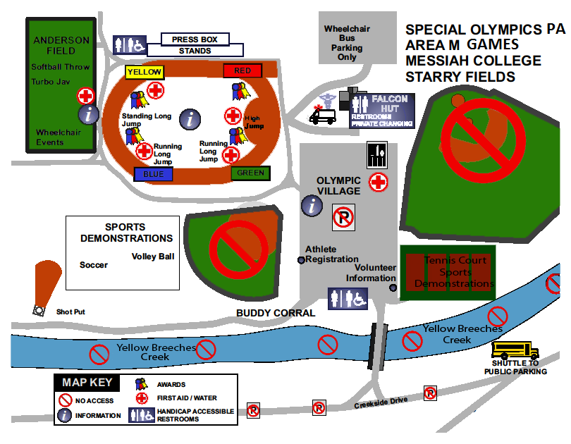
Notes:
It is important to familiarize yourself with the map. On day game, the buddy bag contains a program. Within the center of the program is the map displayed here. Please use that to help locate events and activities. If you need additional assistance, please contact the Information Table in the center of the field or the Information Tent in Olympic Village.
The bathrooms are located at the Falcon Hut and porta-pots are located throughout the event.
PRIVATE CHANGING FACILITY: Located in the Women’s Locker Room in the Falcon Hut. The changing facility is for the school’s usage for wheelchair athletes. Ladies, please respect the privacy for the athletes and do not use this facility as a second restroom.

Slide 11
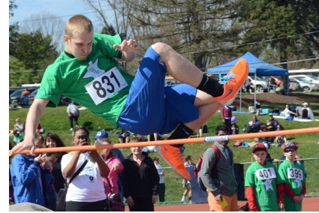
Field Events:
Athletes can compete in their assigned field events at any time
Before Opening Ceremonies
In between the athlete’s track events
Notes:
The six Field Events are listed on the next slide.
Encourage competing in the Running Long Jump before Opening Ceremonies. The line later in the day is long.

Slide 12
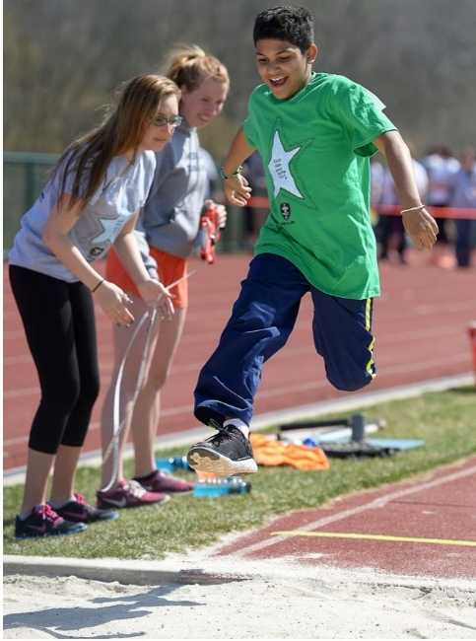
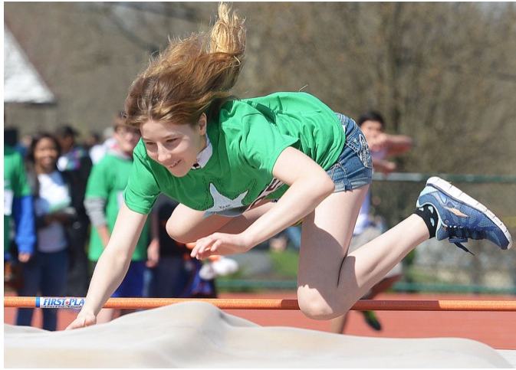
Field Events
Athletes can only participate in field events on their Buddy Card:
  High Jump
  Running Long Jump
  Shot Put
  Softball Throw
  Standing Long Jump
  Turbo Jav

Slide 13
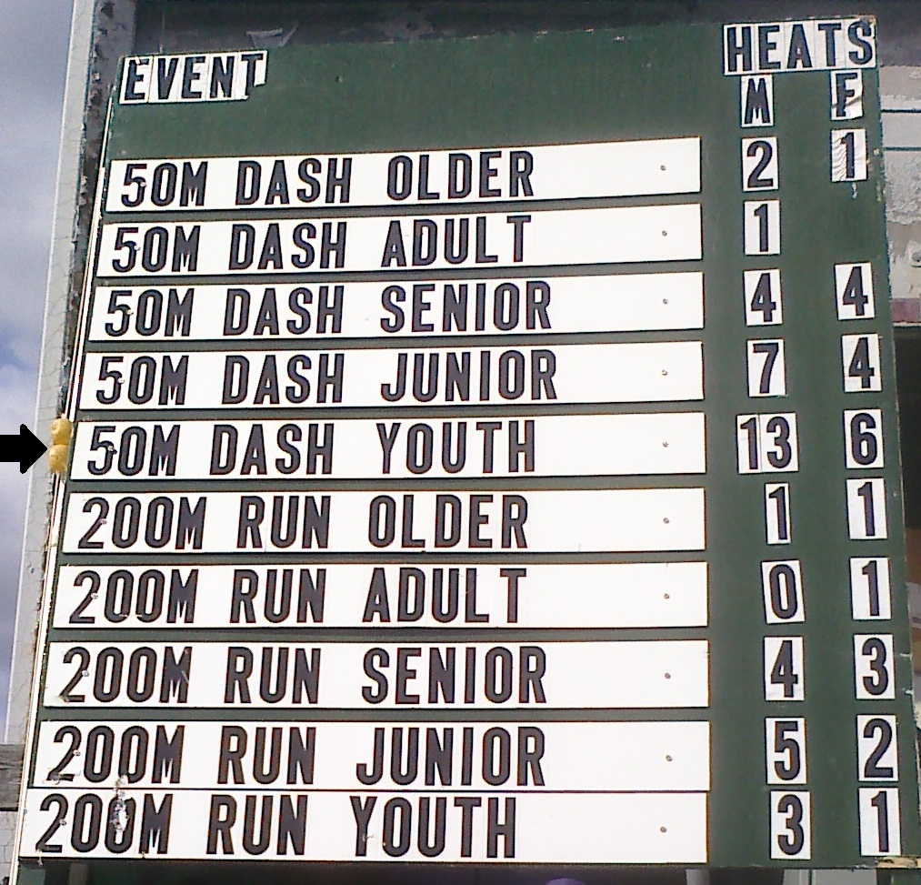
Corner Signs
Indicates all the events in a corner plus how many heats per Male (M) & Female (F)
Look for the markers on the side of the sign to know the current athlete event.
Notes:
The corner signs are located along the fence near the starting line of each corner.
The picture is an example of the Green Corner sign.
For the 50 M Dash Older there are 2 Male Heats and 1 Female Heat
The arrow is pointing to the yellow markers that indicate the current heats that they are in the process of running. In this example, the Green Corner are on the 50 M Dash Youth Events. There are 13 Male Heats and 6 Female Heats.
Use the buddy card and the corner signs to help figure out a plan for the day. Before Opening Ceremonies, go to each corner sign for the events to figure out when to do your field events. In our example, James is participating in the following events:
100 M Dash Male Senior Heat 4 - Yellow Corner
200 M Run Male Senior Heat 6 – Green Corner
Running Long Jump
Lets say James just finished his first event of 100M Dash. When you and James come over to the green corner, it indicates that they need to finish the 50 M Dash Youth Events and there three 200M Run Events before they start the 200M Run Senior Events. If the green corner is on 50M Dash Youth events, there should be enough time for the athlete to participate in the Running Long Jump before the 200M Run Senior Events start.

Slide 14
Staging
Report to the appropriate staging area as soon as the event is called.
Stay near the age group flag of your athlete.
Make sure your athlete is on time for all track events. Check the schedule in your program.
The 50M and 100M dash begin as soon as opening ceremonies end, so please participate in opening ceremonies near that corner.
Notes:
If you know anything about Track and Field, pass on your knowledge.
Make sure your athlete is on time for track events. If the athlete misses their track event, they will run in a heat together after all other heats, only if time permits. Only participation ribbons will be awarded for these athletes, which will disqualify the athlete from state competition.
The track events have starting times, where the field events do not. So, be on time for track events! If the Athlete has an extenuating circumstance such as the athlete needs a whistle start, please inform the Assistant Stager when checking in for the race. Athletes can participate in field events whenever time permits.
Staging – after your athlete is staged for an event, walk down along the side of the track so you can cheer your athlete as they run down the track to the finish line.

Slide 15
Ribbons
Make sure to pick up your ribbons after each track event following the Escort to the proper awards area.
If the athlete does not have time to wait, the ribbon can be picked up at the Information table later in the day.
All ribbons for field events and any unclaimed ribbons will be sent to their school or home after the event.

Slide 16
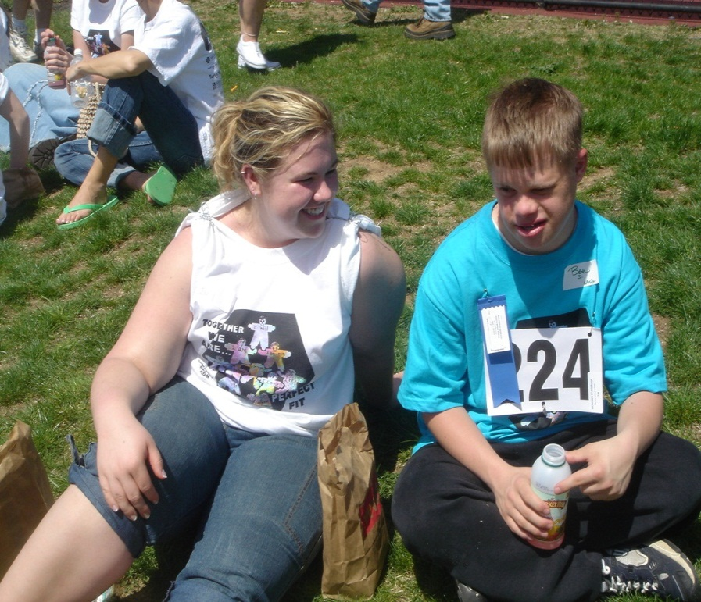
LUNCH
Eat Lunch with your athlete
Available for athletes & volunteers starting at 11:30
Lunches are located in the Meal Tent in the upper corner of the parking lot
Notes:
Lunch is supplied for you and your athlete.
Lunch contains sandwich (turkey or ham), chips, cookies, and a drink. If you have dietary needs and cannot eat the lunch provided, we suggest that you pack your lunch for the day.
Eat lunch with your athlete. Lunches will be available in the Meal Tent in the upper corner of parking lot and in the Wrestling Room for the swimmers, and at Anderson field for Wheelchair athletes after 11:30. Only 1 lunch is available for you, and 1 for your athlete. Do not take extra’s. Prioritize your activities and lunch so that it does not interfere with the track events.
There is food available to buy at the Falcon Hut. If you do not want the lunch provided feel free to bring money or pack your own lunch.
Do not to buy the athlete any food, even if they plead with you…..athletes can try to con you into believing they NEED it. The provided lunch, water and tea provided is just fine. They do not need a soda or a burger - no matter how much they try to convince you they need it.
On hot days, encourage your athlete and yourself to drink water to remain hydrated.

Slide 17
Olympic Village Athletes
Children under 8 years old.
They may participate in the Youth Athletes Program for ages 2-7.
Eligible to participate in all Demonstration Sports and any activity in Olympic Village.
Olympic Village Athletes will have an athlete number that starts with OV. Pin the athlete number to the front of the shirt.
Notes:
*Olympic Village athletes will receive a number that they can put on the front
If the Buddy Card indicates the Athlete is registered as “Olympic Village,” this means that your athlete is too young to participate in the
Track, Field, or Swimming events. As a buddy, you and the athlete may attend Opening Ceremonies, cheer for the athletes running races,
and participate in the activities in Olympic Village.

Slide 18
Special Olympics PA – Area M
2015 Area M Games
DWIGHT SCHRUTE
Athlete Number:
HALIFAX ELEMENTARY
Group: Male Child
Birth Date: 4/2/2007
Event Name
Heat Lane Start Point
Olympic Village – Male Child
Olympic Village
Medical Conditions:
Notes:
Olympic Village Athlete

Slide 19
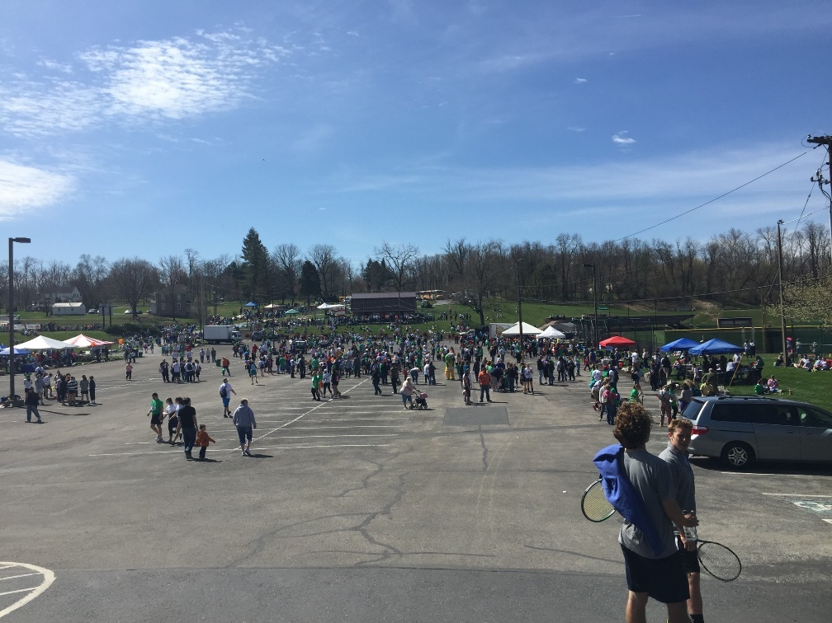
Olympic Village
When your athlete is not competing, take them to the Olympic Village & Demonstration Sports.
There may be special activities that will only be offered to the athletes and may be limited to one time participation.

Slide 20
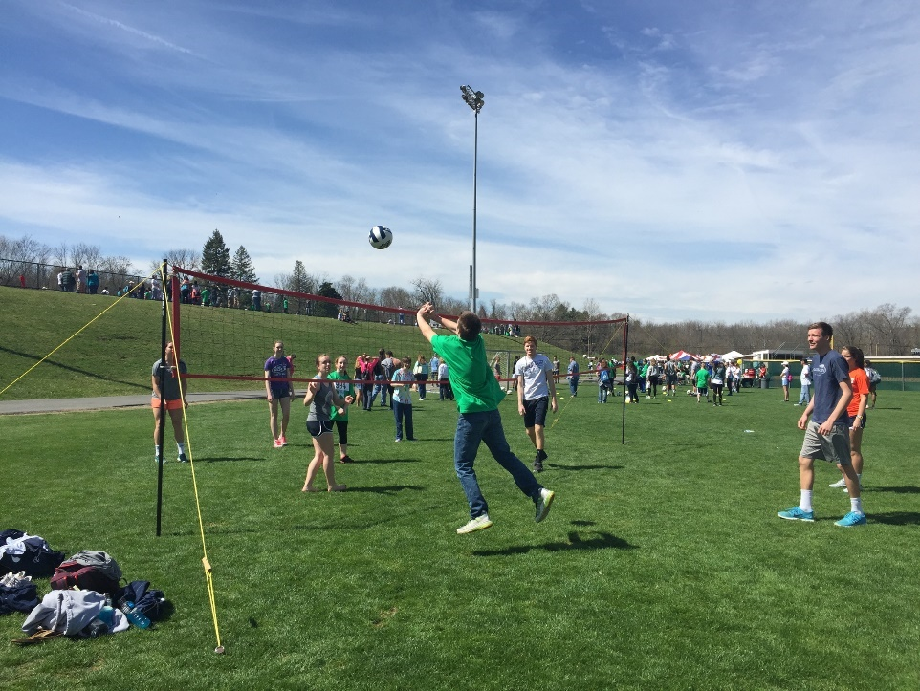
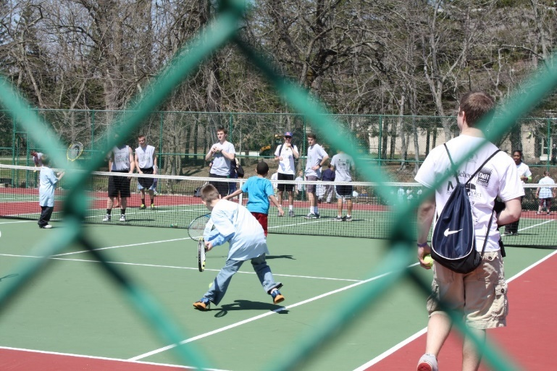
Demonstration
Sports
Soccer
Tennis
Volleyball
Youth Athletes Program for ages 2-7

Slide 21
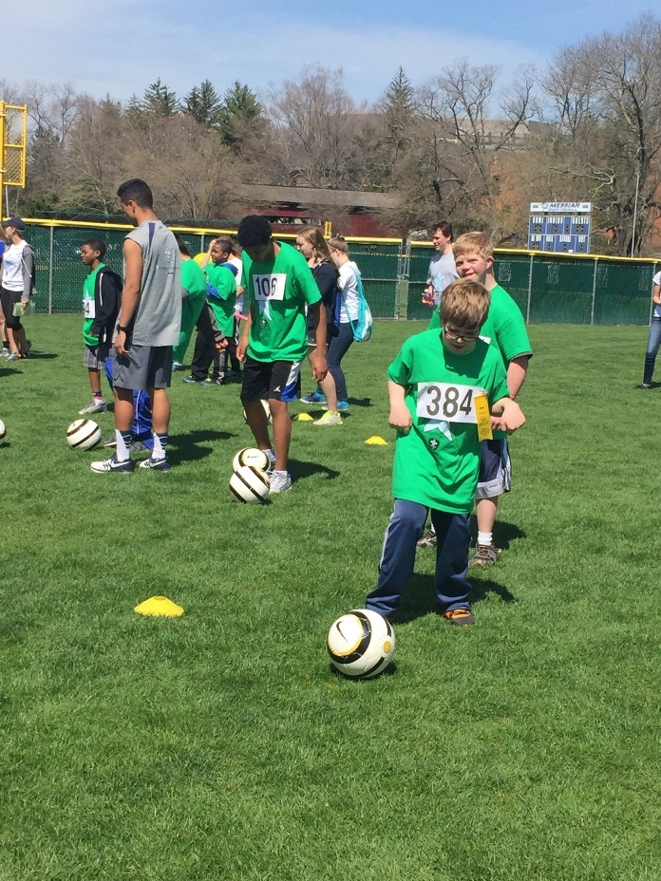
End of Day
Take your athlete to the predetermined location and time to meet with their teacher.

Slide 22
No playing in or near the creek!
The Softball and Baseball fields are also off limits.

Slide 23
Thank You For Your Service!
Please DO NOT forget your ID!
Notes:
*Don’t Forget your ID

