Slide 1
By: Michael
Regular Name: Scarlet Oak
Scientific name: Quercus coccinea
Facts:The tree that the scarlet oak grow on goes to 60-80 feet. The Scarlet Oak is popular for its brightness. It is common in the appalachian mountains but is not rare to find it somewhere else. The first scientific observations were made in 1691.

Slide 2
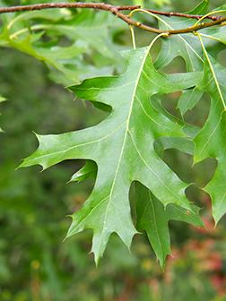
SCARLET OAK
PICS

Slide 3
By: Michael Thompson
Regular Name: Red Maple
Scientific Name: Acer Rubrum
The red maple tree which the red maple leaf is on grow to 60-90 feet. They grow in eastern forests in Newfoundland to southern florida. The Red Maple tree is Rhode Island's state tree. The largest Red Maple Tree ever recorded was 141 feet long in the Great Smoky National Park.

Slide 4
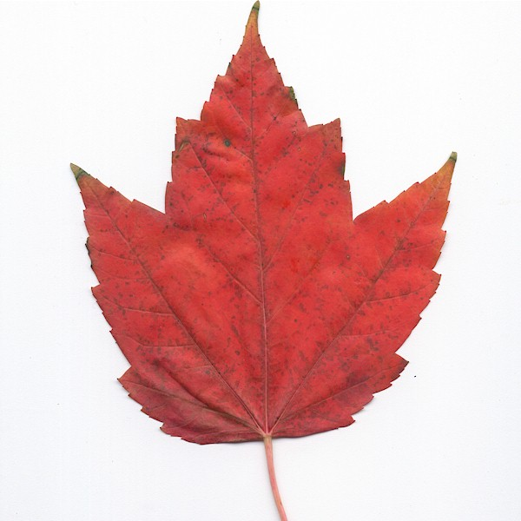
RED MAPLE PICS

Slide 5
By: Michael Thompson
Regular Name: sand pine
Scientific Name: Pinus Clausa
It is also known as scrub pine and spruce pine. The majority of trees in natural sand pine are located in western Florida and especially between Panama City and Pensacola. It is part of the plantae kingdom. It is in the pinaceae. It is in the coniferopsida class.

Slide 6
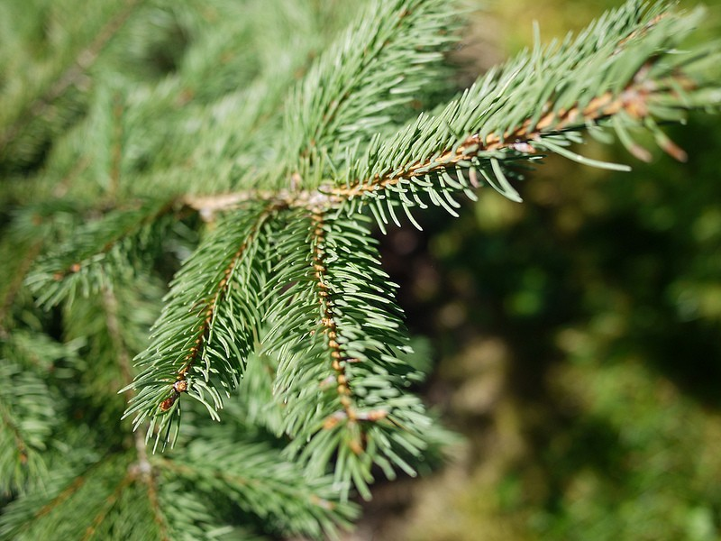
SAND PINE
PICS

Slide 7
Glossary
Conifer: A tree that has cones need needlelike or scalelike leaves.
Oak: A tree that has acorns as fruit and usually lobed deciduous leaves.
Maple: A tree with lobed leave winged fruit and colorful autumn leaves.

