Slide 1
My maple, oak, and conifer leaves

Slide 2
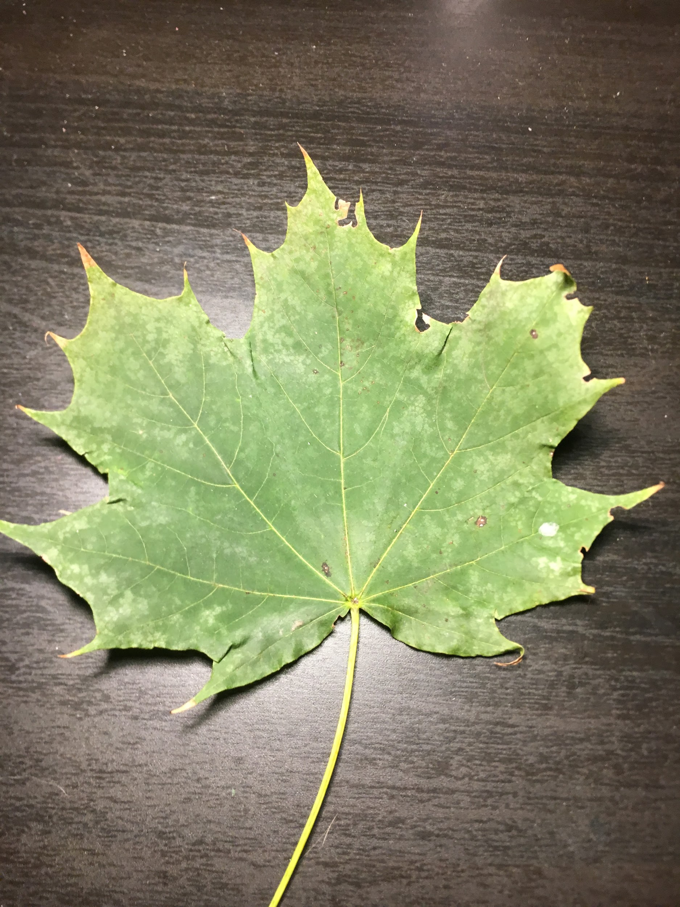
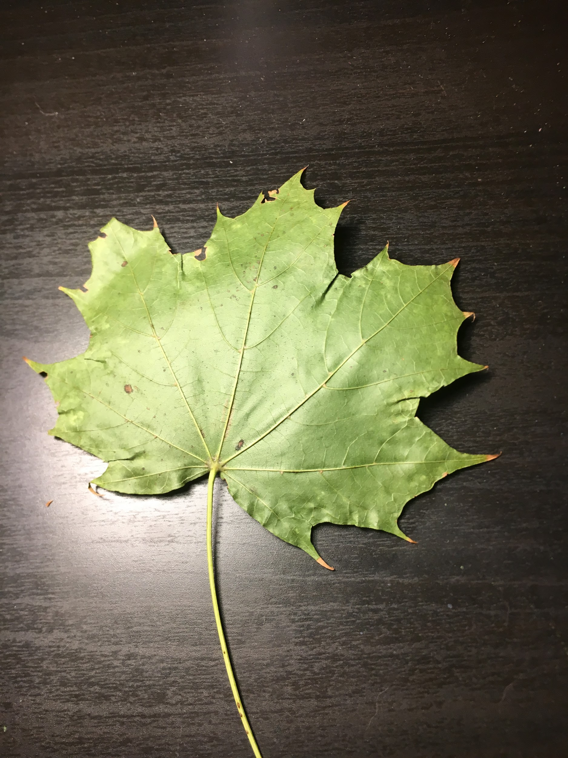
Maple
The leaf i collected was a red maple.
Scientific name: Acer rubrum
I identified my leaf by looking at the point and scoopes and comparing it to other leaves then i found red maple. And the seeds also helped me because they look like like helicopter things idk.

Slide 3
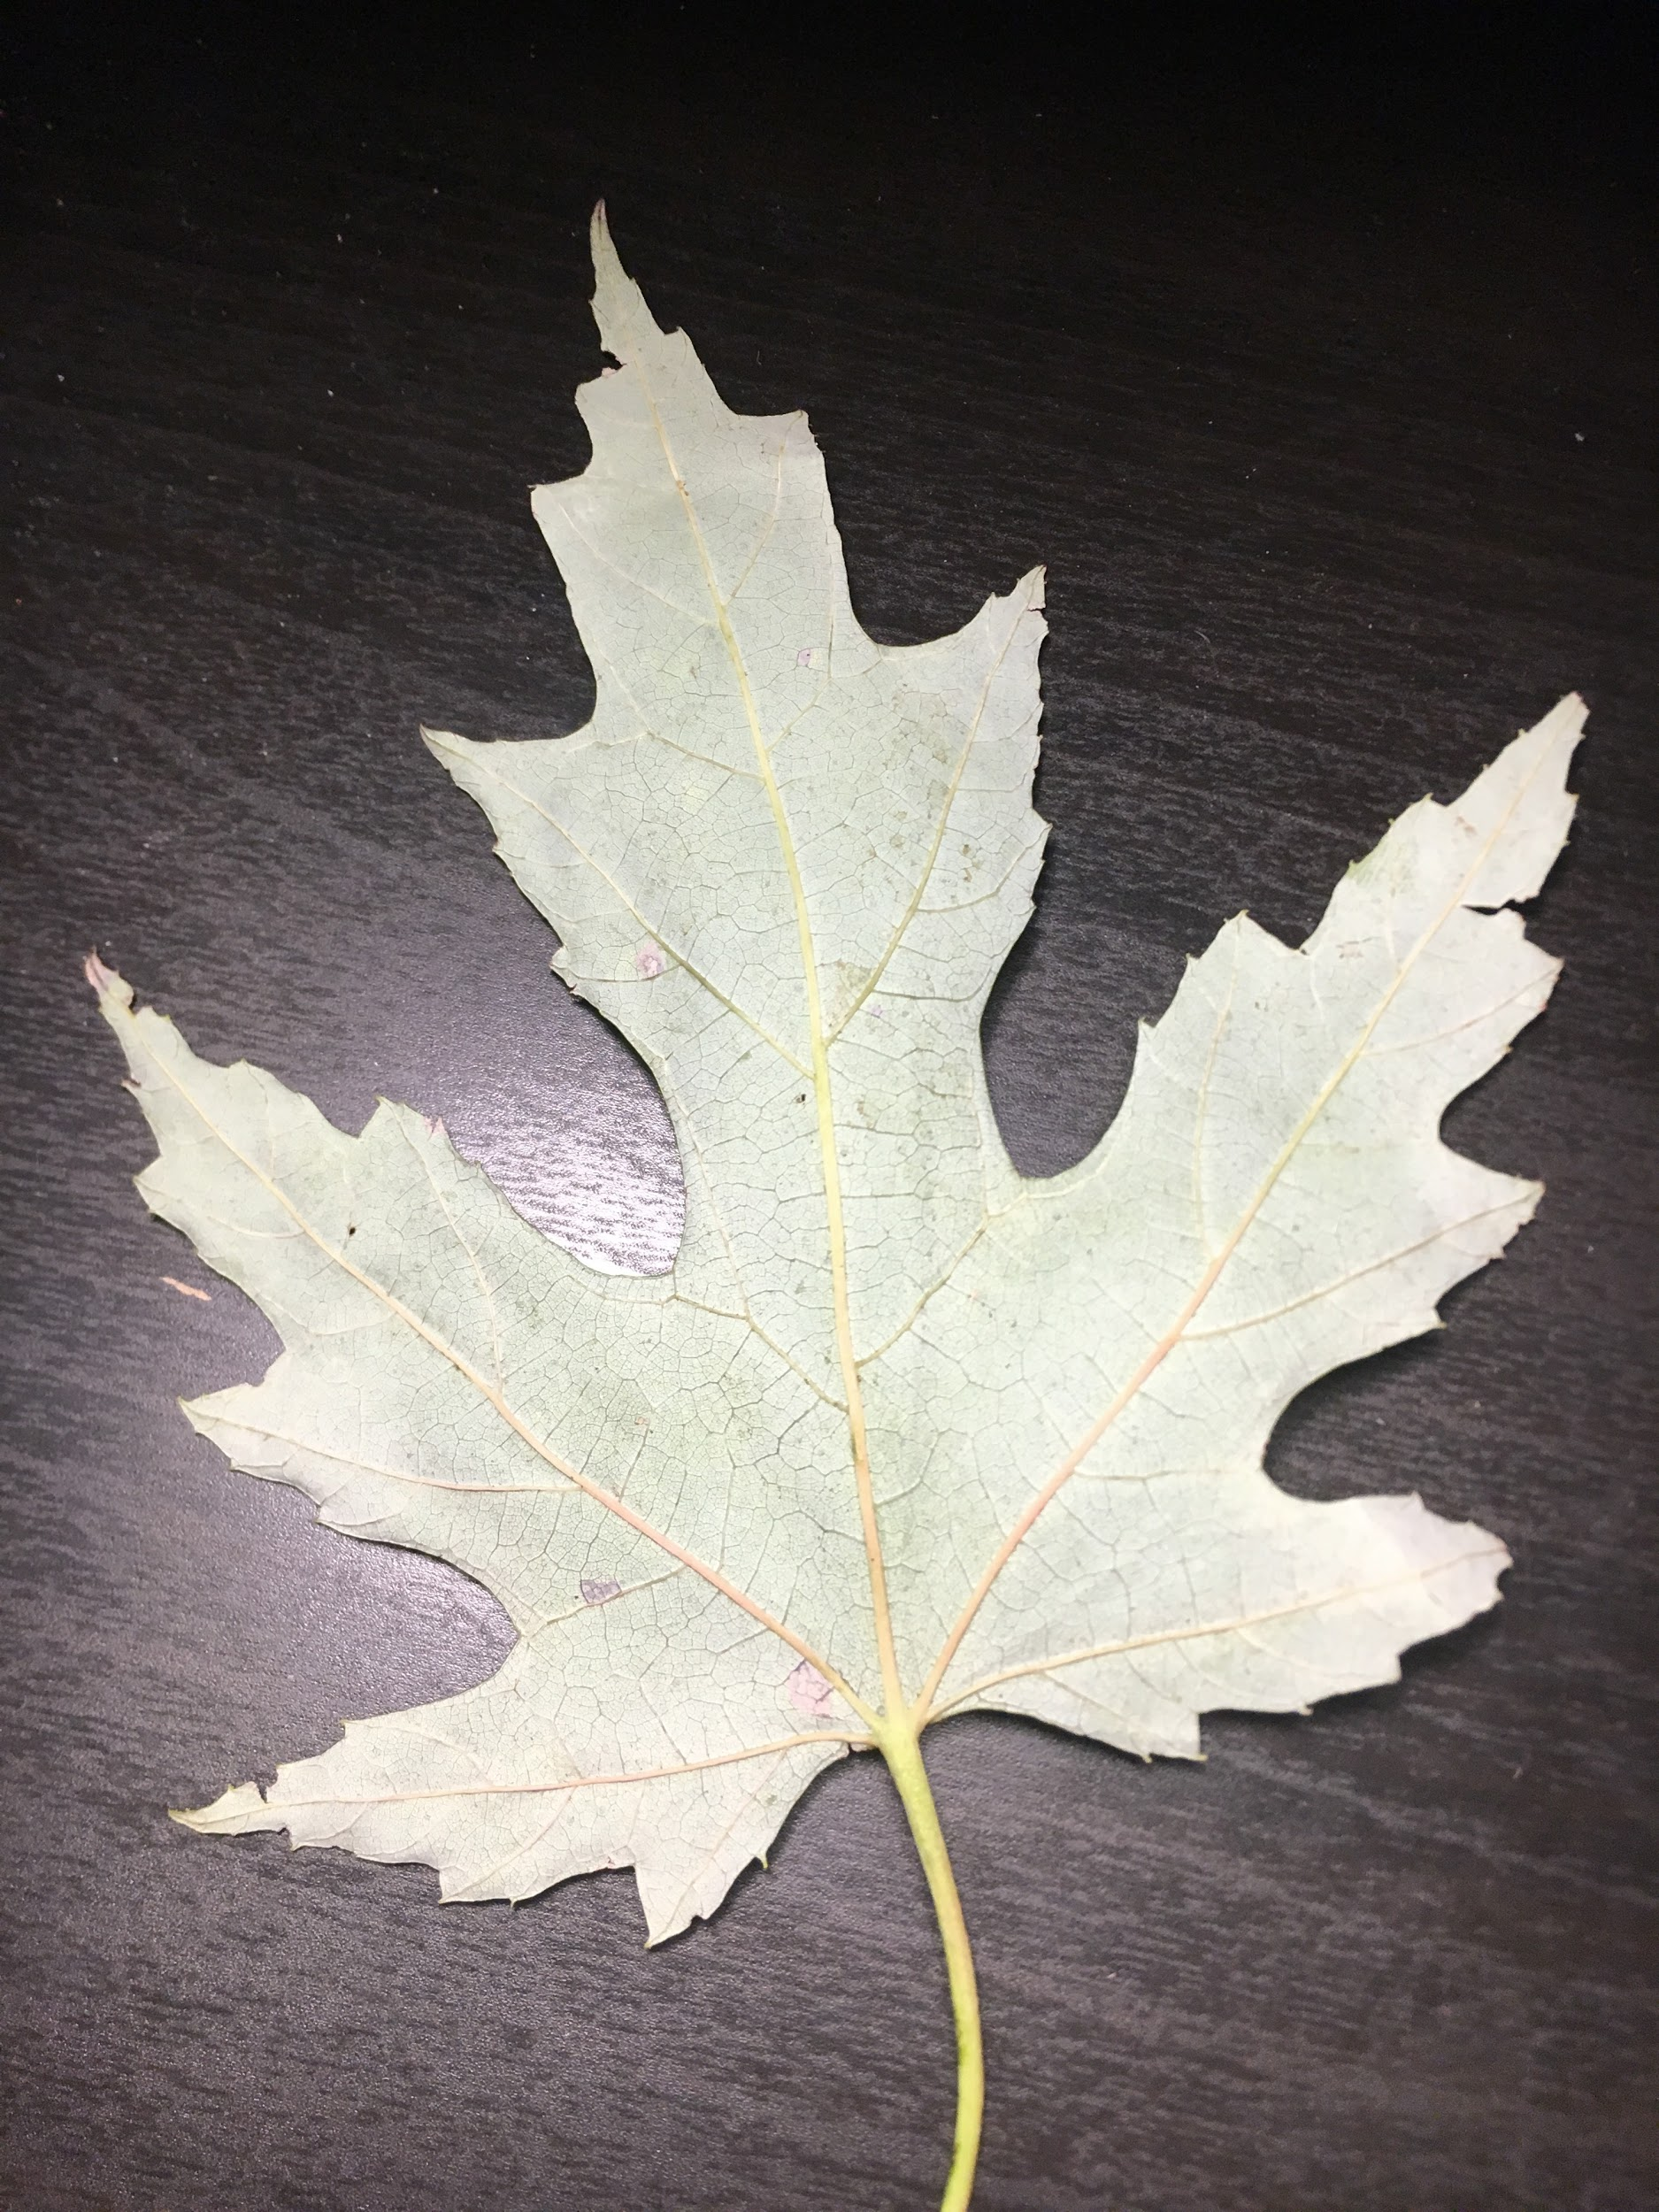
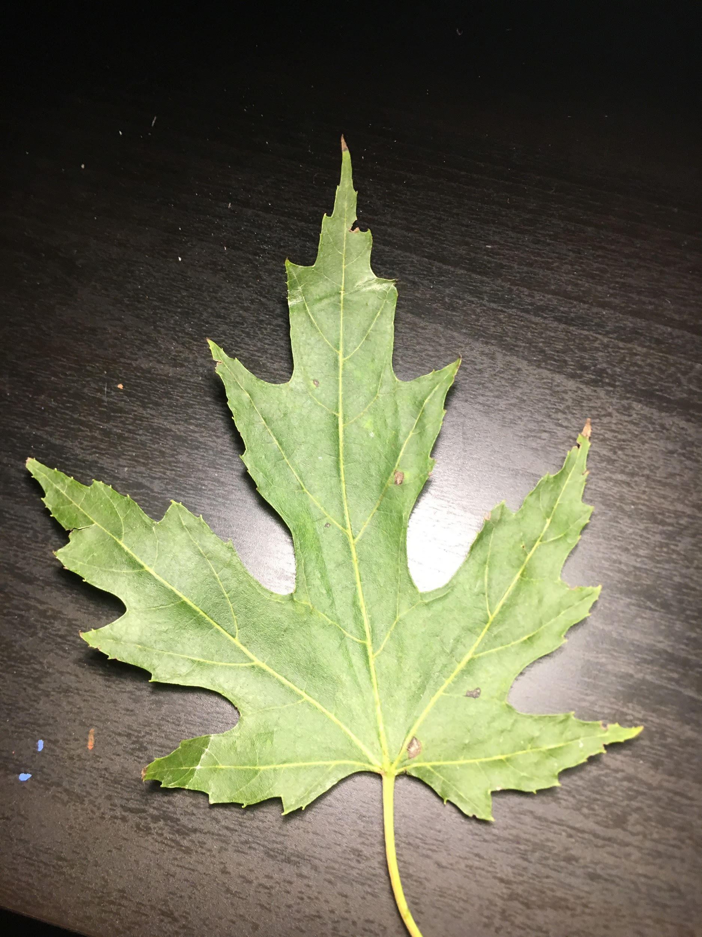
Oak
Black oak
Scientific name:Quercus velutina
Identify: i looked at the points and the bark on the tree and i had compared this leave with a couple other ones and settled on black oak. You can also identify oak by there acorns.

Slide 4
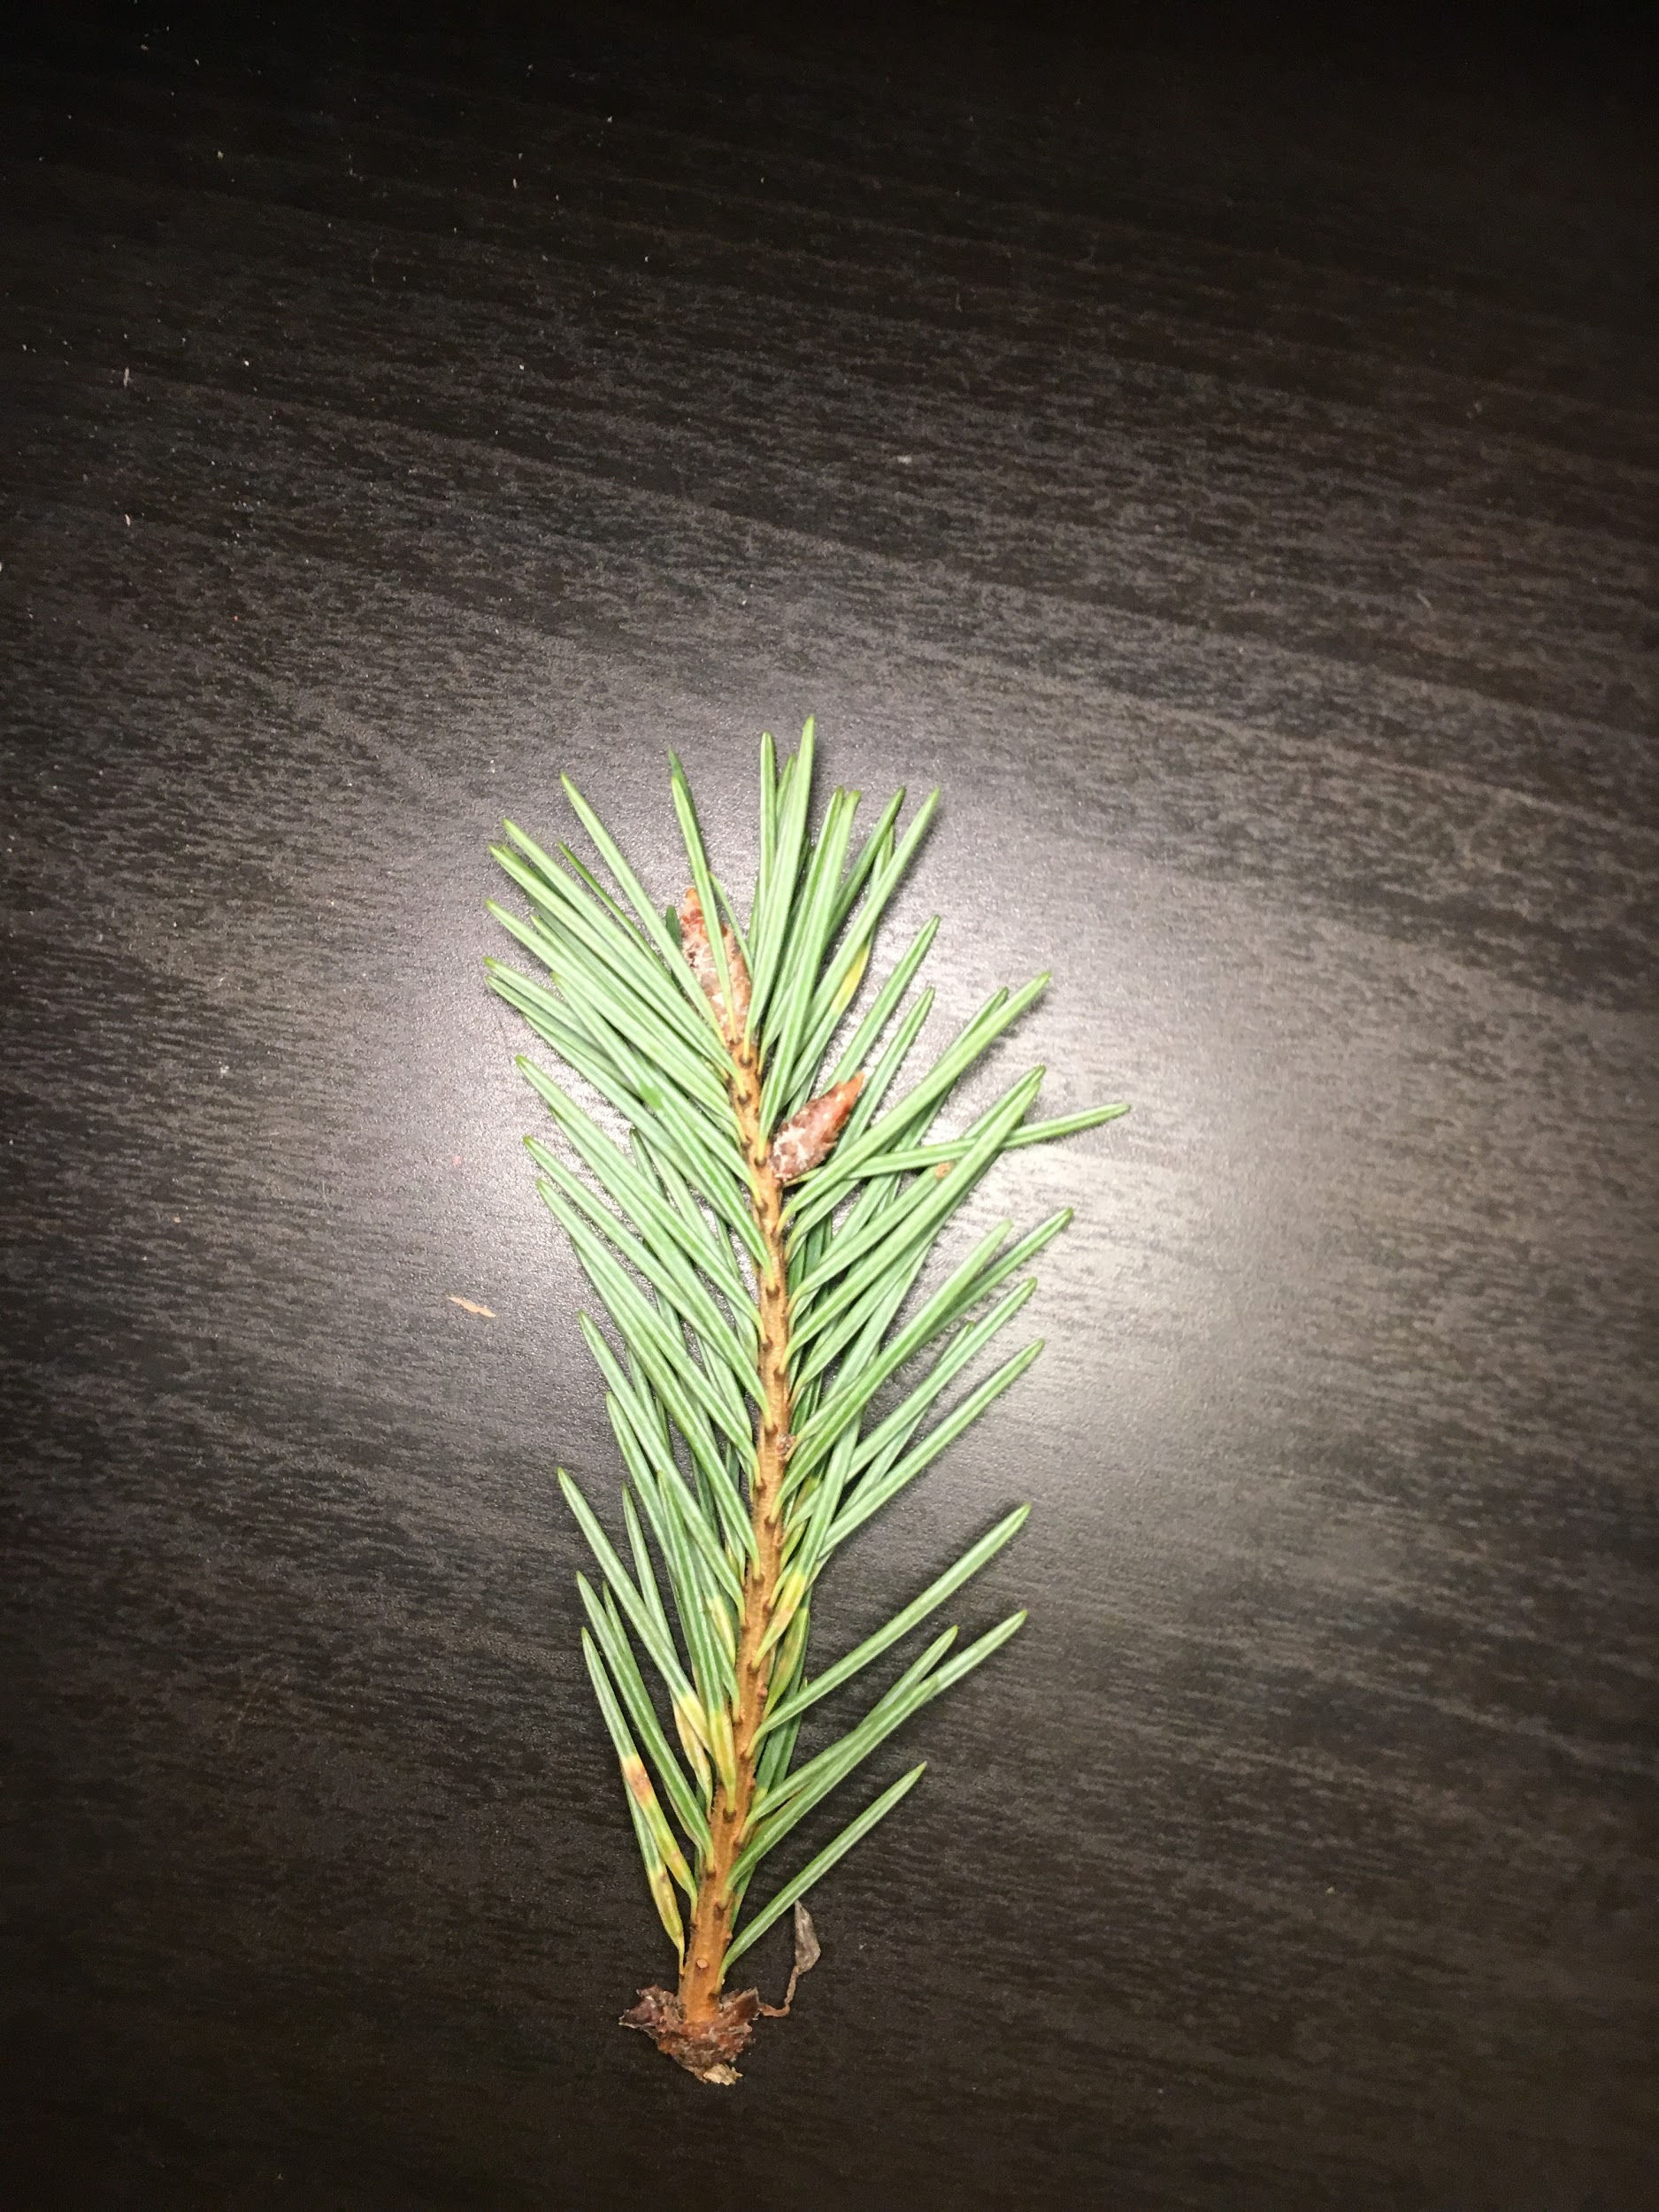
Conifer
Spruce
Scientific name:picea
Identify: i identified my spruce needles because i compared it with pictures of conifers until they matched up. And theier leaves are called needles.

