Slide 1
How to Identify Oak, Maple, and Conifer Leaves
By: Jacob

Slide 2
Pin Oak
4-6 inches long to 4 inches wide
Grout Leaf surface is smooth
The fruit is a small acorn, round about 1⁄2" in diameter, light brown, often striped with dark lines.
bristle-tipped lobes

Slide 3
Sugar maple
Leaves turn bright yellow orange or red in autumn
5-lobed
3-5” long, bright green above and pale green below
Leaves turn bright yellow, orange or red in autumn.
Twigs Reddish-brown to orange-brown. Buds are brown and sharp pointed

Slide 4
Eastern. White pine
LeaVes: Evergreen needles in clusters of 5, soft flexible, 3-sided, 2"-5" long, and bluish green. This is the only pine native to Pennsylvania with 5 needles per cluster.
Cones 4-7" long, without prickles
usually bears 2 winged seeds as do all our native pines.
flexible, with rusty hairs when young, later smooth. Buds egg-shaped, usually less than 1⁄2" long, gray-brown. Each whorl of branches represents a year's growth.
Young trunks and branches greenish brown, later darker grooved and scaly.

Slide 5
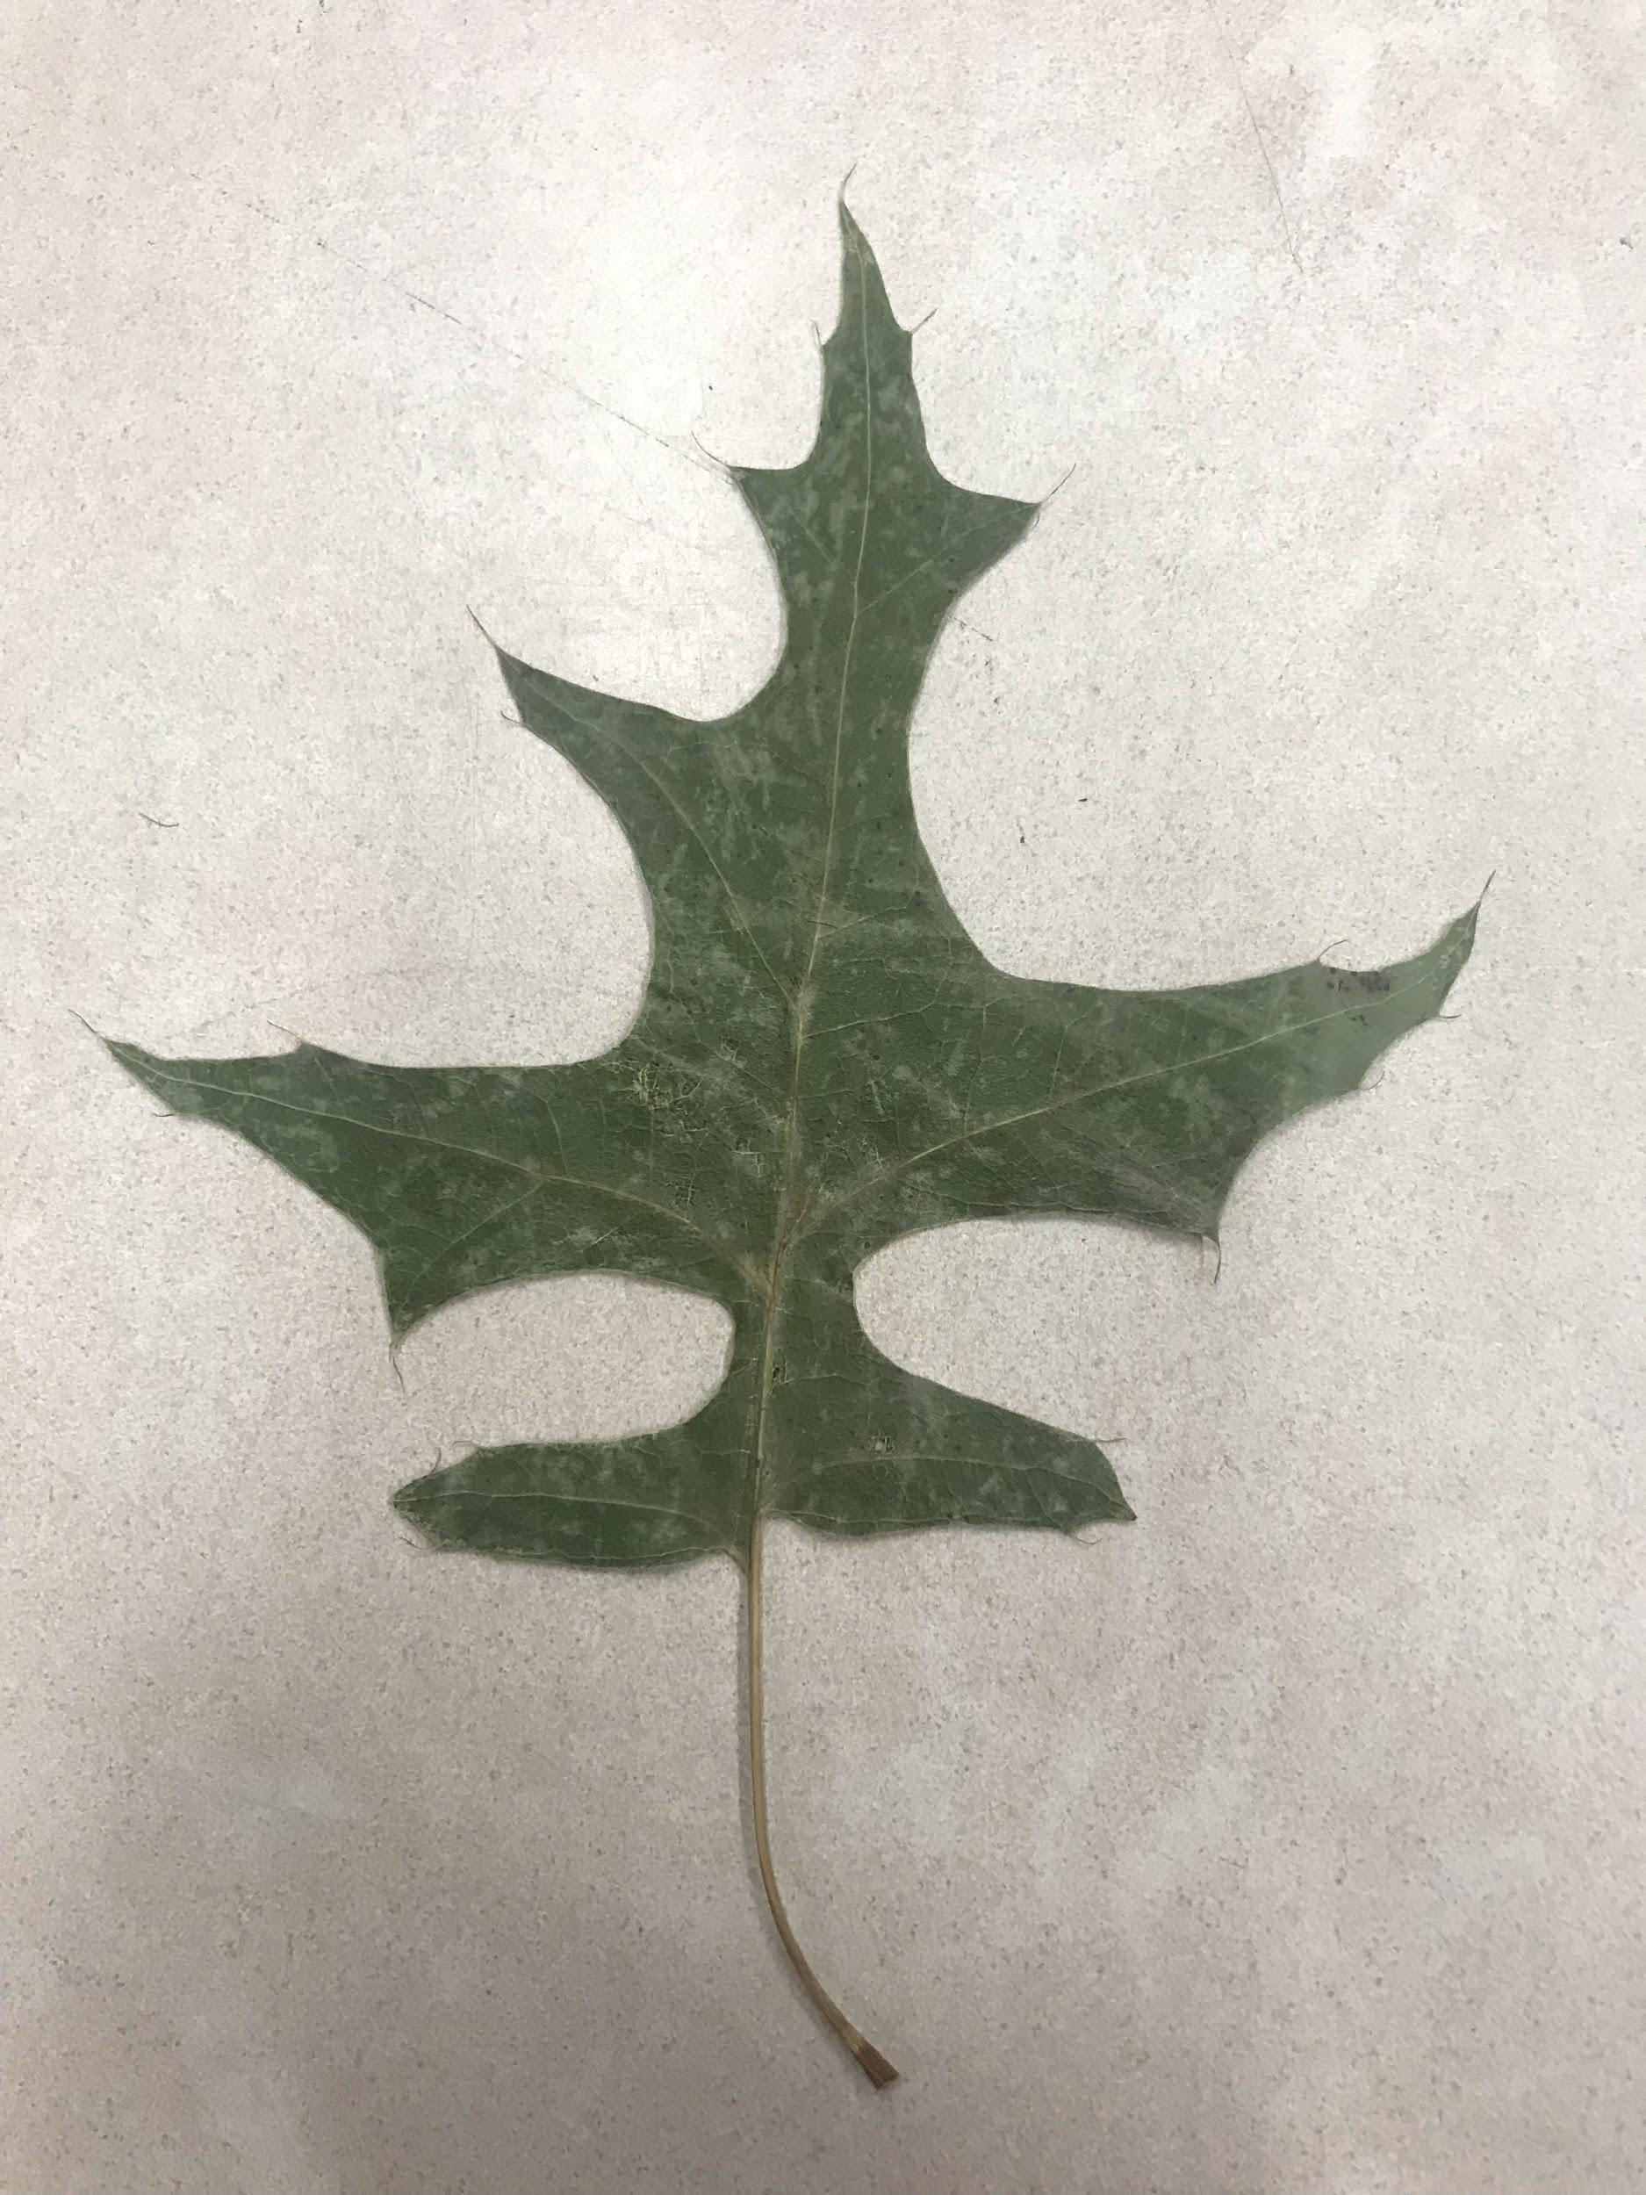
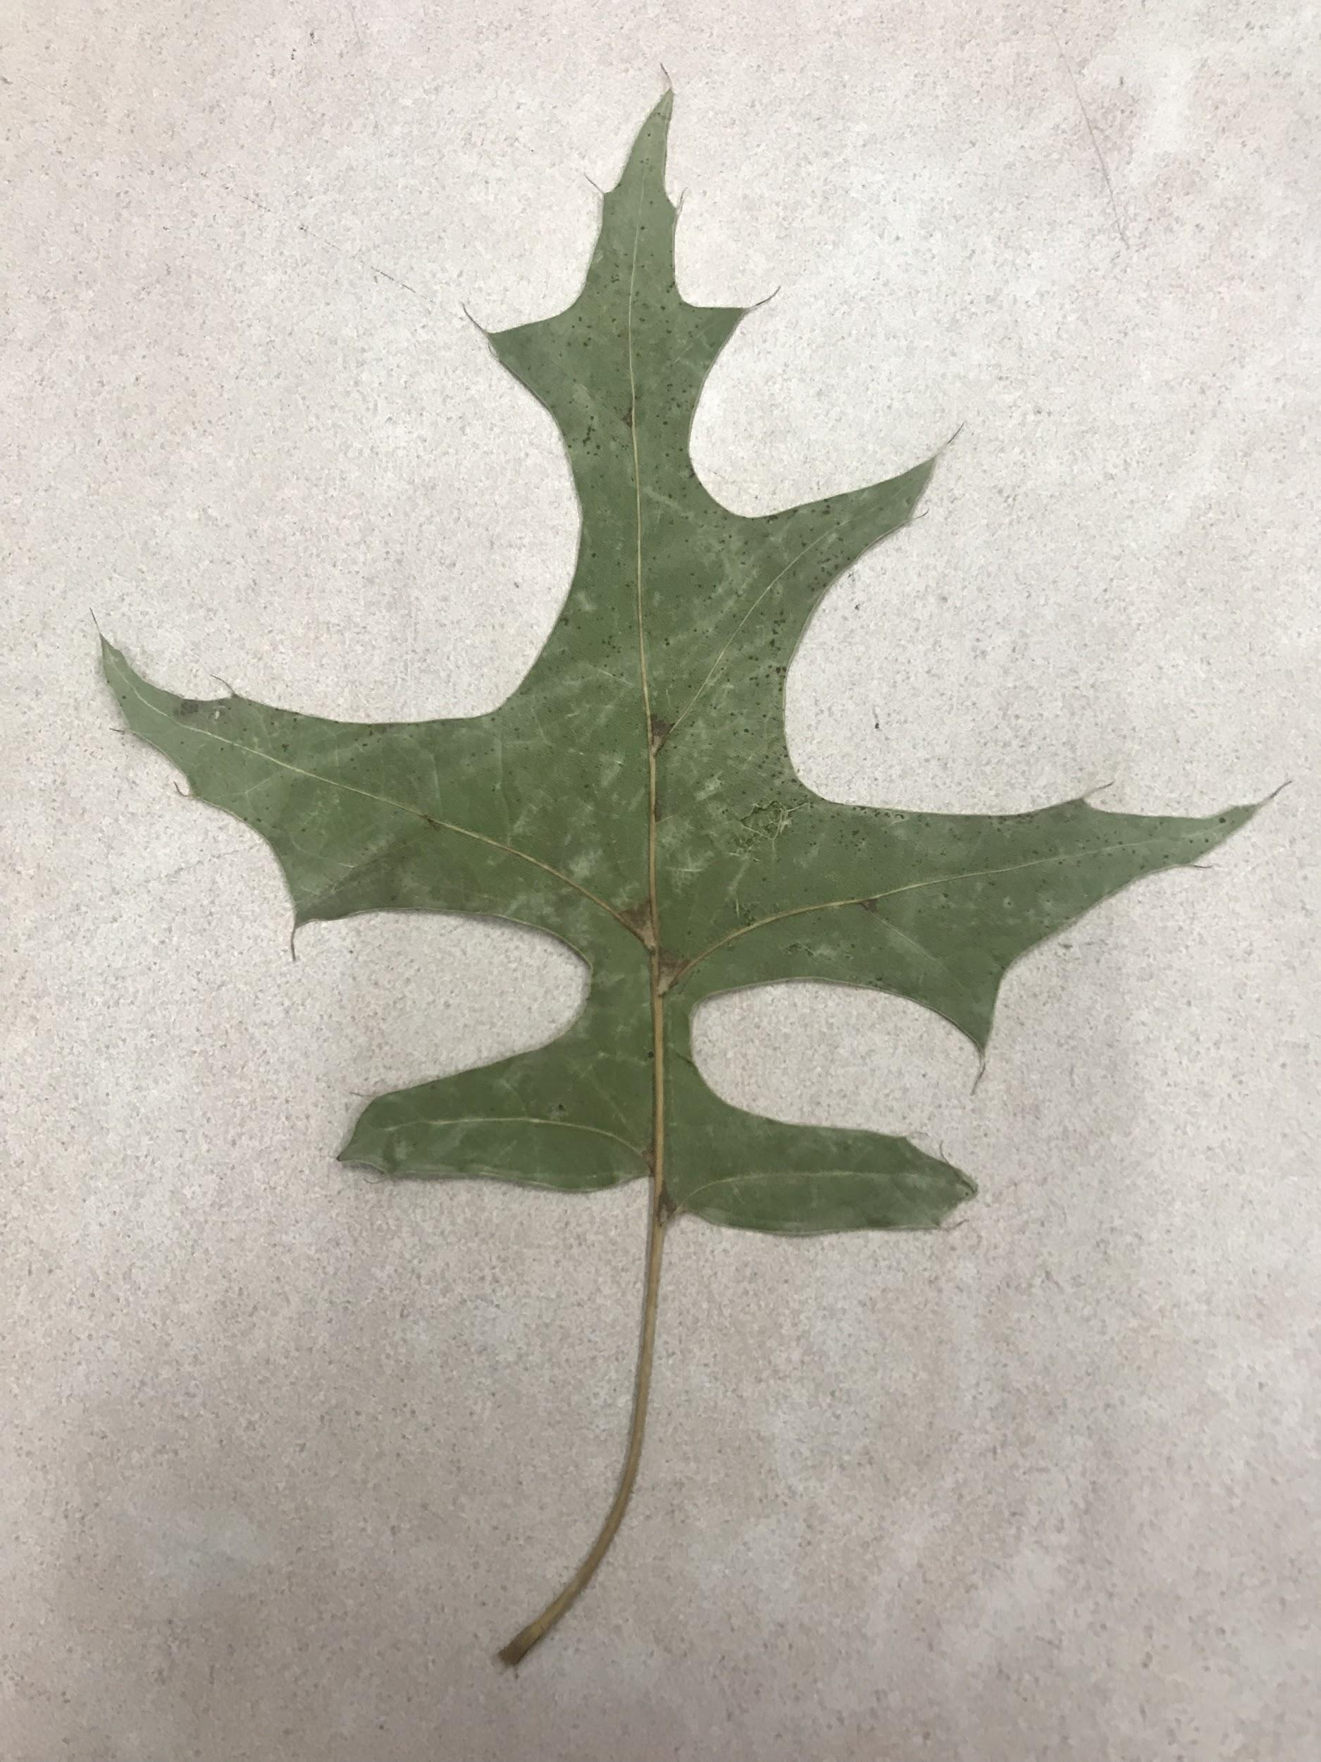
Pin oak

Slide 6
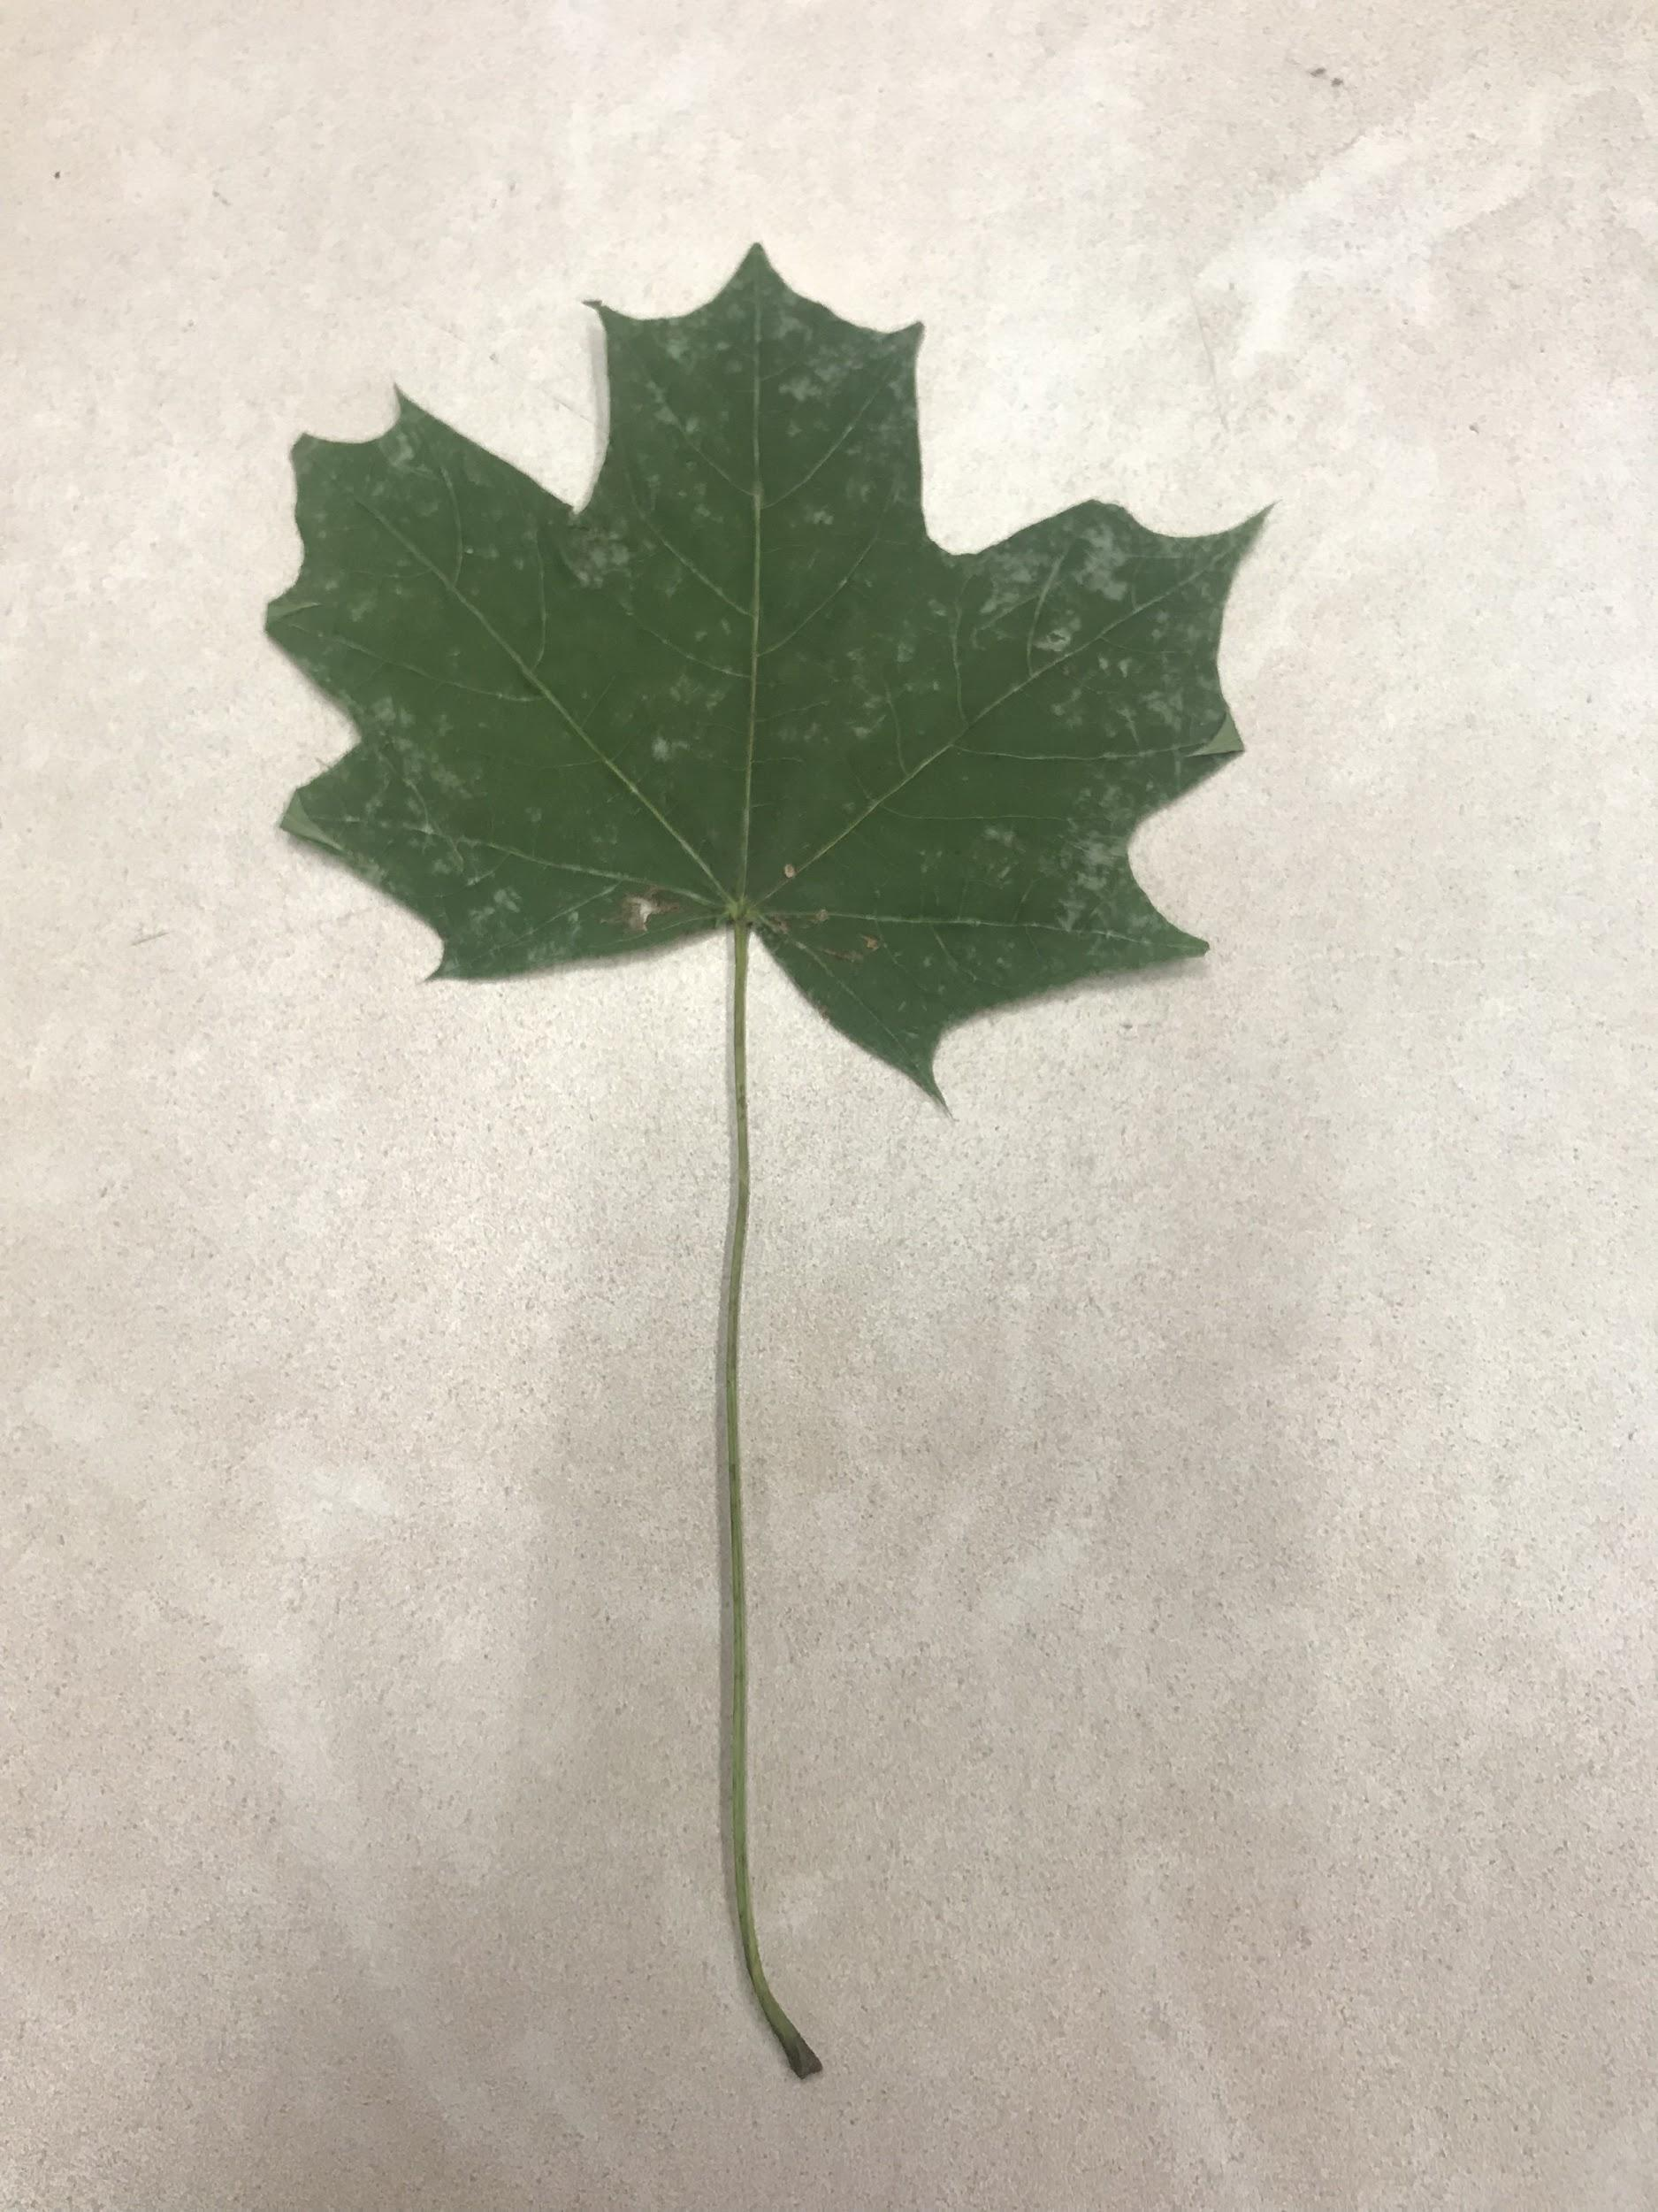
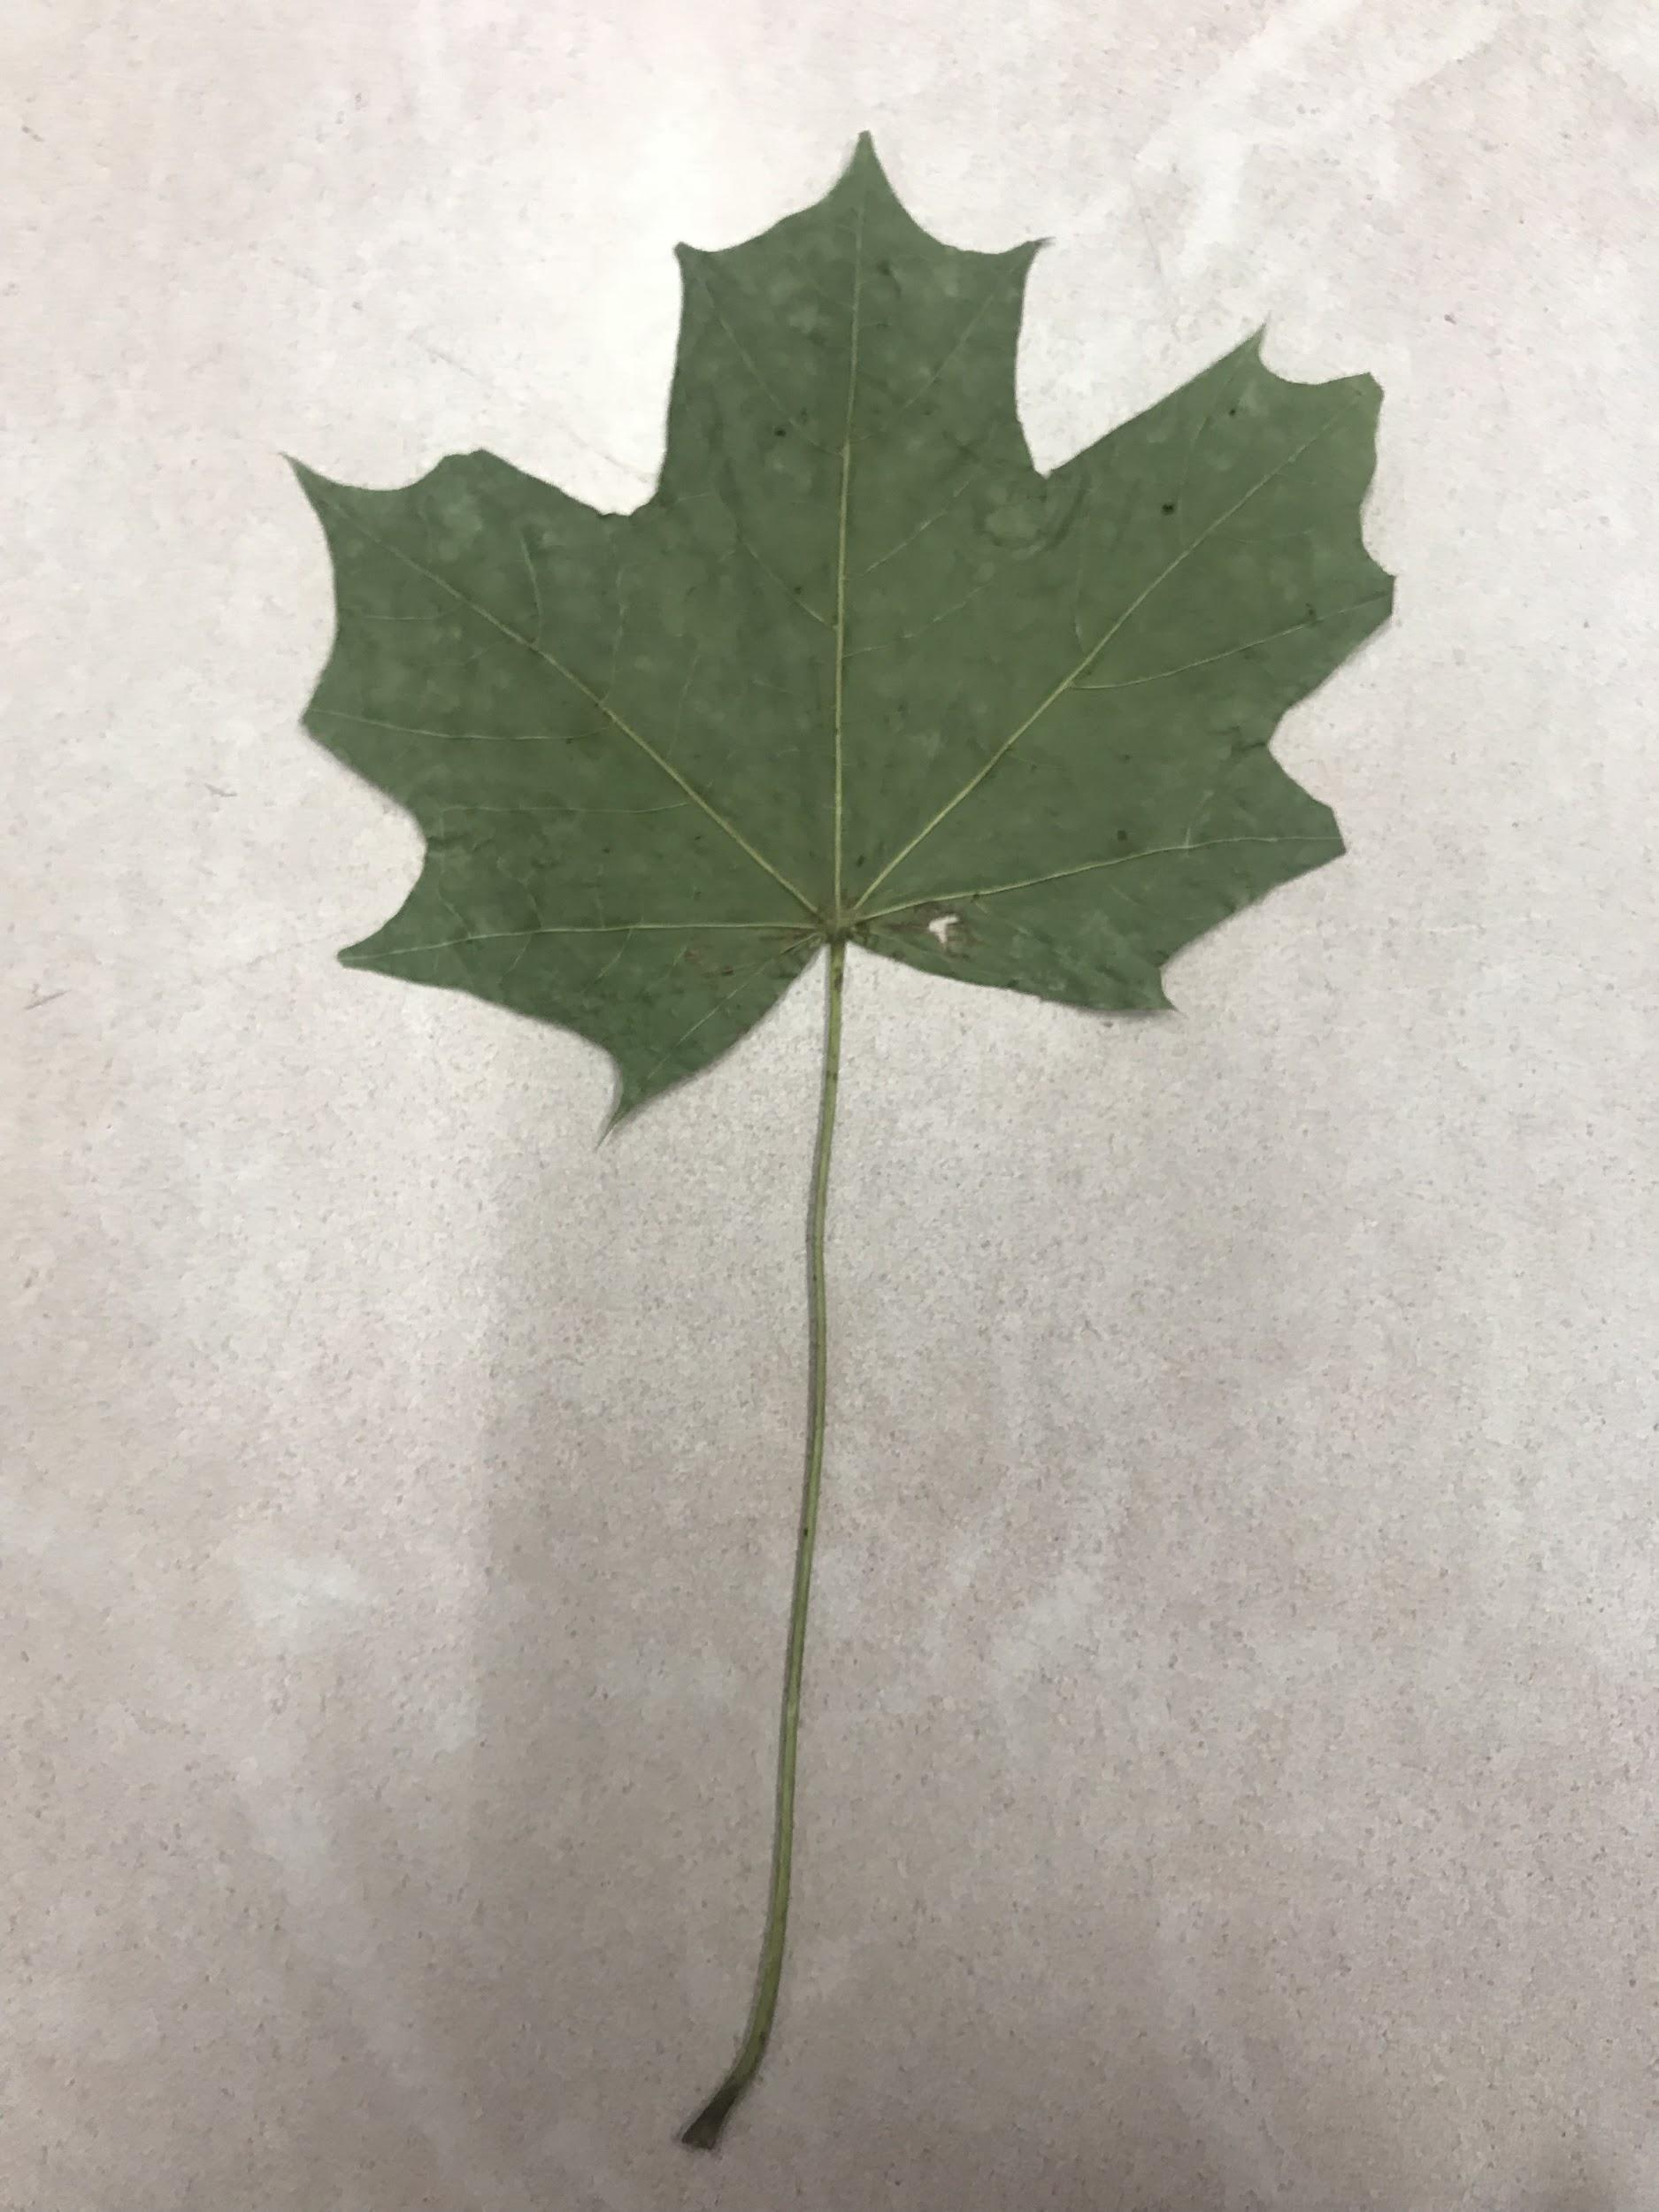
Sugar Maple

Slide 7
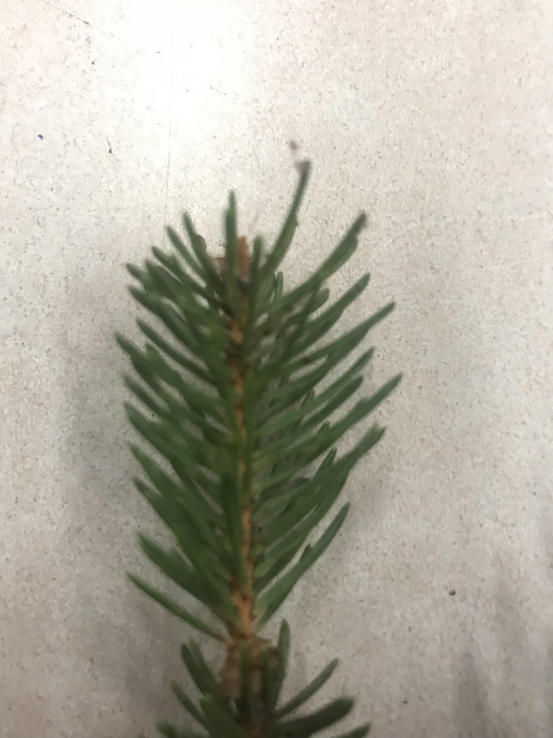
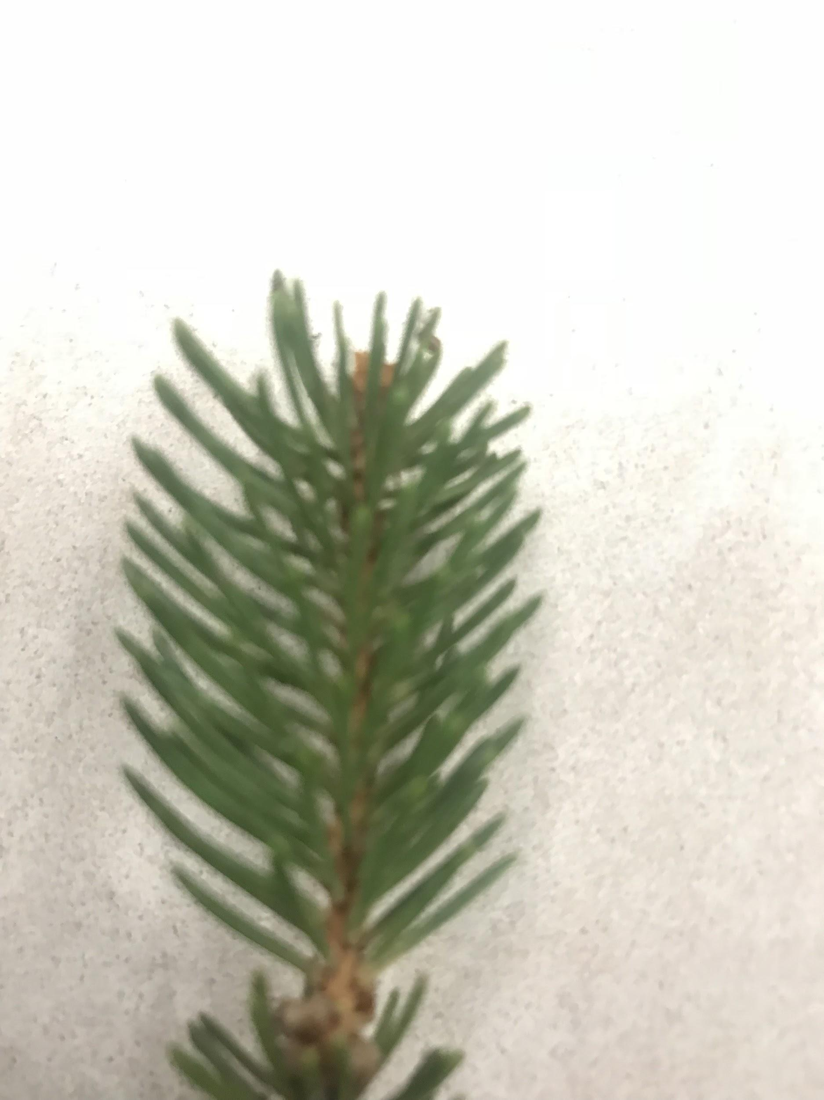
Eastern white pine

Slide 8
refs
Common trees of pennsylvania

