Slide 1
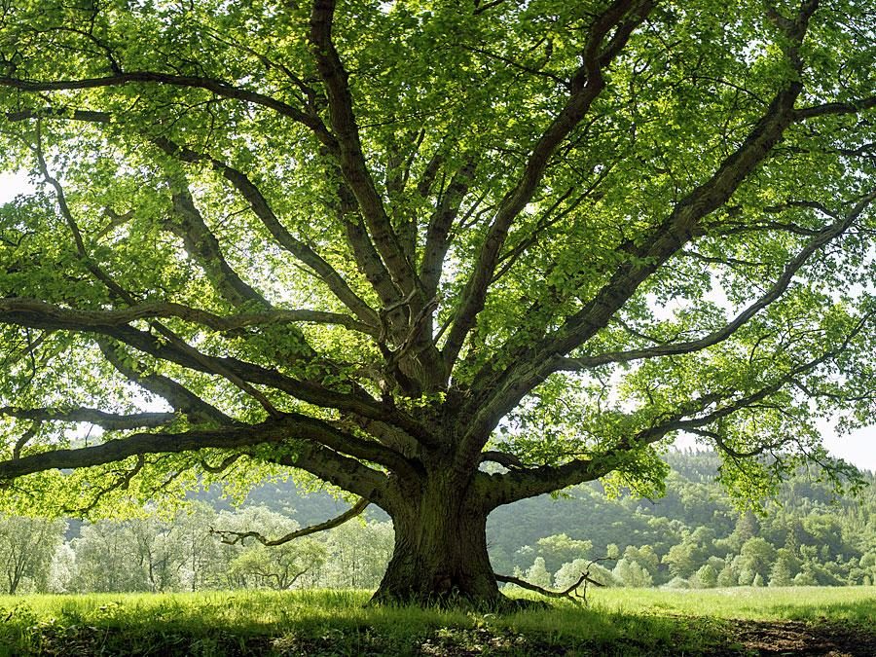
Different Trees
Different trees
By raychel
By Raychel bistline
Mod 7

Slide 2
Table of content
Maple:Chalk maple pg571
Oak:Scarlet oak pg385
Coniferous:Austrian pine pg 290

Slide 3
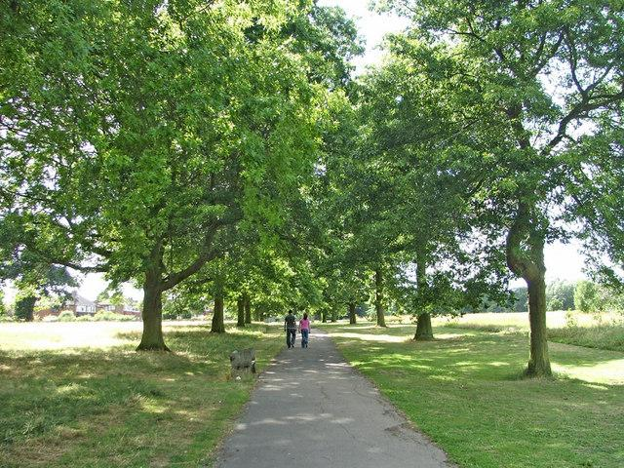
Scarlet Oak
The Scarlet oak or oak tree is a large tree with a glossy foliage. This tree was described in the book as a very tall tree. The acorns are egg shaped enclosed by a thick deep top of tightly pressed scales fade to stalk like base.The tree described in the book sounded simular to the one my leaves came from.
Interesting fact the scarlet oak is a popular and handsome shade and street tree

Slide 4
Striped maple
The striped maple is a small tree with a short trunk with upright branches and foliage. Th picture in the book of the leaves looked exactly like the leaves i picked up from under the tree. The fruit long many paired winged and light brown and matured in autumn. The striped maple is easily recognized even in the winter by the striped twigs which make it a popular ornamental.
Interesting fact The bark is eaten by many woodland creatures espesially during winter

Slide 5
Austrian pine or Conifer
The austrian pine or conifer is a cone bearing tree with a straight trunk and dark green foliage.I felt this trees leaves looked almost exactly like mine .The cone was round sorta egg shaped and opened up a bit . The needles were long and shiny .The description of the tree was almost identical to the one i chose .The tree in my field guide also described my tree perfectly .
Interesting fact ;The Austrian pine is one of the more common introduced ornamental trees

Slide 6
References
The Audubon Society field guide to North American Trees
Fusion book
Extra pictures of trees on next 3 slides

Slide 7
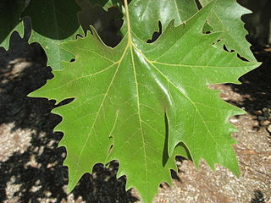

Slide 8
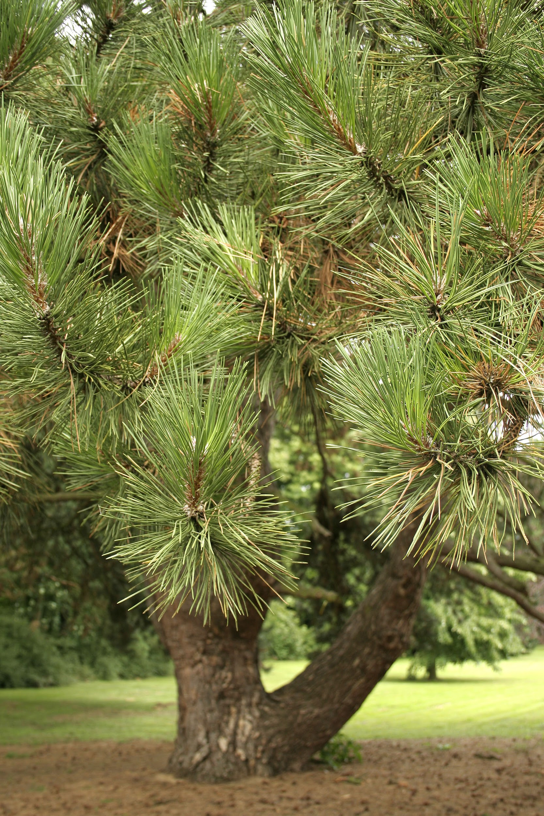
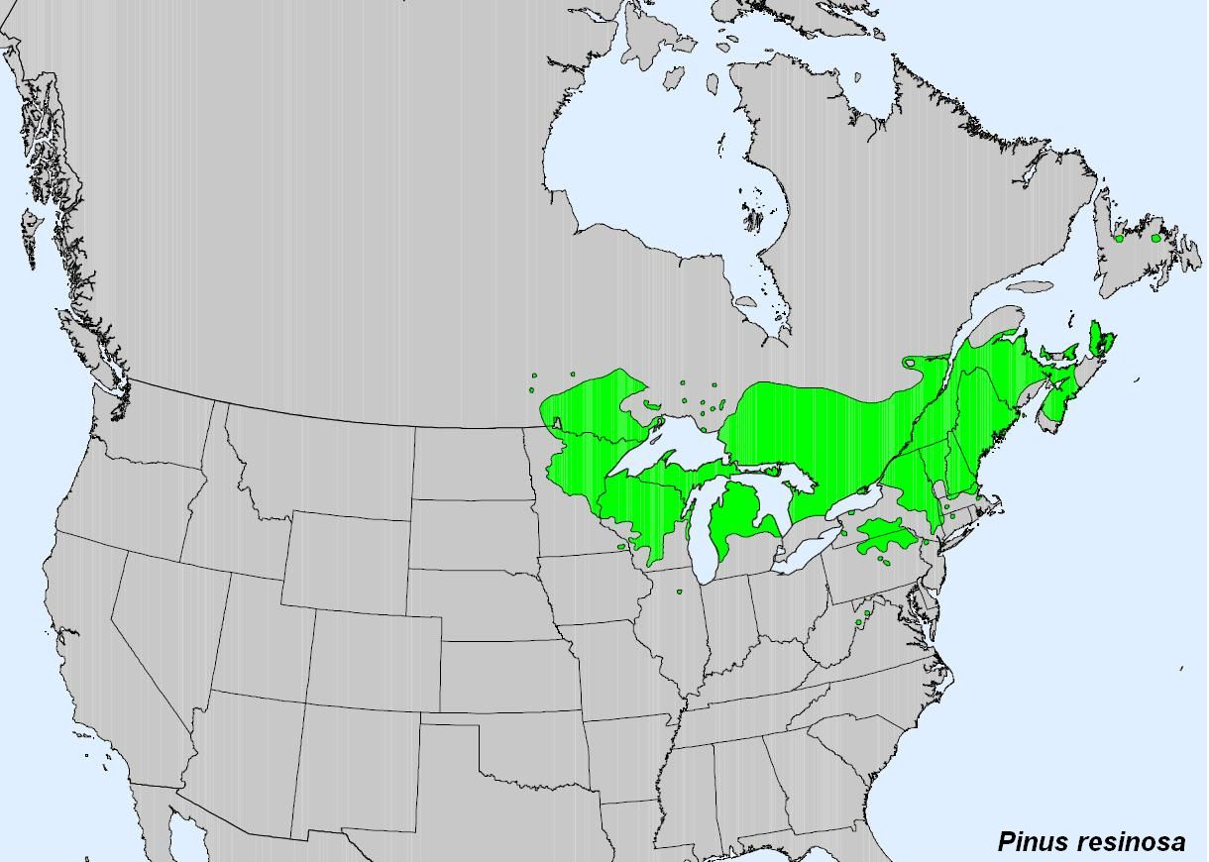

Slide 9
