Slide 1
Leaf Specimens Collection Project
By Cally

Slide 2
Silver Maple
A silver maple can also be known as a silverleaf maple and soft maple.
Scientific name: The scientific name for silver maple is Acer Saccharinum.

Slide 3
Silver Maple (continued)
Description
A large tree with a short, stout trunk and an irregular crown of long, curving branches and graceful cut leaves. The leaf of a silver maple has margins that are single toothed with 3 to 5 lobes and to which the lobes are separated by deep angular openings.

Slide 4
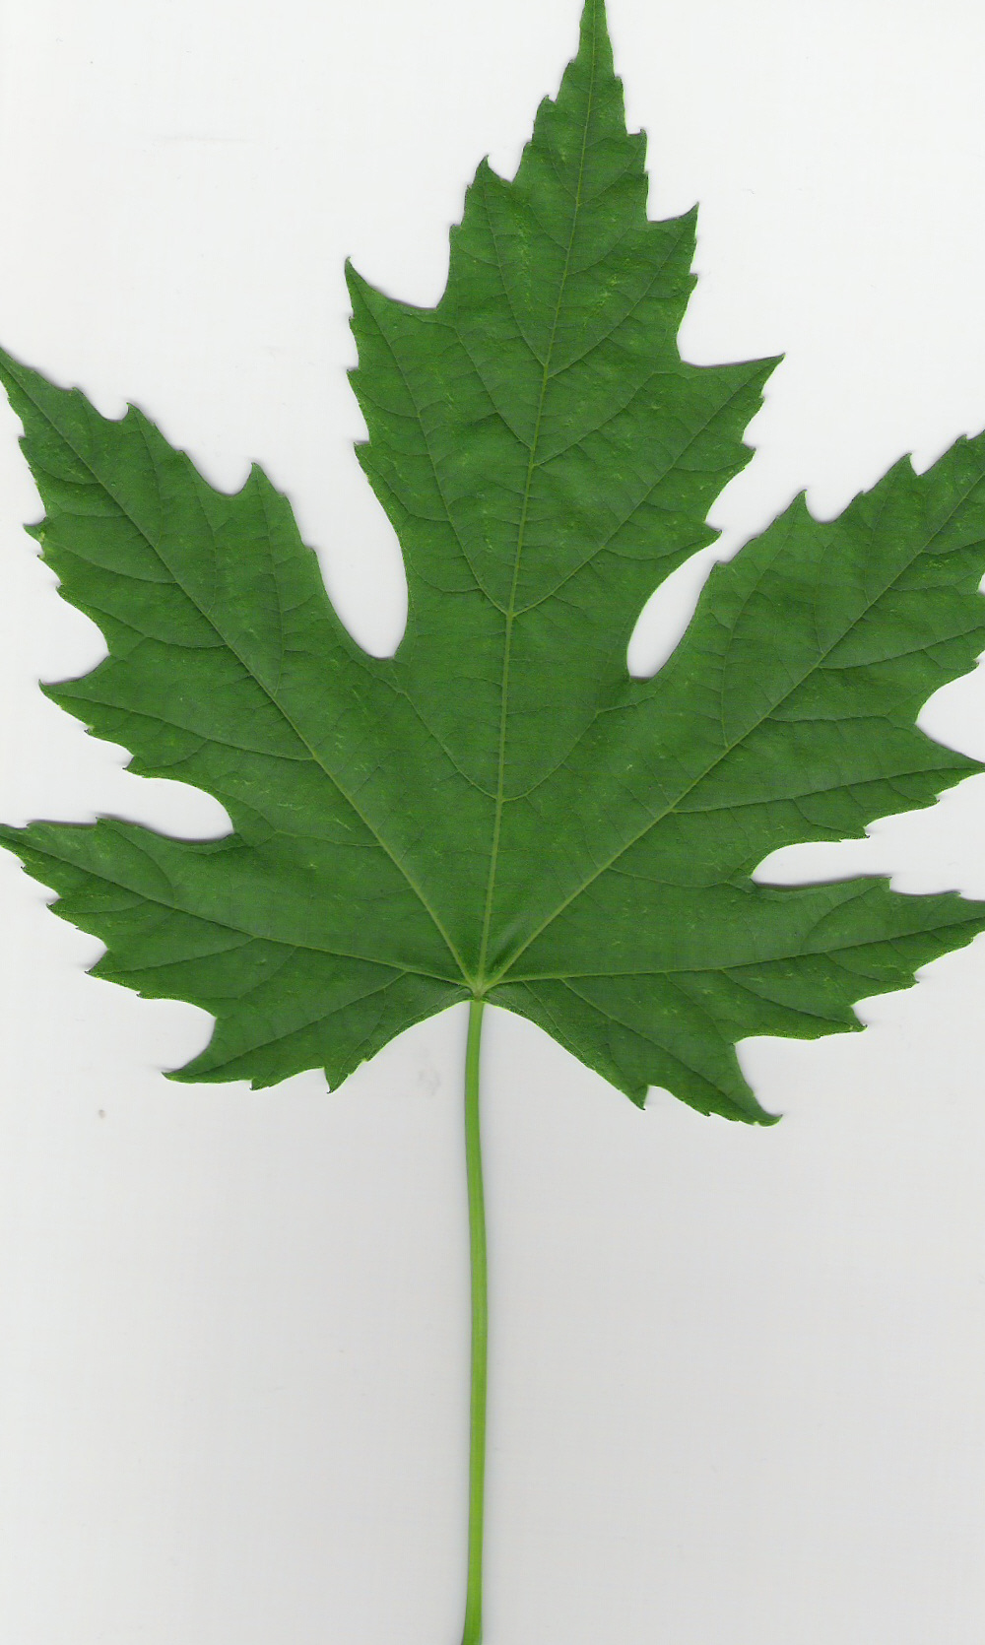
Silver Maple (continued)
Leaves
Leaves: 5 lobed and coarsely spiked. The color is bright green on the top and silvery-white on the bottom (hence the name SILVER Maple). In the Fall, Silver Maples are a greenish yellow color.

Slide 5
Silver Maple (continued)
Twigs
Twigs: The twigs of a silver maple are slender, glossy, and green (in spring) and later turning to chestnut brown. Lower branches typically have a distinctive upward curve at the end.

Slide 6
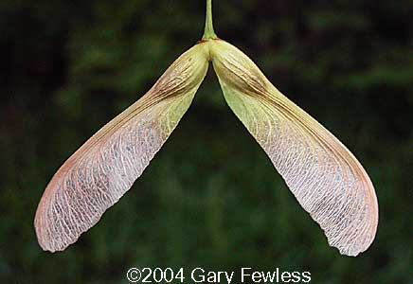
Silver Maple (continued)
Fruit
Fruit: Silver Maples have the largest of the native maples wings which is 2 inches long spread apart.

Slide 7
Silver Maple (continued)
Bark
Bark: The bark on a silver maple is different depending on whether or not it is a sapling or mature tree. For instance saplings will have smooth, gray trunks, but as for older trunks they will typically be brown and bumpy with plates that curl on both ends.

Slide 8
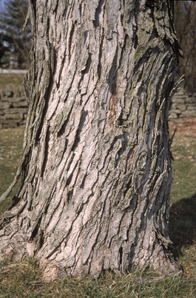

Slide 9
Silver Maple (continued)
Animals supported and fact
Animals supported: Squirrels and chipmunks and some game birds are examples of the animals that are supported from the silver maple.
Fact: If you break the twig it will have an unpleasant smell.

Slide 10
Silver Maple (continued)
Uses
Since the wood and bark of a Silver Maple is hard and the texture is brittle, it can be easily worked. It is used for things like furniture, flooring, and even musical instruments.

Slide 11
References for Silver Maple
CommontreesofPACover2014.cdr
Summer key to pa trees.pdf

Slide 12
Scarlet Oak
A Scarlet Oak is also referred to as a Northern Red Oak.
The scientific name of a scarlet oak is Quercus Coccinea Muench.

Slide 13
Scarlet Oak (continued)
Description
The Scarlet Oak is a medium to large sized tree. The sinuses are between the lobes and extend halfway to the mid rib.

Slide 14
Scarlet Oak (continued)
Leaves
The leaves of a Scarlet Oak have bristle tipped lobes. The sinuses are between the lobes and extend halfway to the mid rib. The leaf is smooth, dull green above and paler with small hints of reddish brown in the vain axils.

Slide 15
Scarlet Oak (continued)
Twigs
The color of a scarlet oaks are greenish brown to reddish brown depending on the season. When a Scarlet oak matures it becomes smooth. Also Buds are pointed and are the color of light brown.

Slide 16
Scarlet Oak (continued)
Fruit
The fruit of a Scarlet oak is an acorn. An acorn has a shallow cup and is teacup shaped. To grow the fruit/acorn it requires two growing seasons to ripen because the kernel is bitter.

Slide 17
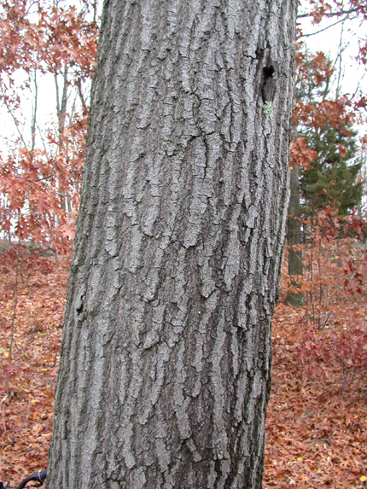
Scarlet Oak (continued)
Bark
The bark on a Scarlet Oak completely depends on the maturity of the tree. If the tree is younger and less mature it will be smooth brownish/greenish/gray. Eventually it will mature into dark gray or nearly black.

Slide 18
Scarlet Oak (continued)
uses
The rough but easily workable wood of a Scarlet Oak tree is used for things such as cabinetry, furniture, and flooring.

Slide 19
Scarlet Oak (continued)
Animals supported
The Scarlet Oak supports animals because it produces acorns which is a food source of squirrels.

Slide 20
Scarlet Oak (continued)
Fact
A Scarlet Oak is usually mistaken for the Pin Oak and the Black Oak because of the physical features of the lobes and bristle tops, but the Scarlet oak is different because of the slight red in it.

Slide 21
Scarlet Oak
References
CommontreesofPACover2014.cdr
Summer key to pa trees.pdf

Slide 22
Eastern Red Cedar
The Eastern Red Cedar can be recognized by a few other names like Red Juniper and Eastern Juniper.
Scientific name: Juniperous Virginiana

Slide 23
Eastern Red Cedar (continued)
Description
The mature leaves of an Eastern Red Cedar are scalelike and dark green. The immature leaves are needle like and pointed.

Slide 24
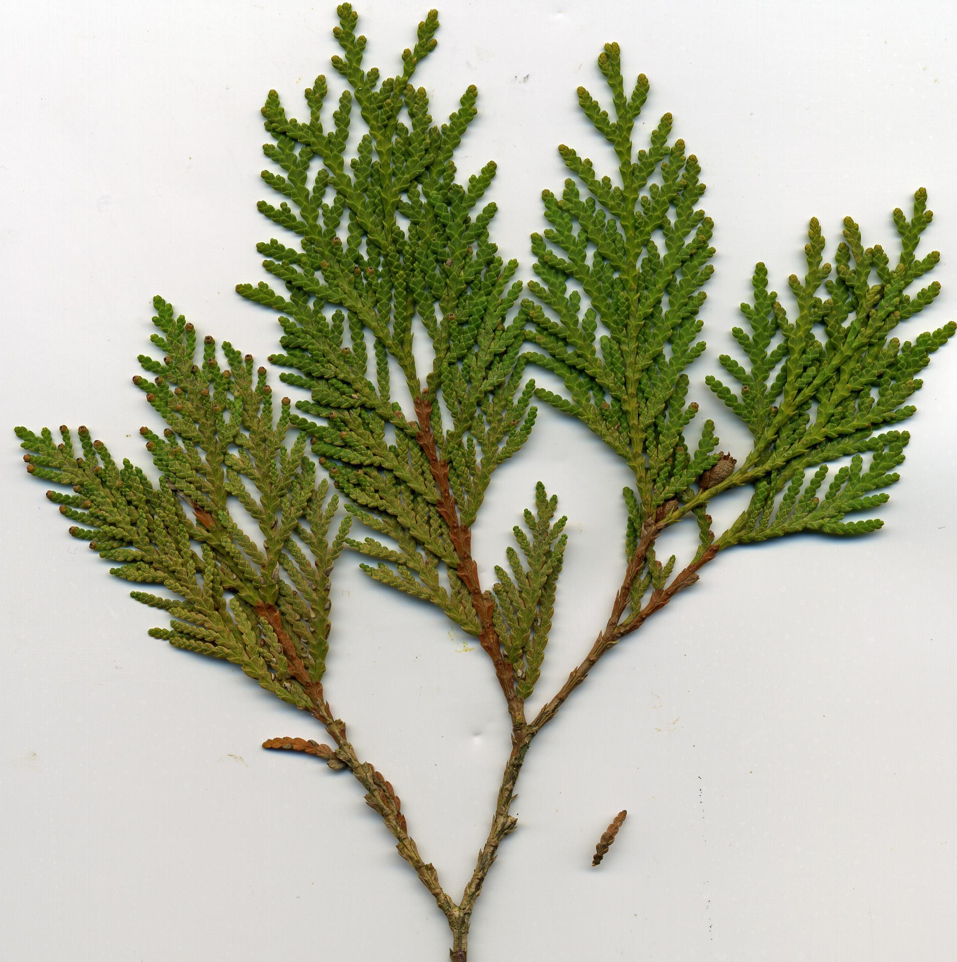
Eastern Red Cedar (continued)
Leaves
There are two types of Red Cedar leaves. The first kind is the older, more common kind and are scale like. The other variation is the younger ones which have a hint of white and are sharp pointed.

Slide 25
Eastern Red Cedar (continued)
Twigs
The twigs on the red cedar are slender and are typically 4 sided and have a reddish brown color.

Slide 26
Eastern Red Cedar (continued)
Fruit
Eastern Red Cedars have berry like cones with a white, waxy coating. Cones typically ripen in one growing season.

Slide 27
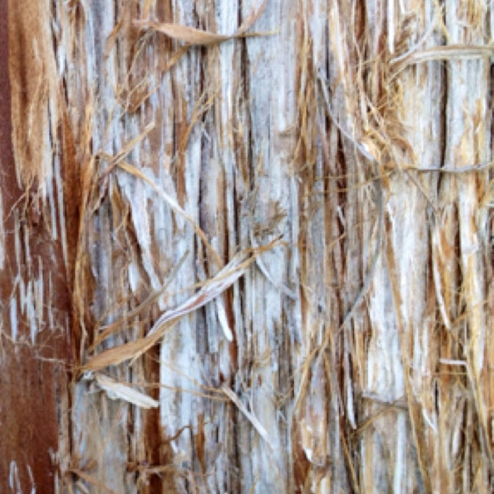
Eastern Red Cedar (continued)
Bark
The Eastern Red Cedar is reddish brown and will peel off in stringy and flaky strips.

Slide 28
Eastern Red Cedar (continued)
Fact
The wood of an Eastern red Cedar is rot-resistant so it is used and made for many things.

Slide 29
Eastern Red Cedar (continued)
Uses
Since the wood is rot-resistant it is usually used for fence posts.

Slide 30
Eastern Red Cedar (continued)
Animals supported
The animals that live or that can benefit from this tree are Cedar waxwings and song birds/game birds because they enjoy the fruit like cones from the tree.

Slide 31
References
summer key to pa trees.pdf
commontreesofPACover2014.cdr
(AKA Ms.McCallus’ links on her website)

Slide 32
Glossary
Scientific name: A two worded name given to an organism and consists of a genus and a species.
Lobe: The round part(s) of a leaf.
Sapling: A young tree.
Sinus: A cavity or curve in a leaf.

Slide 33
Glossary (continued)
Bristle: Resembling hair.

