Slide 1
My Leaf Specimens
By-Sara

Slide 2
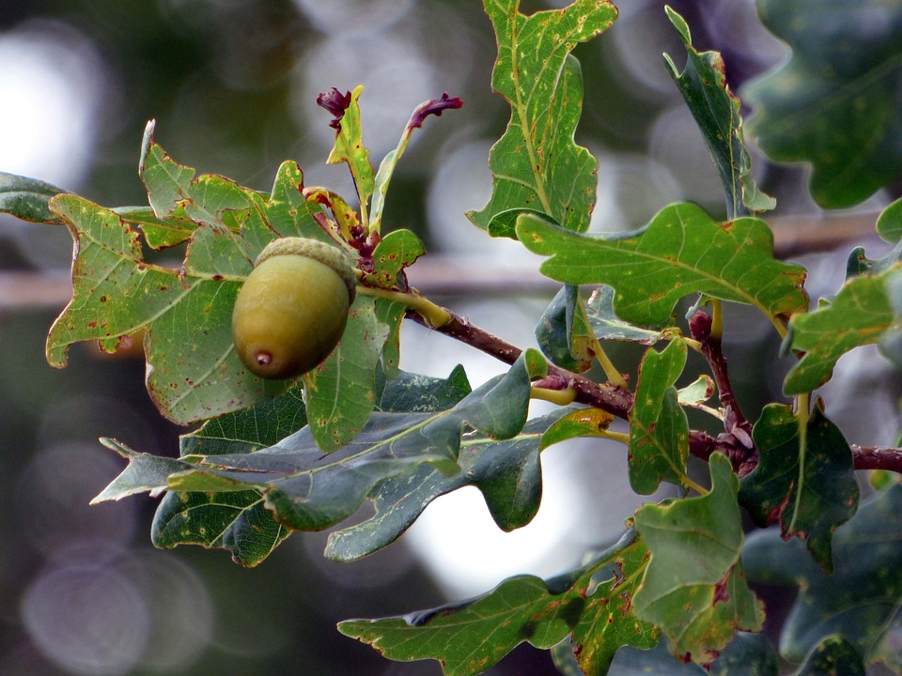
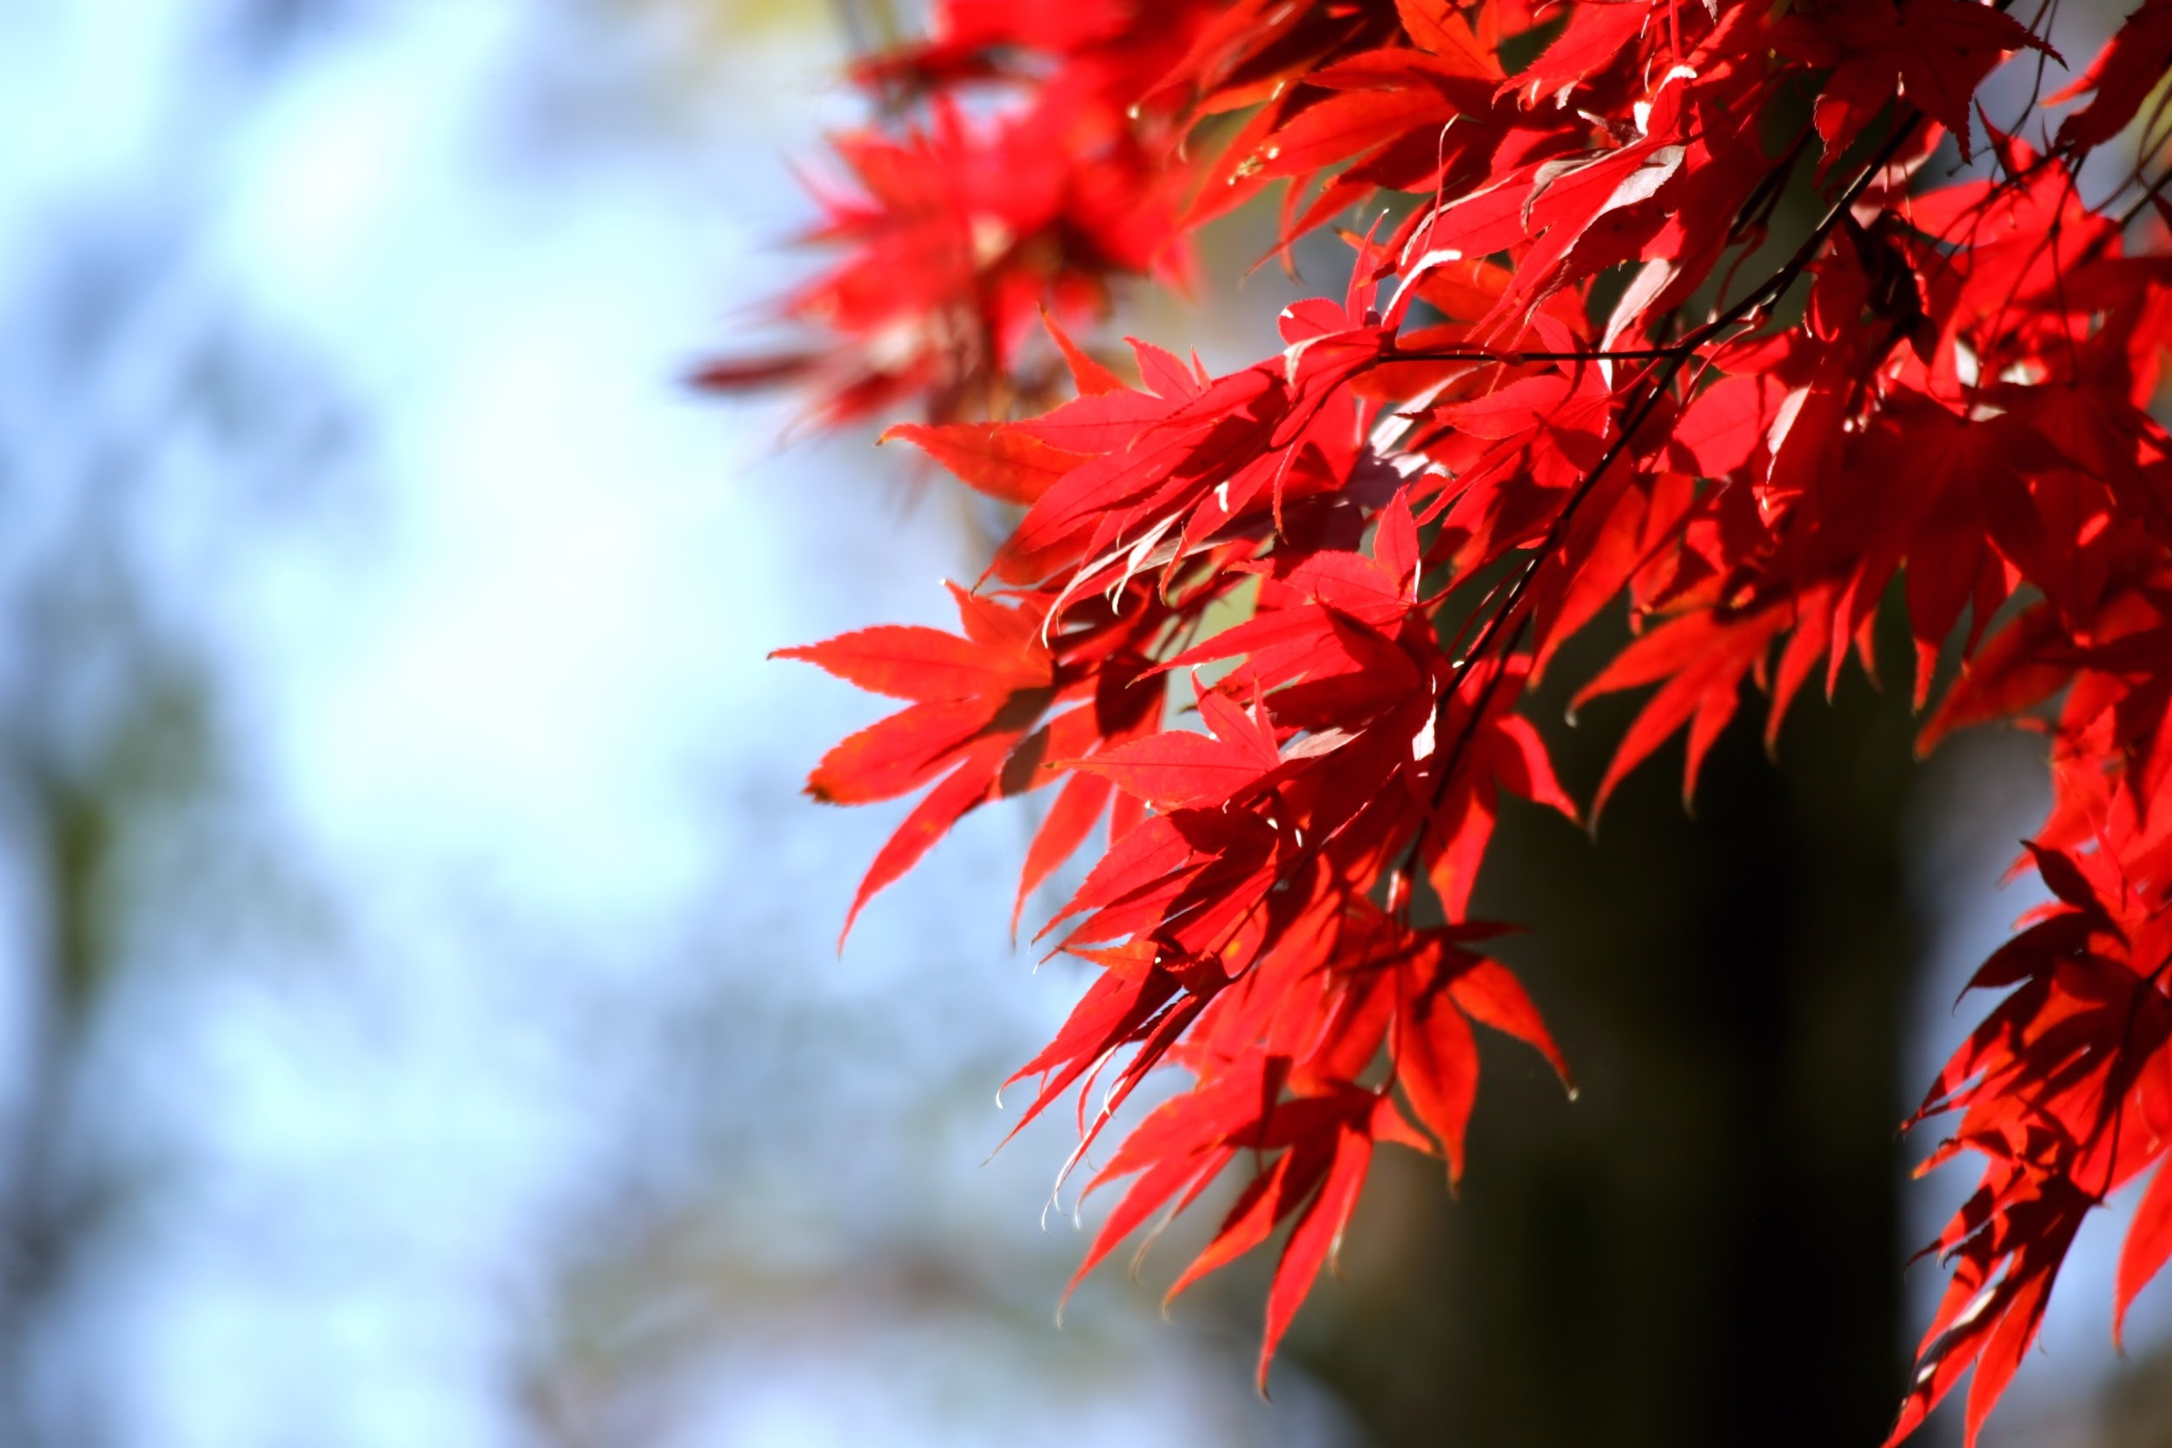
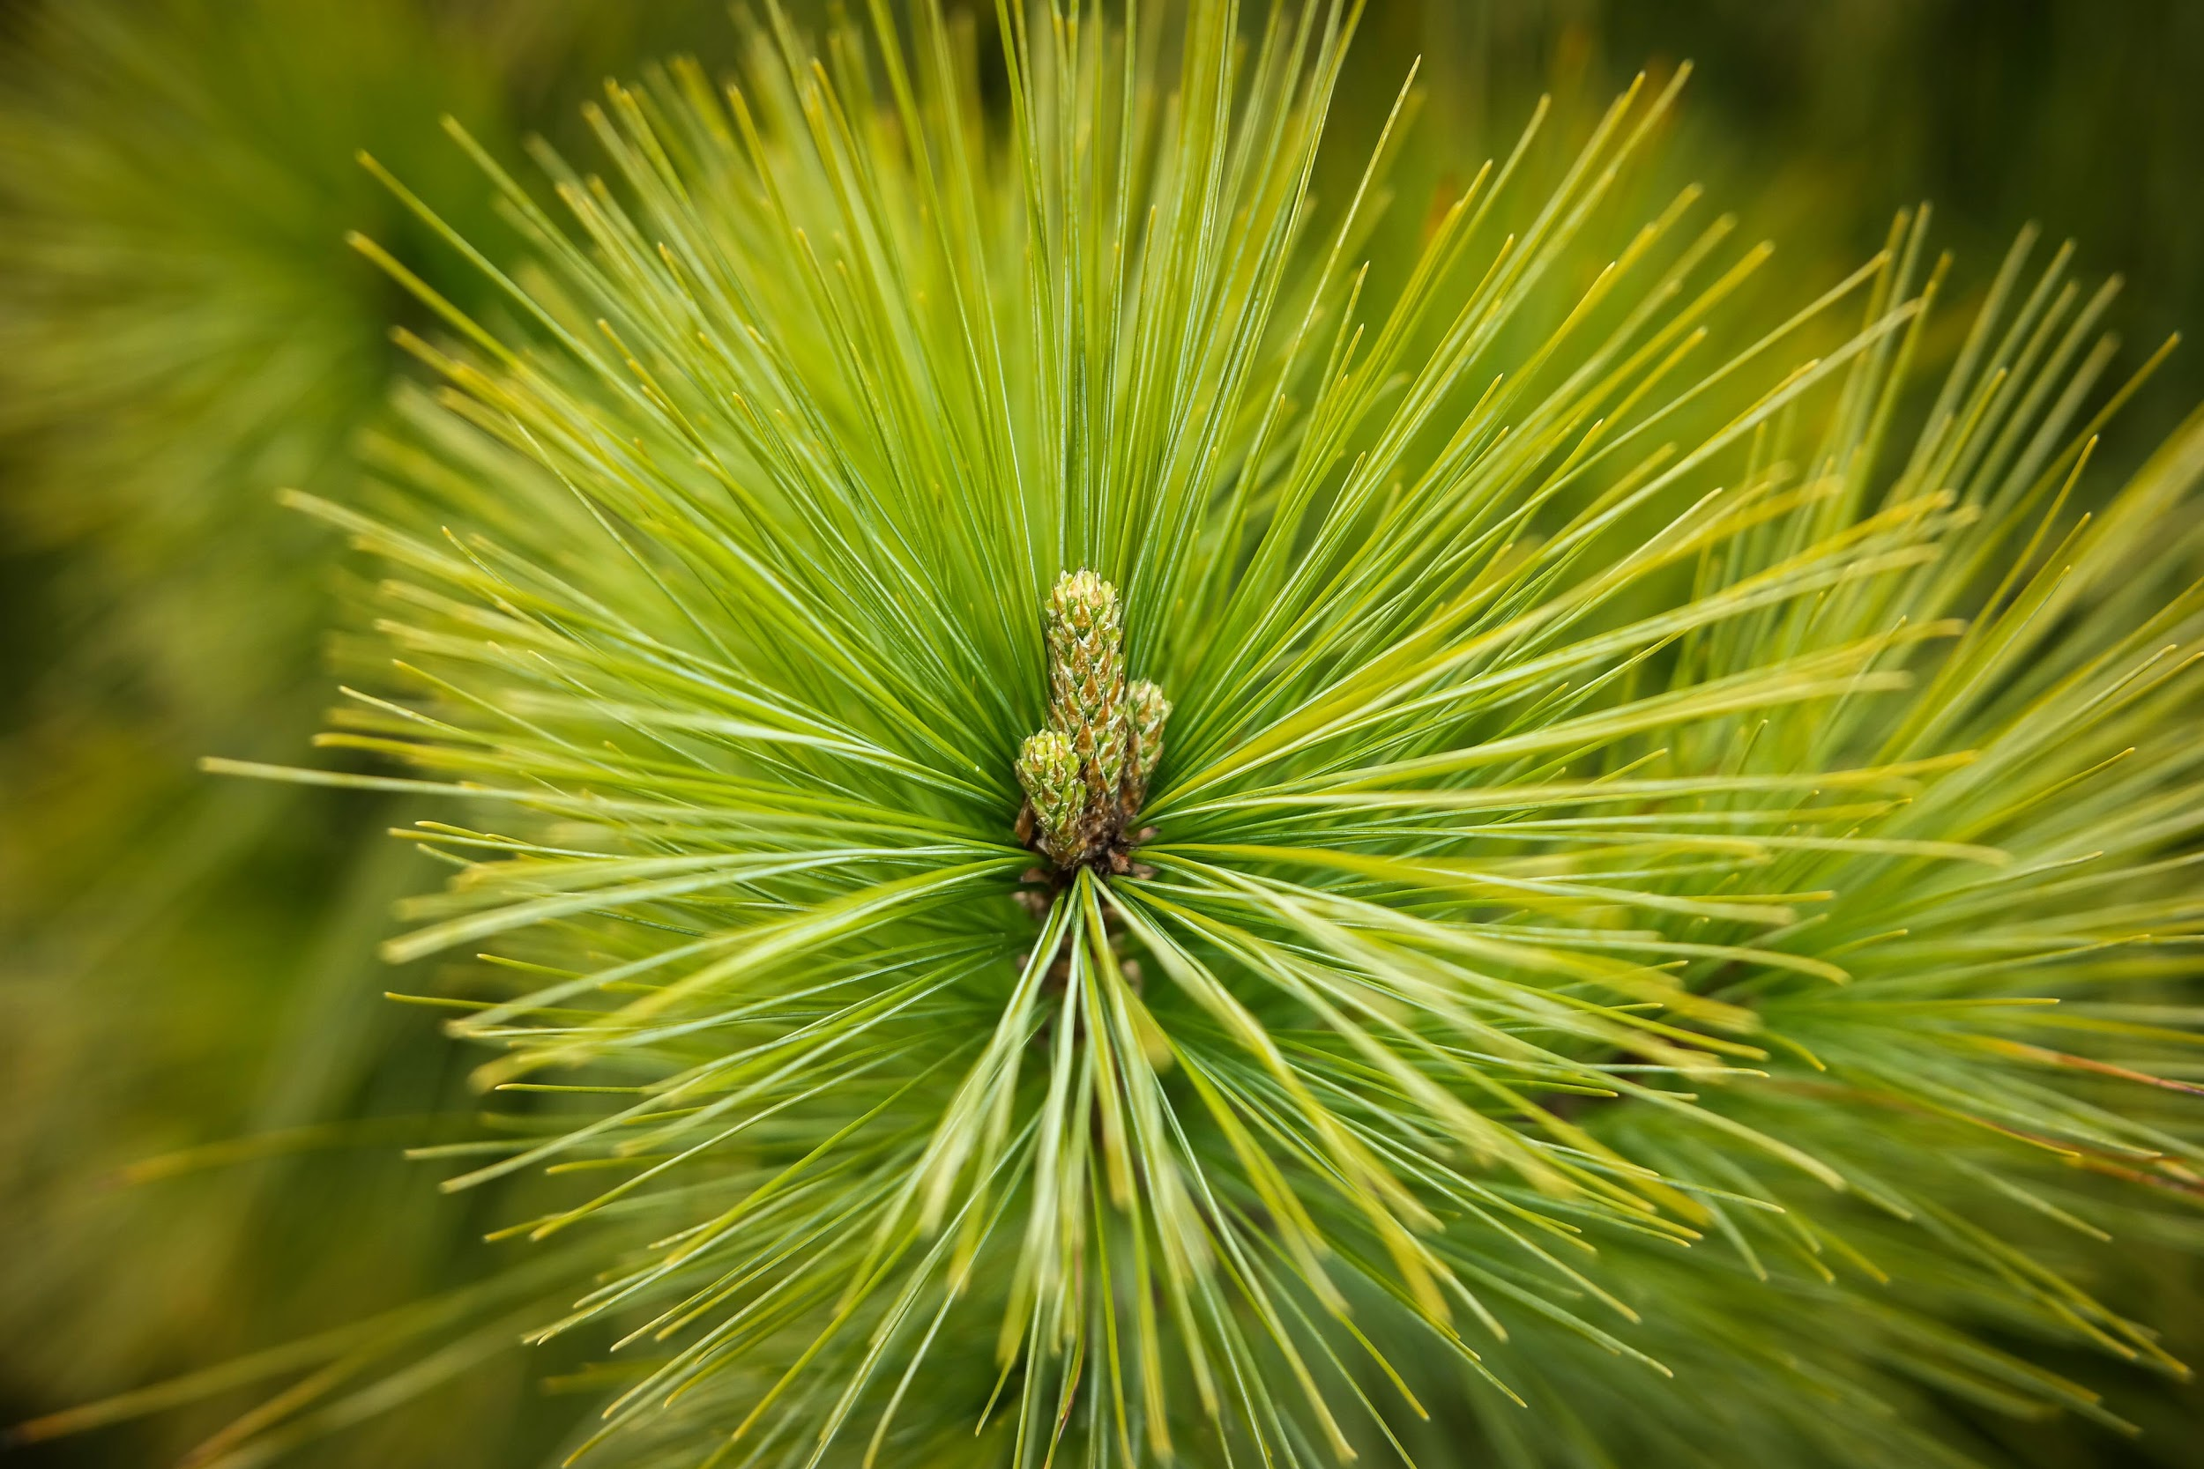
Picture and Description
Oak- a tree of the beech family that bears acorns as fruit, and typically has lobed deciduous leaves.
Maple- Acer is a genus of trees or shrubs commonly known as maple. The genus is placed in the Sapindaceae family
Conifer-evergreen trees and shrubs having usually needle-shaped or scalelike leaves and including forms (such as pines) with true cones and others (such as yews) with an arillate fruit.
Oak-
Maple-
Conifer-

Slide 3
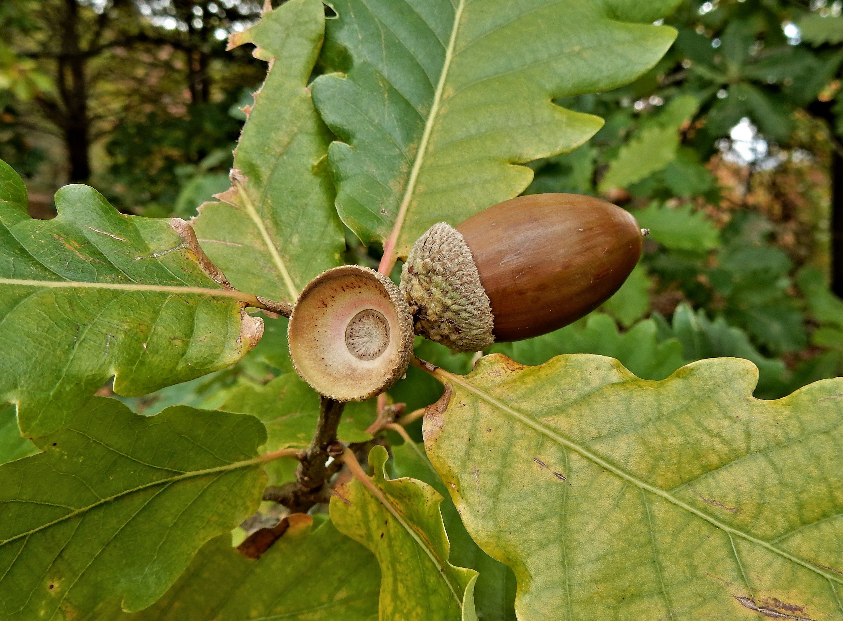
Oak Tree
Most species of oak trees are deciduous trees. Which are trees that shed their leaves annually. There are approximately 600 types of oak trees.
Common Name-White Oak
Scientific Name-Quercus alba,
REF(S)-http://bioimages.vanderbilt.edu

Slide 4
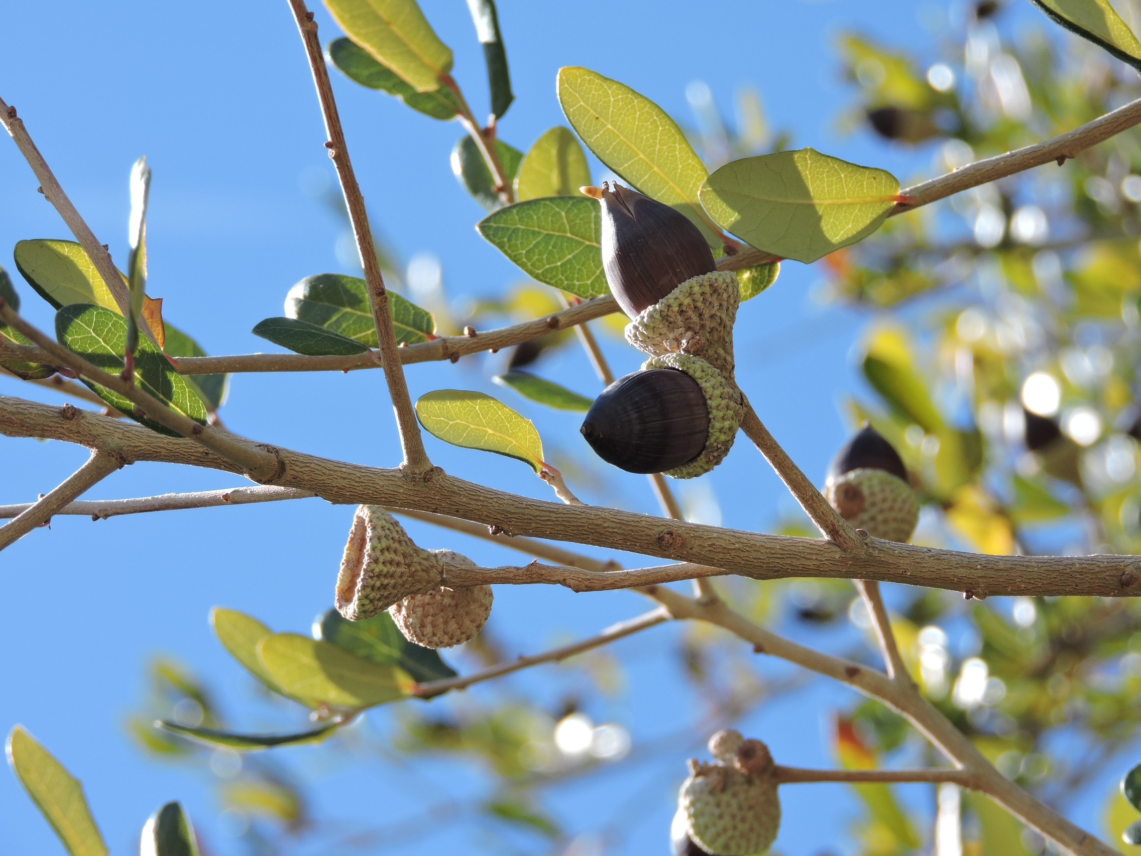
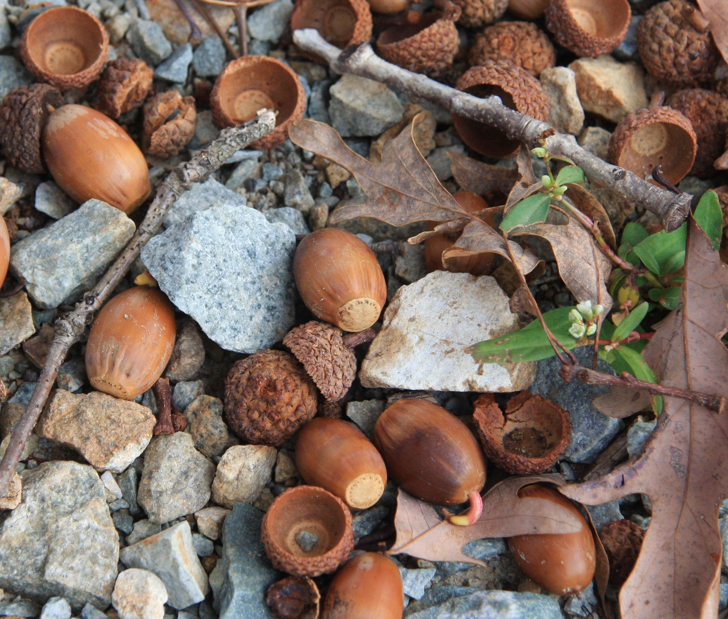
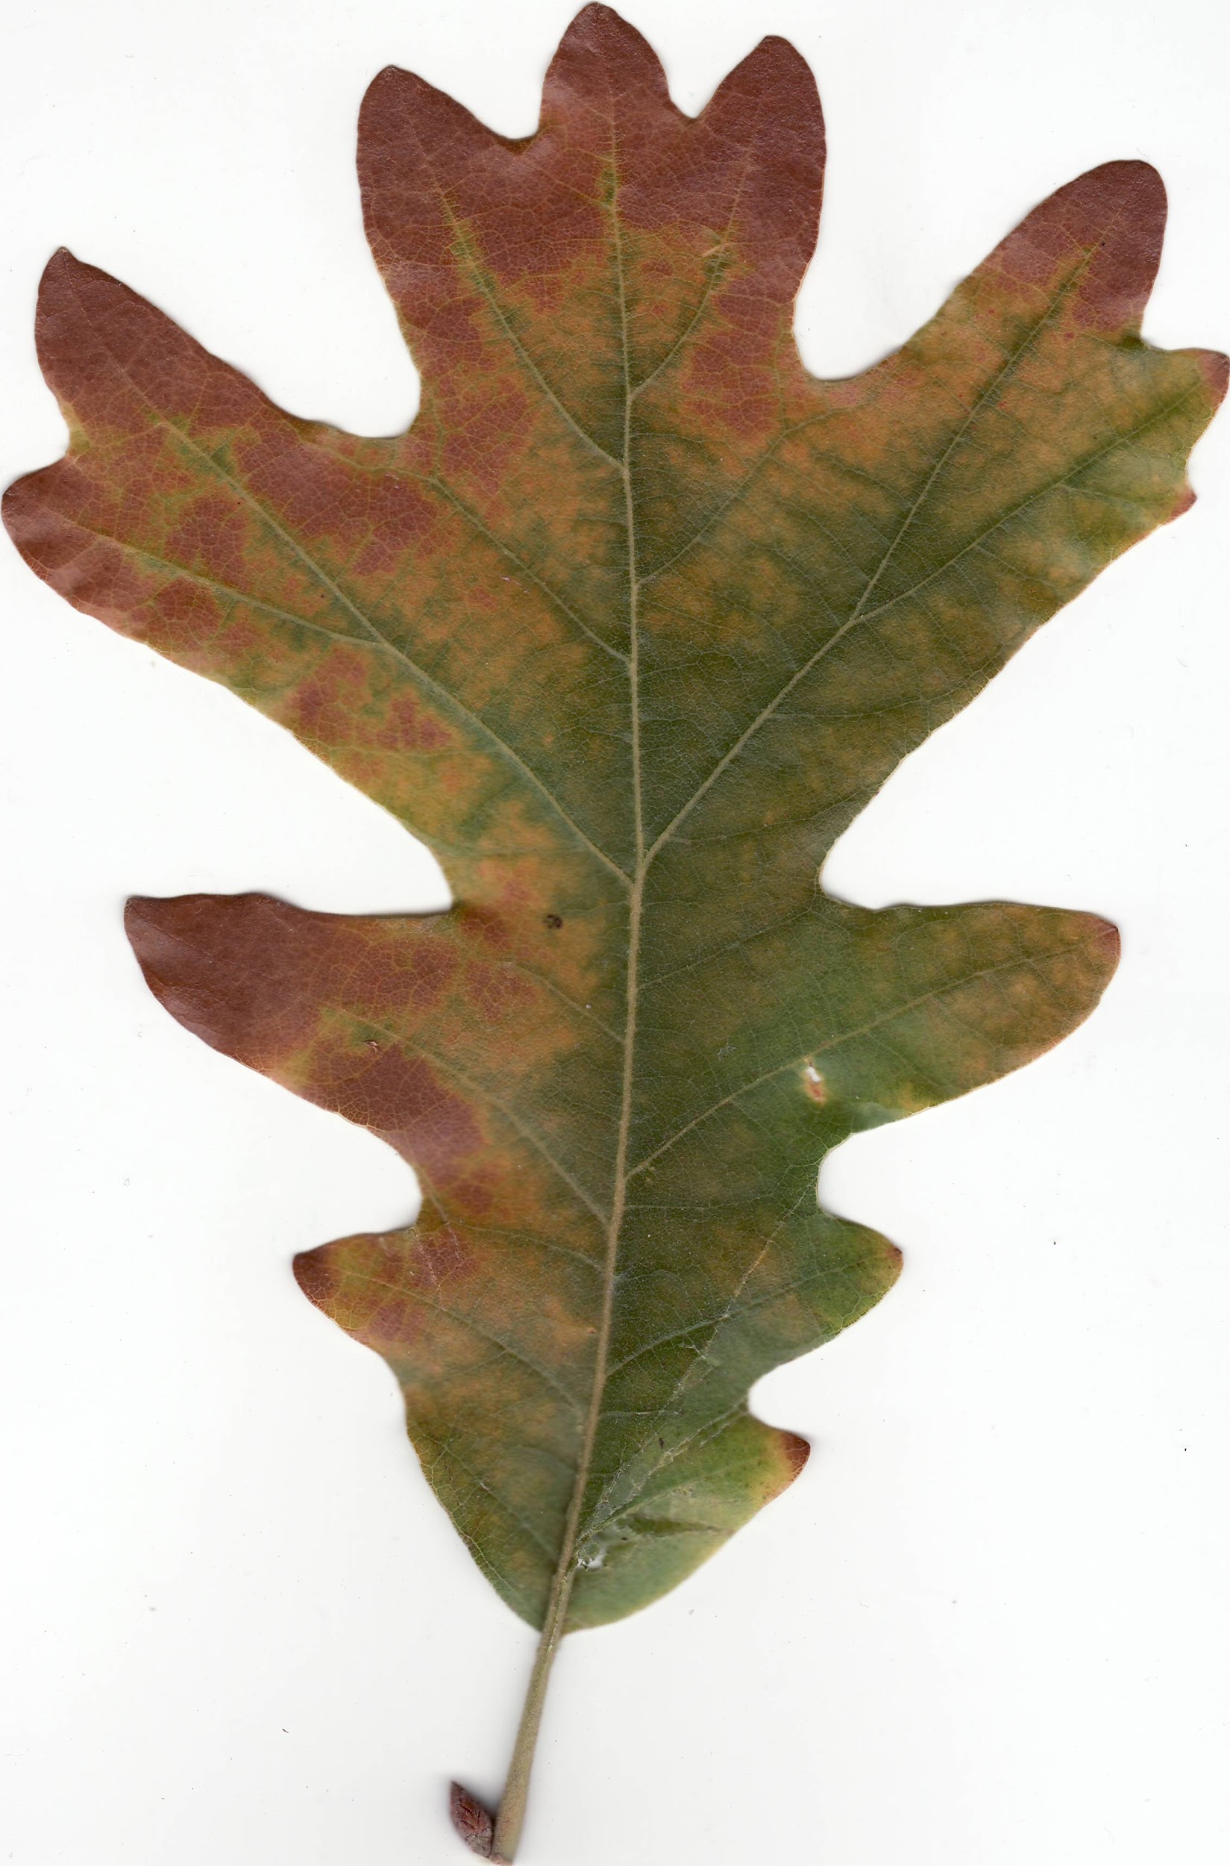
Oak Trees
My Oak Tree Specimen is a Quercus Alba. I know this because they grow in areas with rich soil. I also know this because they have finger like lobes. The twig is a brown/reddish/gray color. The twig is hairless.
Leaf- Twig- Acorns-

Slide 5
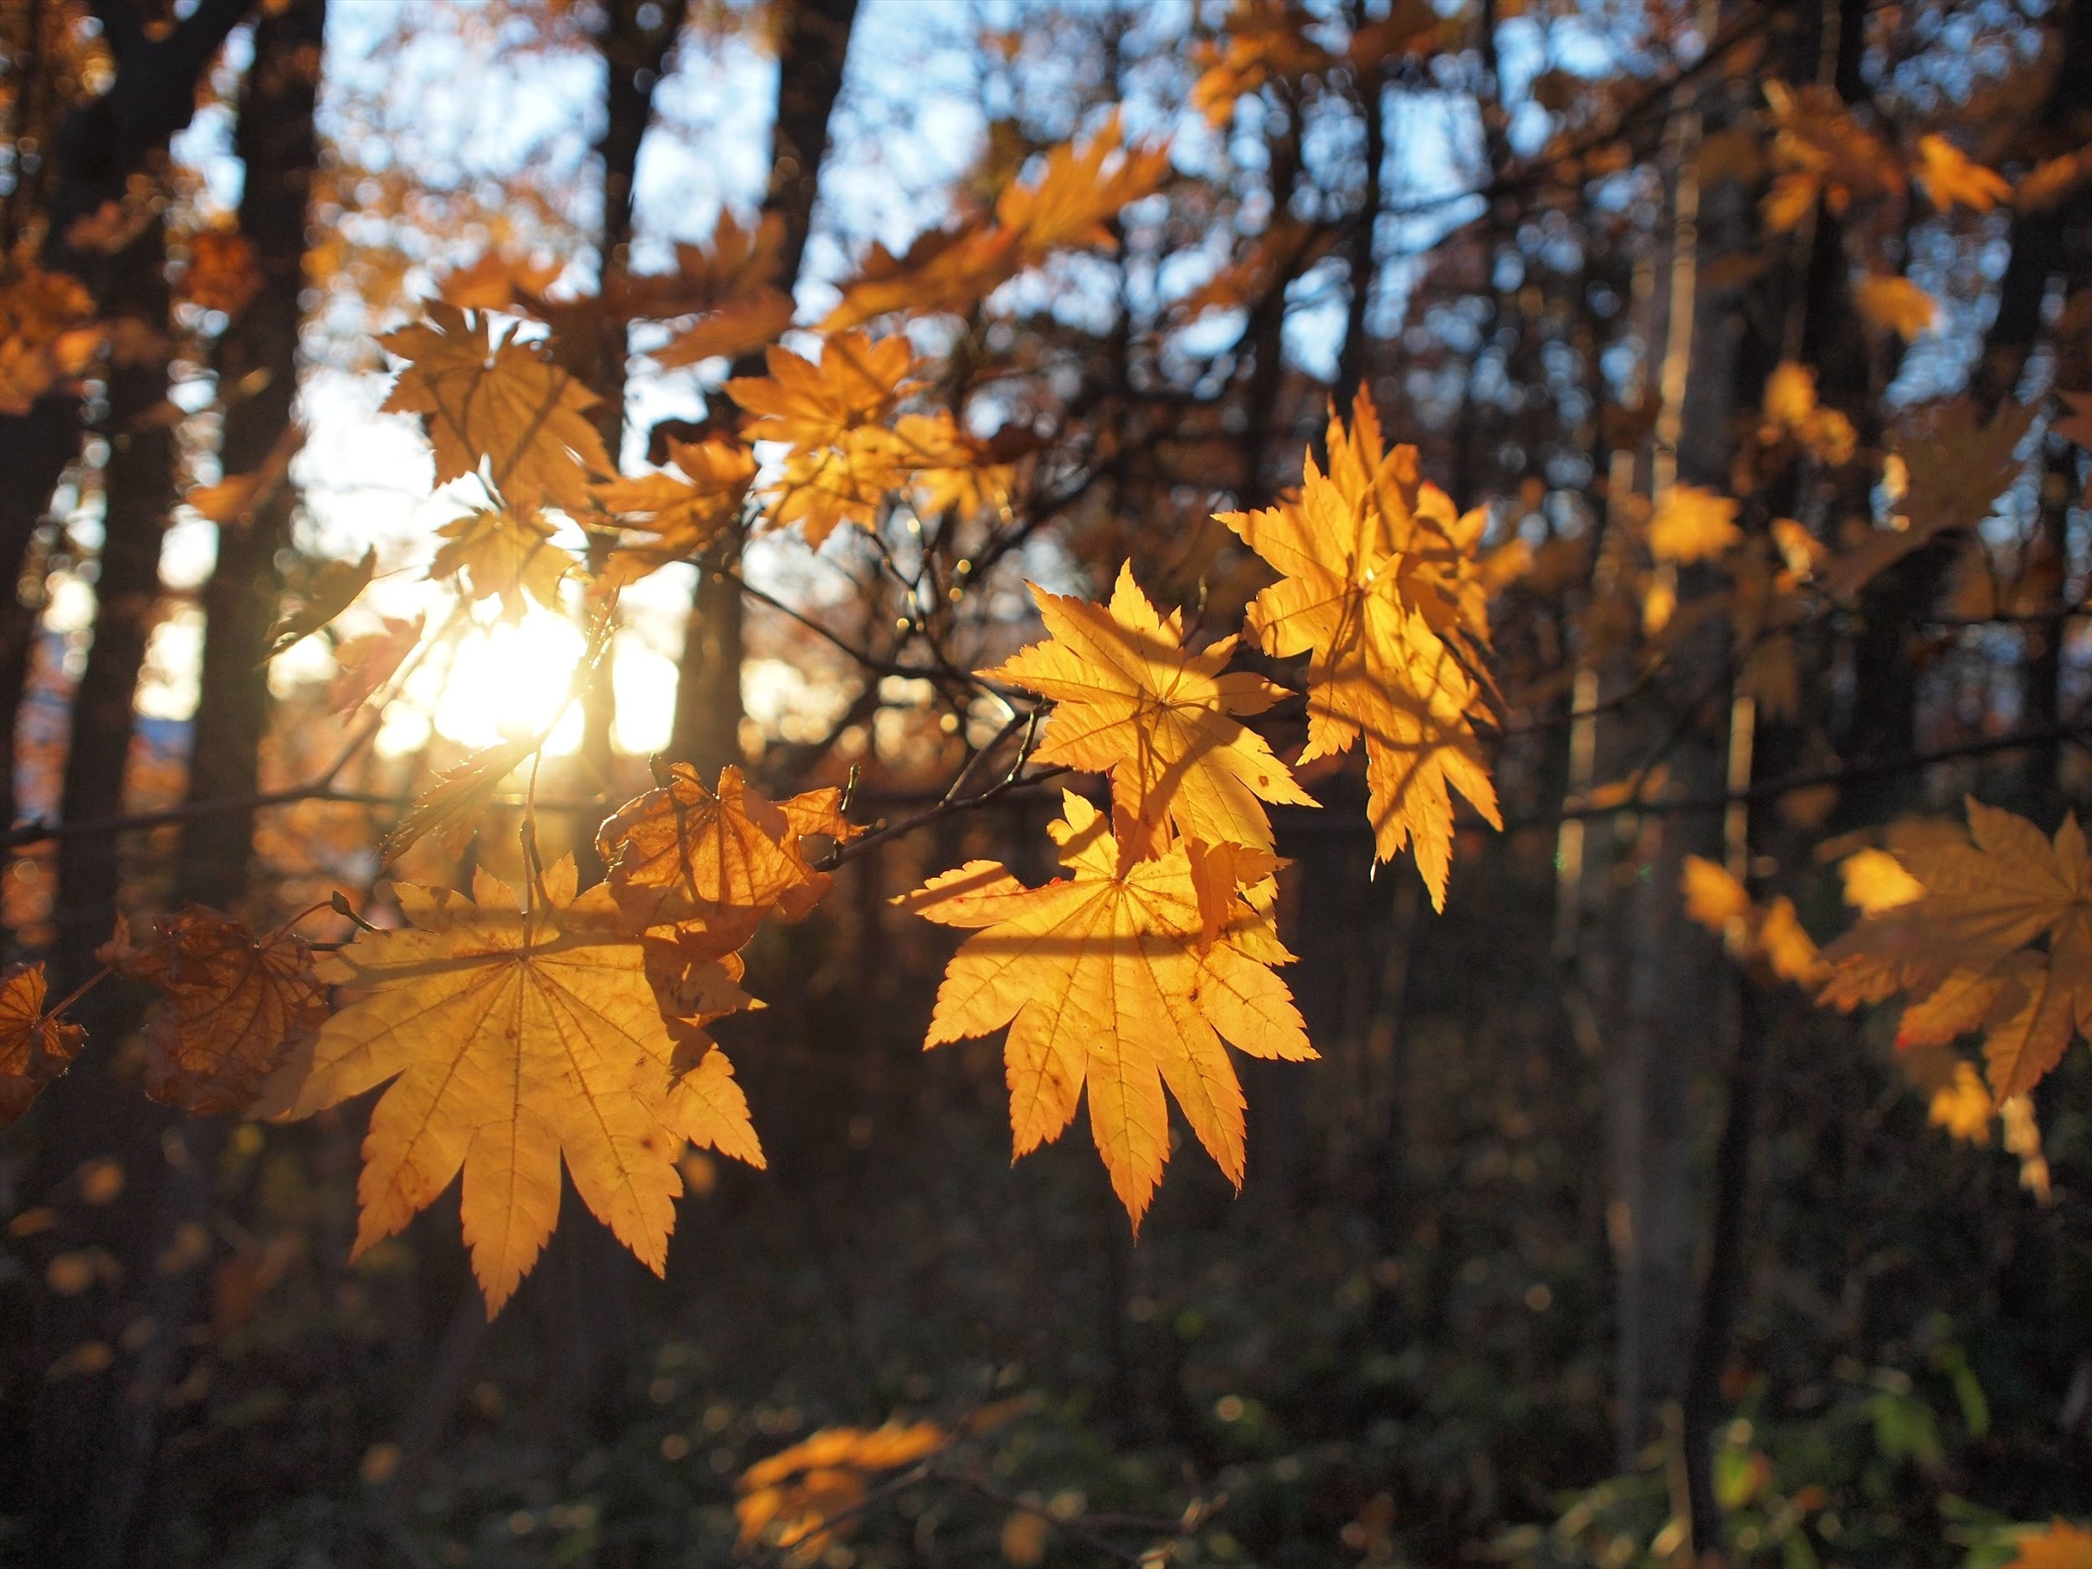
Maple Tree
Almost every species of Maple trees are deciduous. Which are trees that shed their leaves annually. There are 128 species of Maple trees.
Common Name-Norway Maple
Scientific Name-Acer platanoides
REF(S)-gobotany.newenglandwild.org

Slide 6
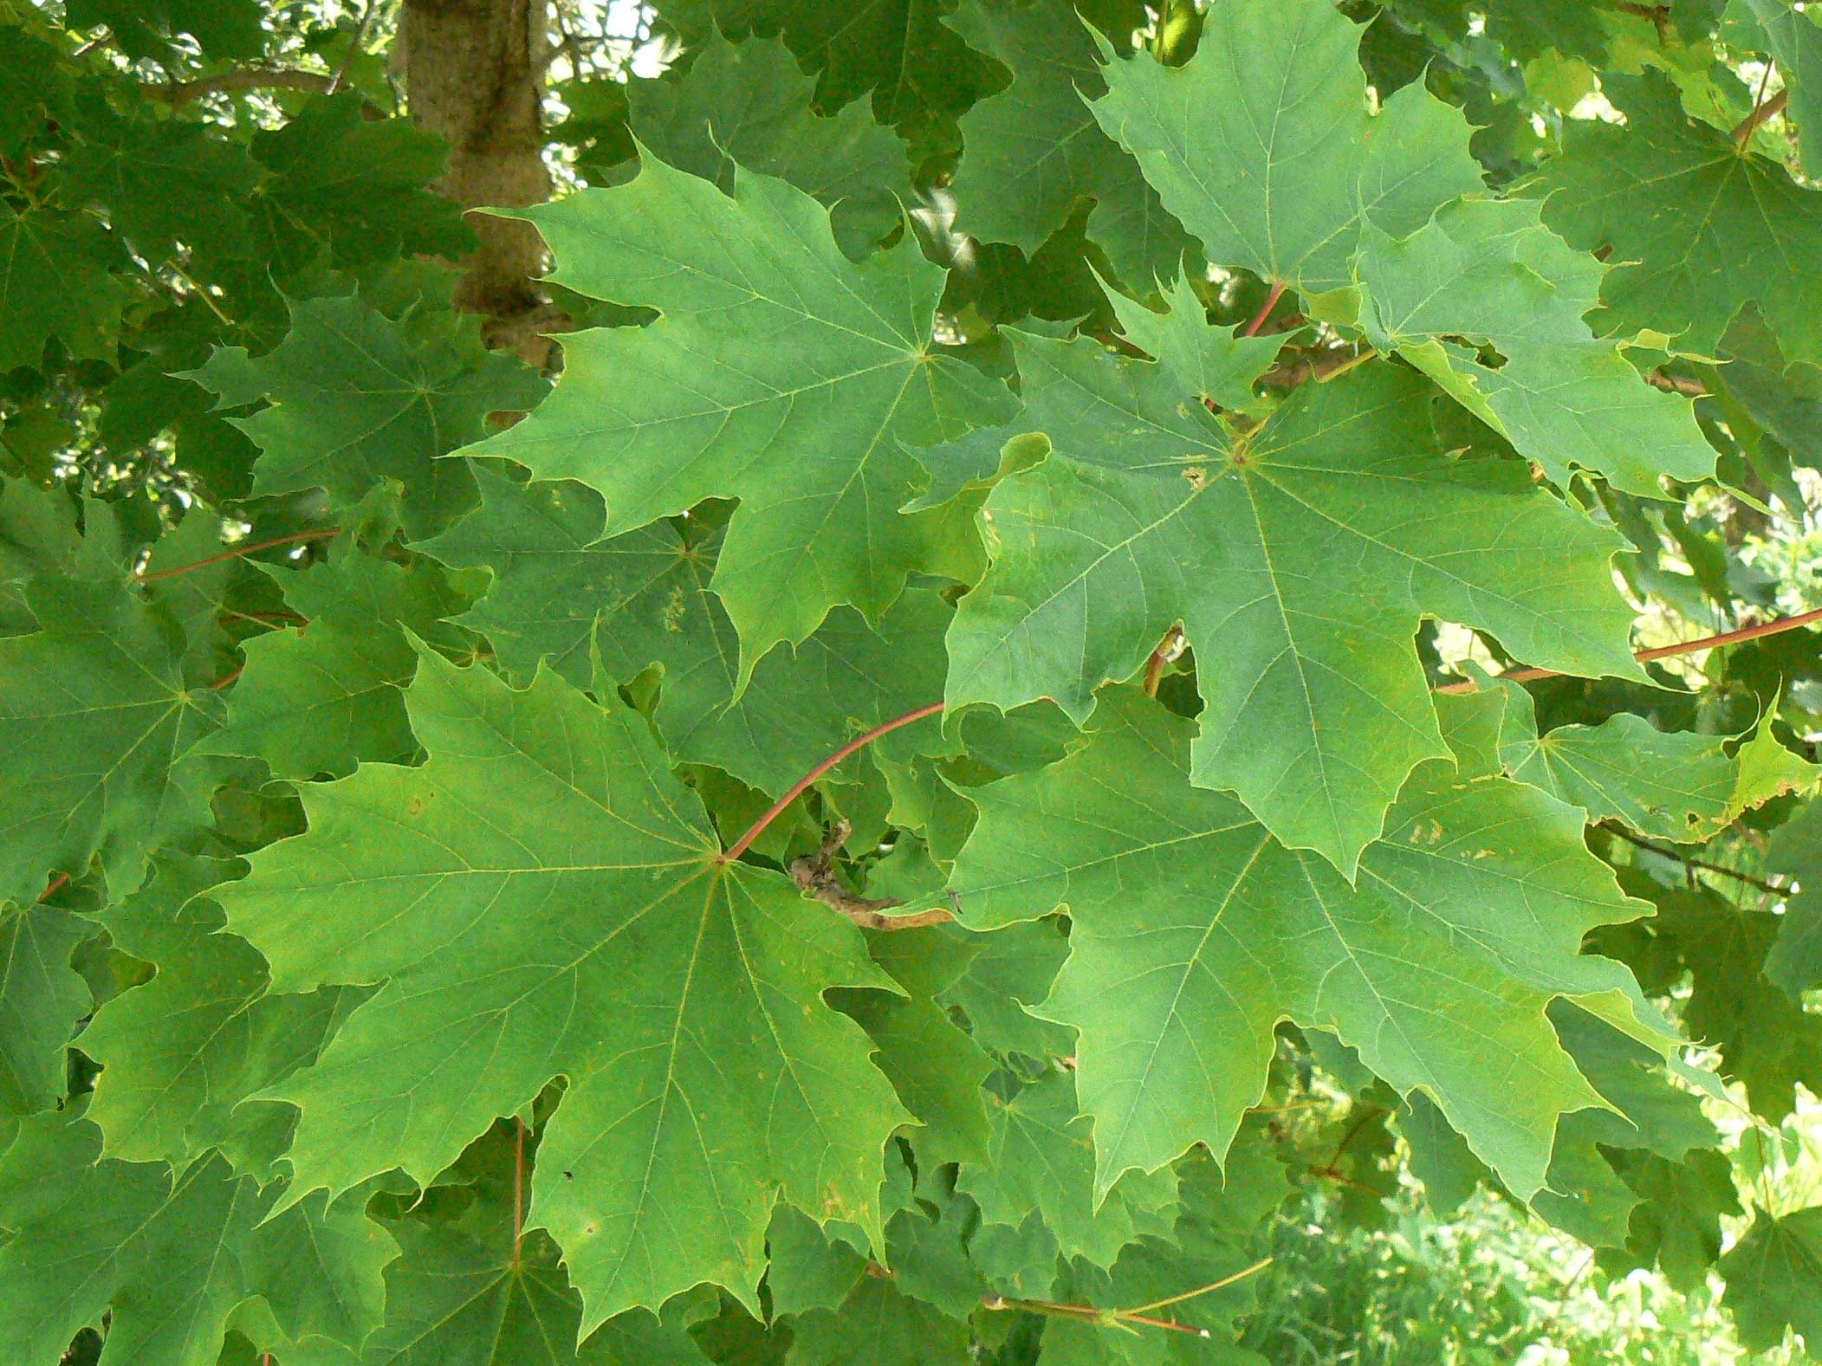
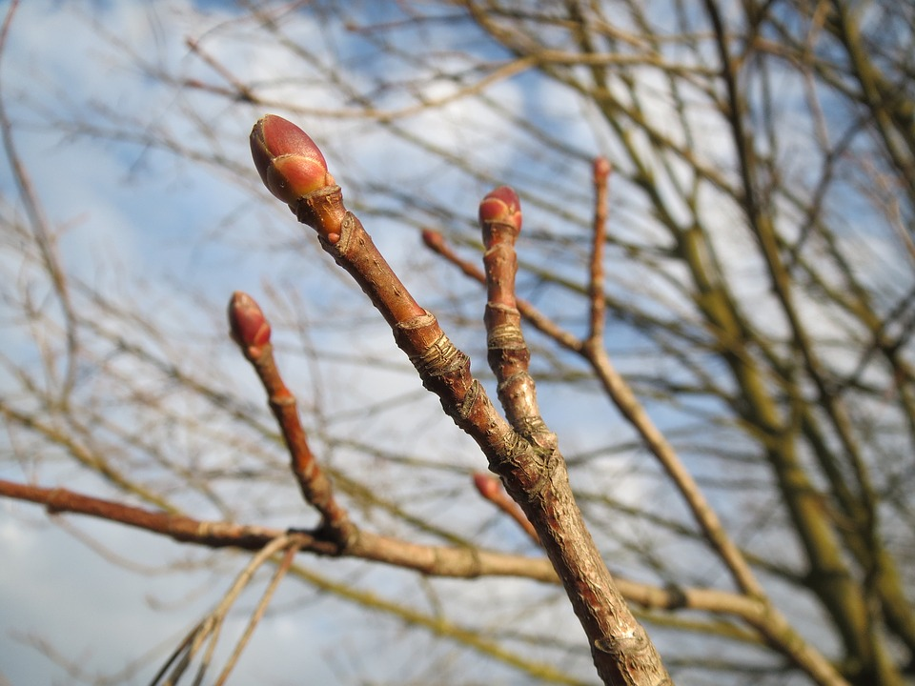
Maple Trees
My specimen is a Norway Maple. I know this because of its leaves, twigs, and bark. Their leaves are opposite, they have five lobes which are finger like rounded leaves. The autumn color is yellow and sometimes red-orange. Their twigs stouts wich are the hard stem like thing at the bottom of the stem, are reddish-brown. Their twig buds are glossy red with green on the base. Their bark is smooth and light brown on young trees, and dark and fissured on older trees.
Leaf- Twigs-

Slide 7
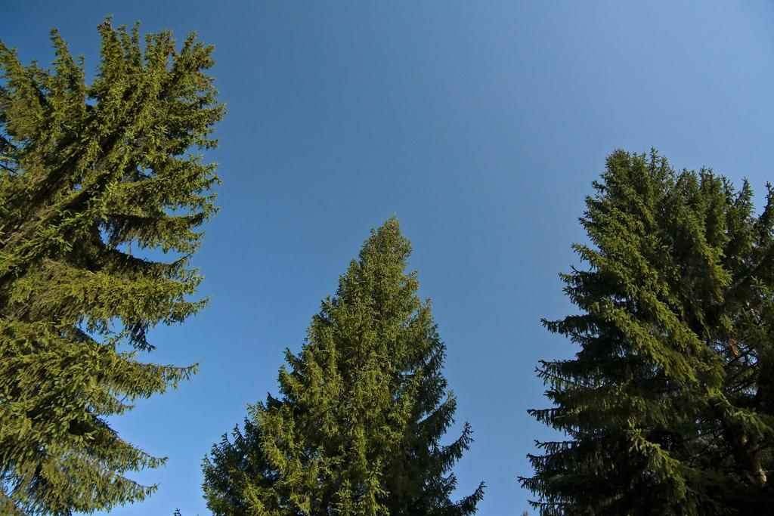
Conifer Tree
My conifer tree specimen is a Norway Spruce. Norway Spruces are Conifers, which are trees that stay green forever and they don't shed. There are about 38 different types of spruce trees. Norway Spruce is one of them.
Common Names- Norway Spruce
Scientific Names- Picea abies
REF(S)-envirothonpa.org

Slide 8
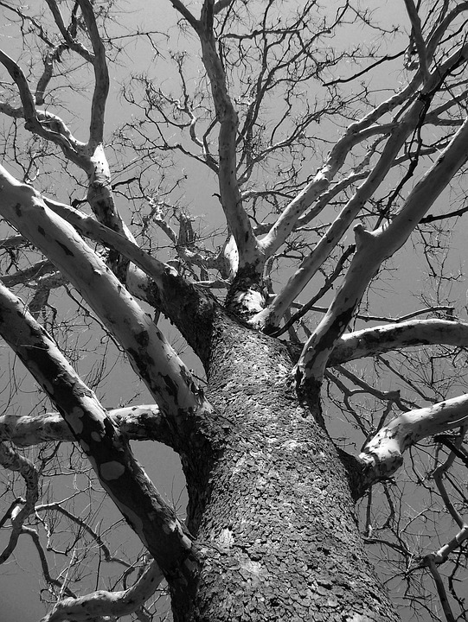
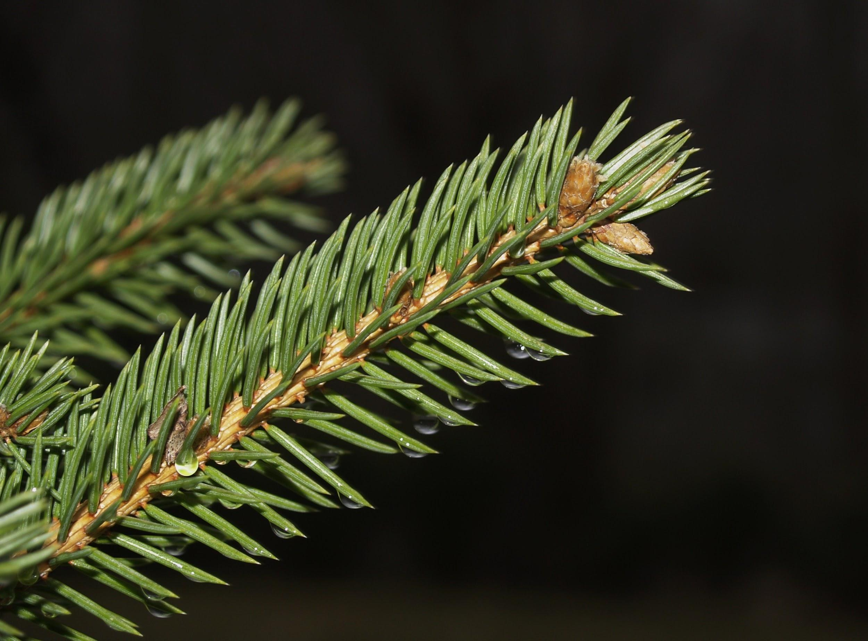
Conifer Trees
My Specimen is a Norway Spruce. I know this because they are evergreen and stiff. Their needles are 4 angled and flattened. Their twigs are medium in size,and lacking hair and they orangish brown.Their Needles are brown on wooden pegs.
Needles- Twigs-

