Slide 1
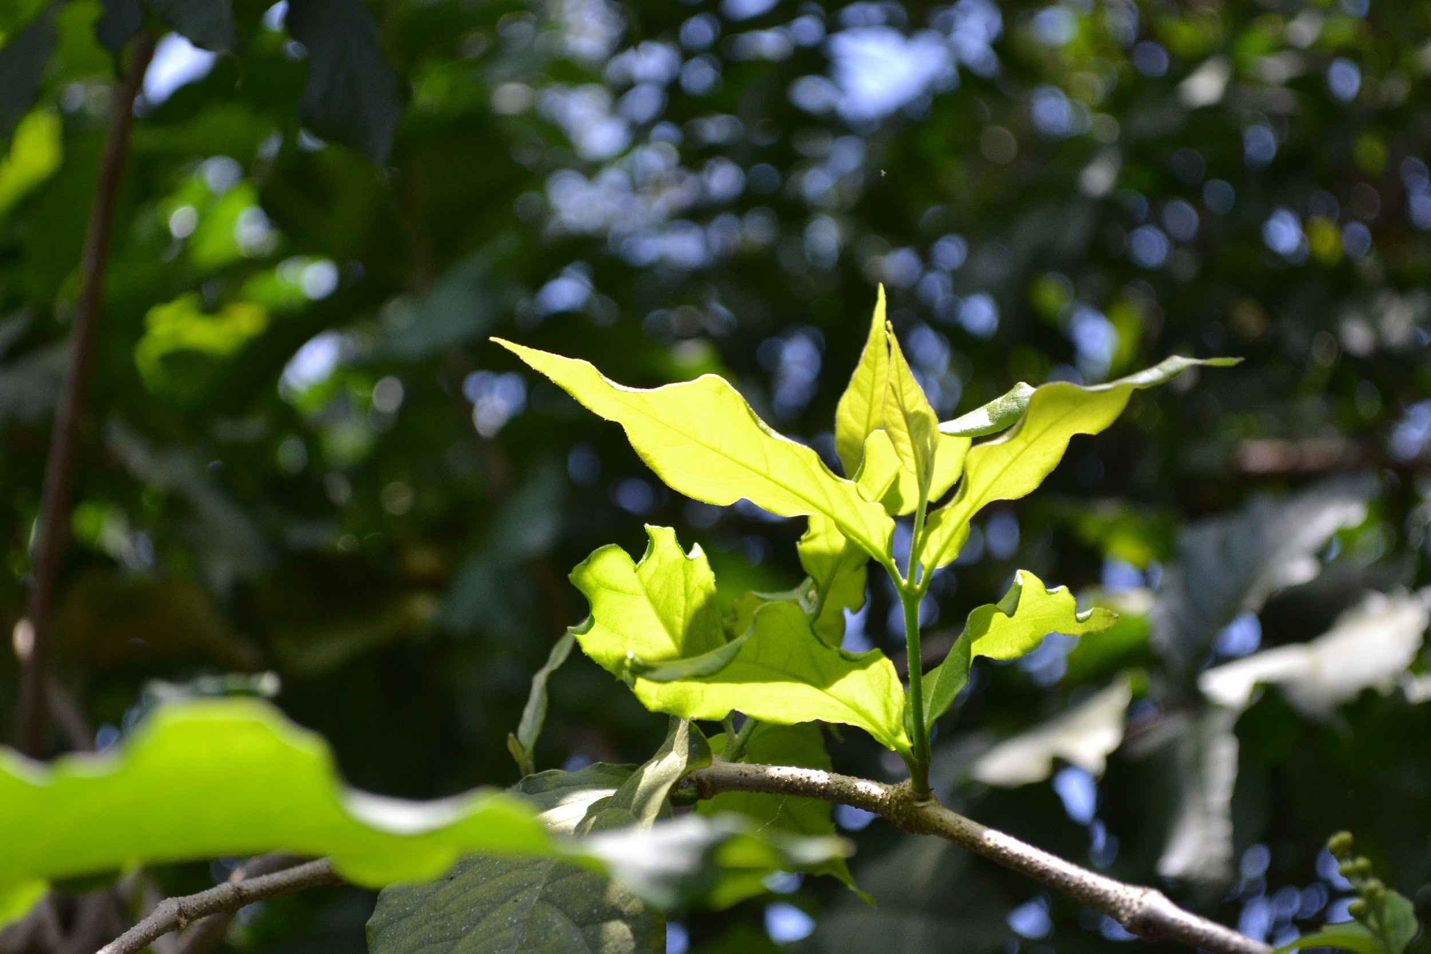
My Leaf Specimens Project
by:Mackena
Mod 3

Slide 2
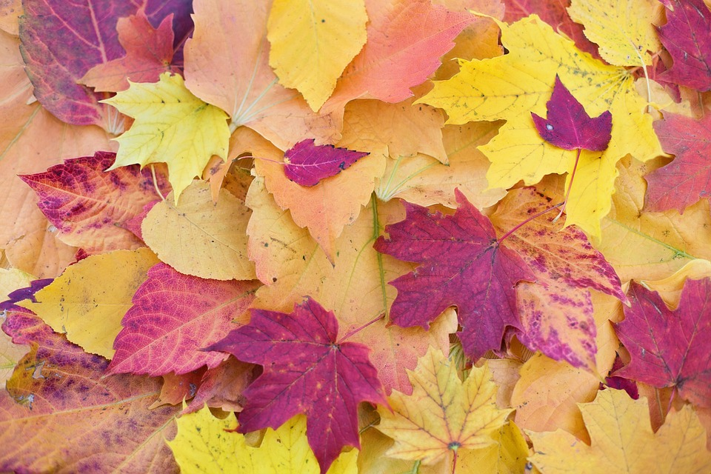
Where I Got My Leaves
Borough Park
My Nana’s house

Slide 3
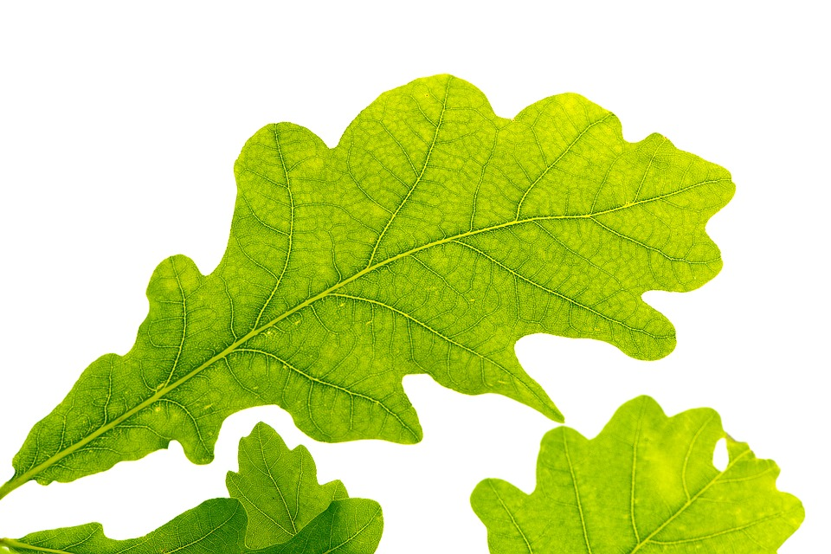
The Oak Leaf
To identify the oak leaf you must go through certain steps to identify this leaf. The first thing i did to identify this leaf is to determine if it is coniferous or deciduous.Then after i knew it was deciduous because it is a leaf and coniferous leafs are like needles I then went through a ton of books about leafs. I found a book titled The Audubon Society Field Guide To North American Trees. I then went to the glossary and looked up oak. The oak leaf has little hairs at the points of each tip and the oak leaf is living because it needs all the things any living organism needs/has.
Reference: The Audubon Society Field Guide To Northern American Trees.

Slide 4
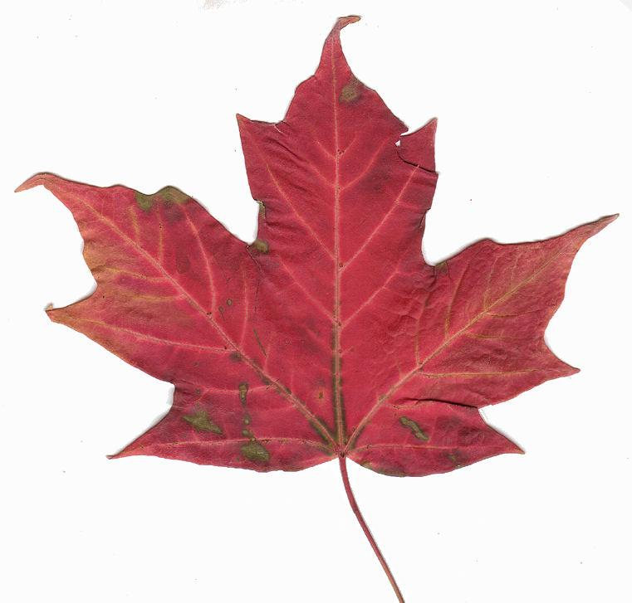
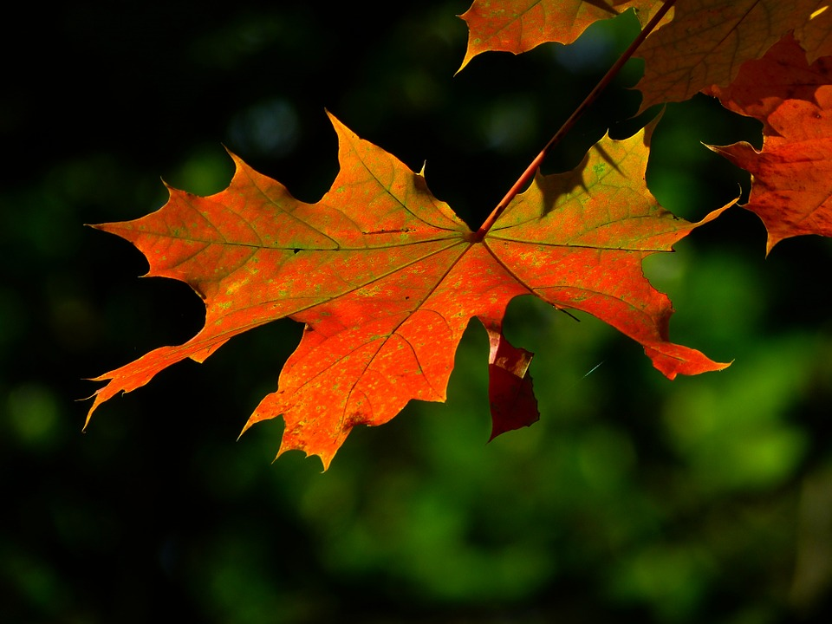
The Maple Leaf
The maple leaf is a deciduous leaf and it is living. I know this because the maple leaf has hair on each of its tips and it not like needles. To identify this leaf I had to go through the same steps as the maple leaf. I went to the glossary of the book titled The Audubon Society Field Guide To Northern American Trees. It told me that the maple leaf is palmately lobed, meaning that each leaf is divided into distinct sections and shaped like a hand. That is why I believe that the maple leaf is a living organism.
Reference: MCcallus Website, The Audubon Society Field Guide To Northern American Trees.

Slide 5
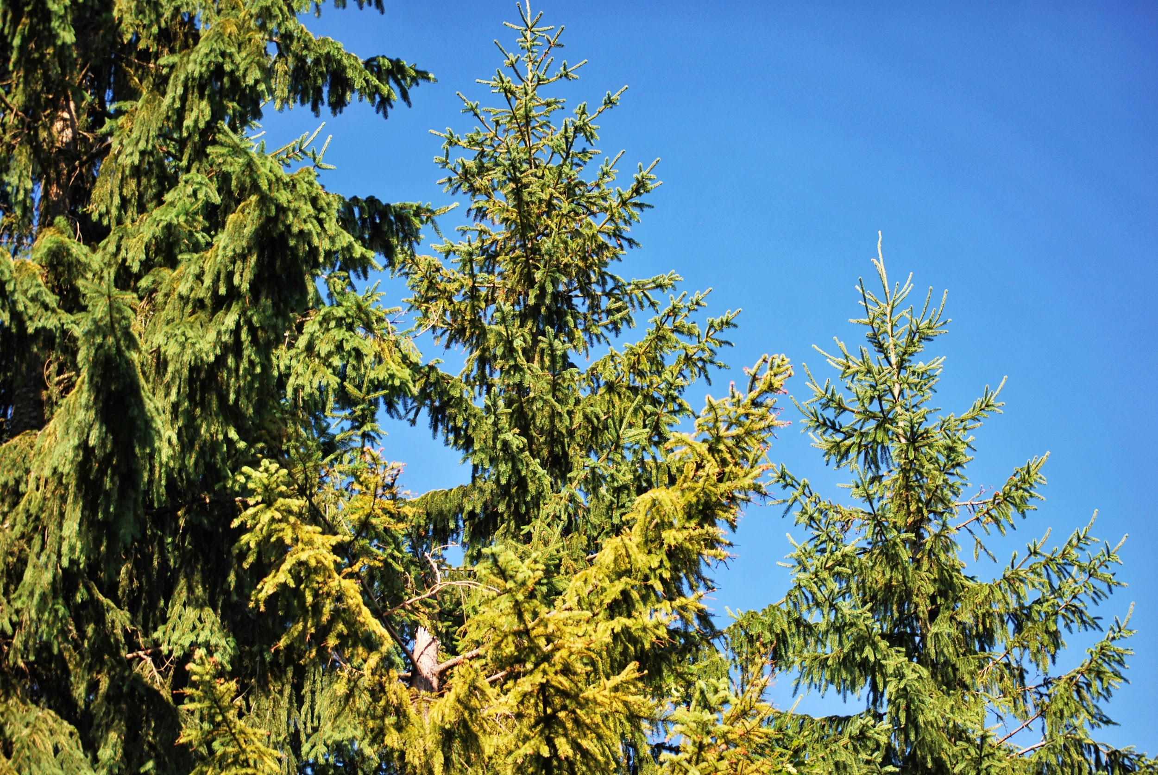
How To Identify A Conifer Leaf
Conifer leaves have a needle like body and can be be prickly at its tips. To identify this leaf, it is very easy to tell if it is conifer. All you need to do is see if it looks like a needle and if there there is a little point at the end. Some coniferous trees are pine,fir,and spruce trees. I believe that coniferous trees are living.
Reference: Ms.MCcallus Website.

Slide 6
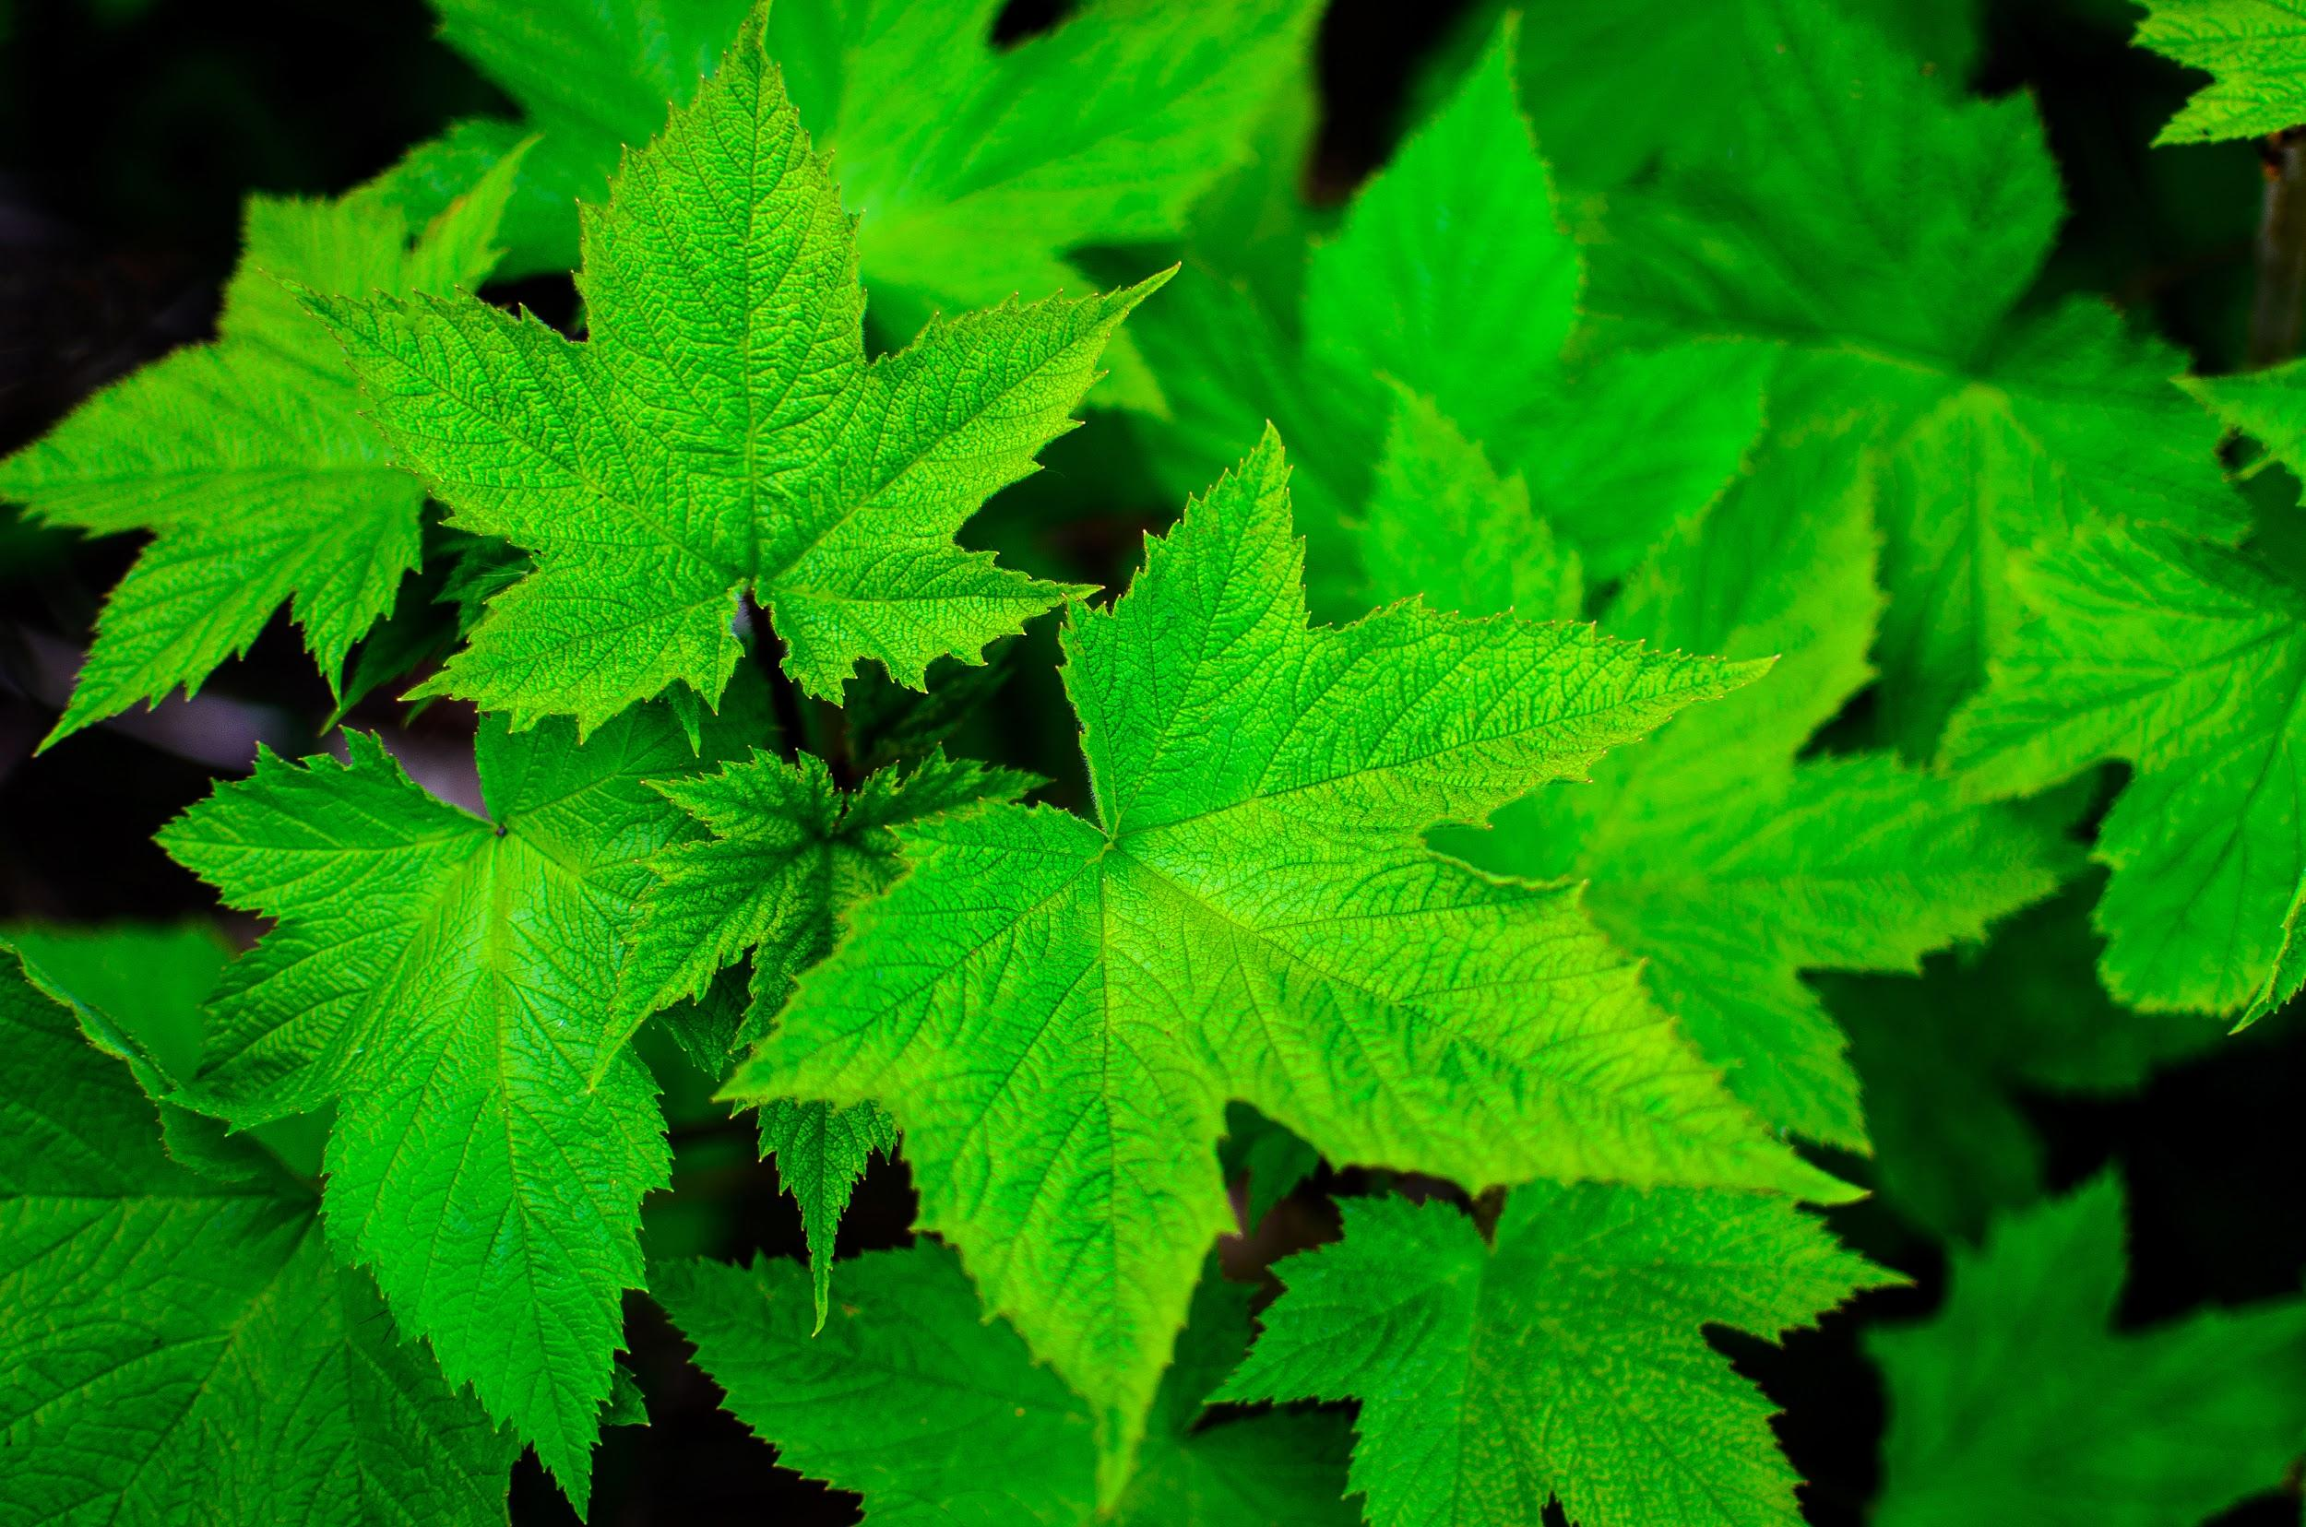
Vocab
Coniferous- Belonging or pertaining to the conifers
Deciduous- shedding the leaves annually, as certain trees and shrubs
Palmate -shaped like an open palm or like a hand with fingers extended, as a leaf or antler.

Slide 7
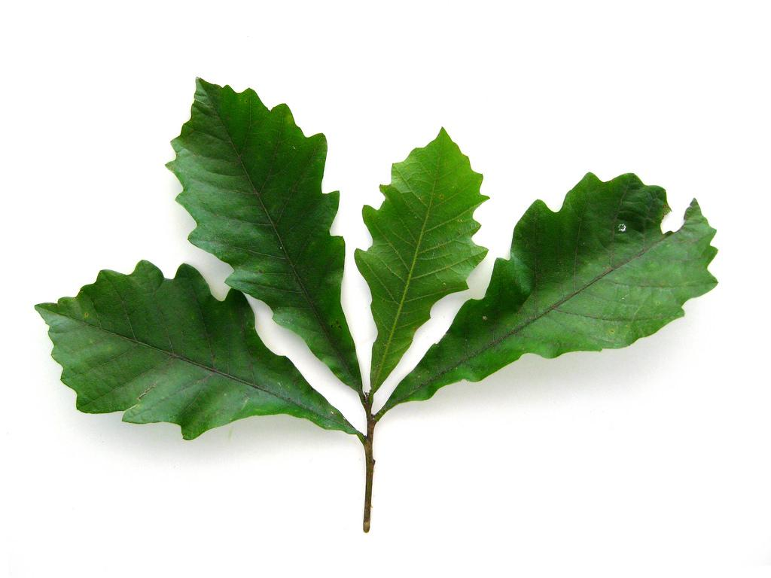
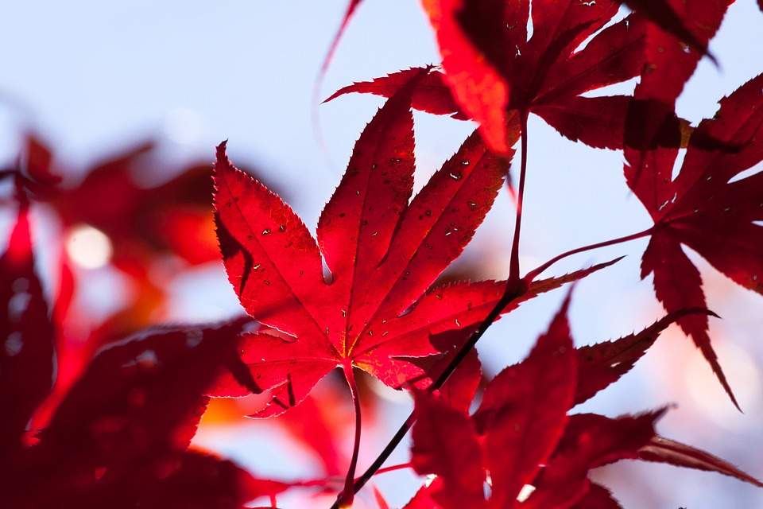
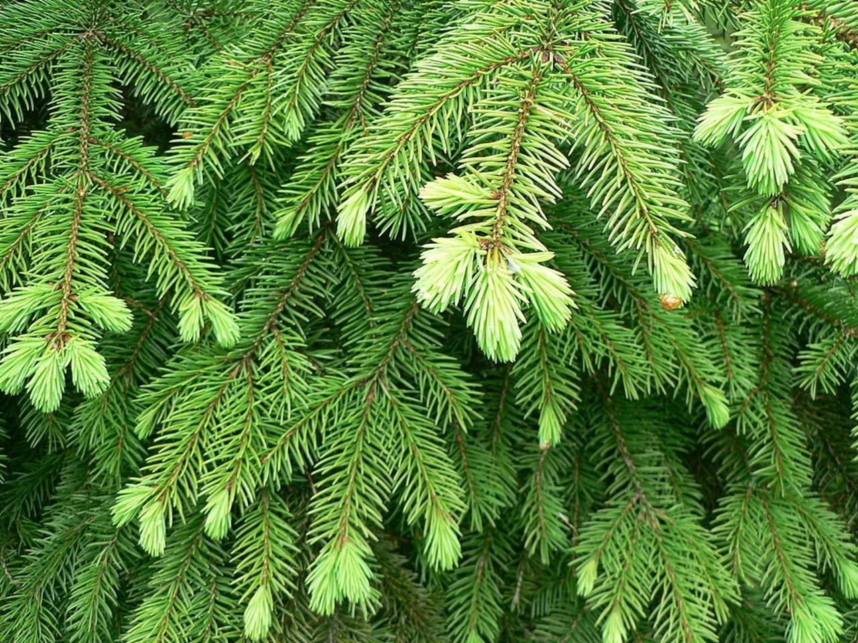
Leaves;)
-Oak
-Maple
-Conifer

Slide 8
That All For Today Folks;)

