Slide 1
Identifying leaves
By: Aidan

Slide 2
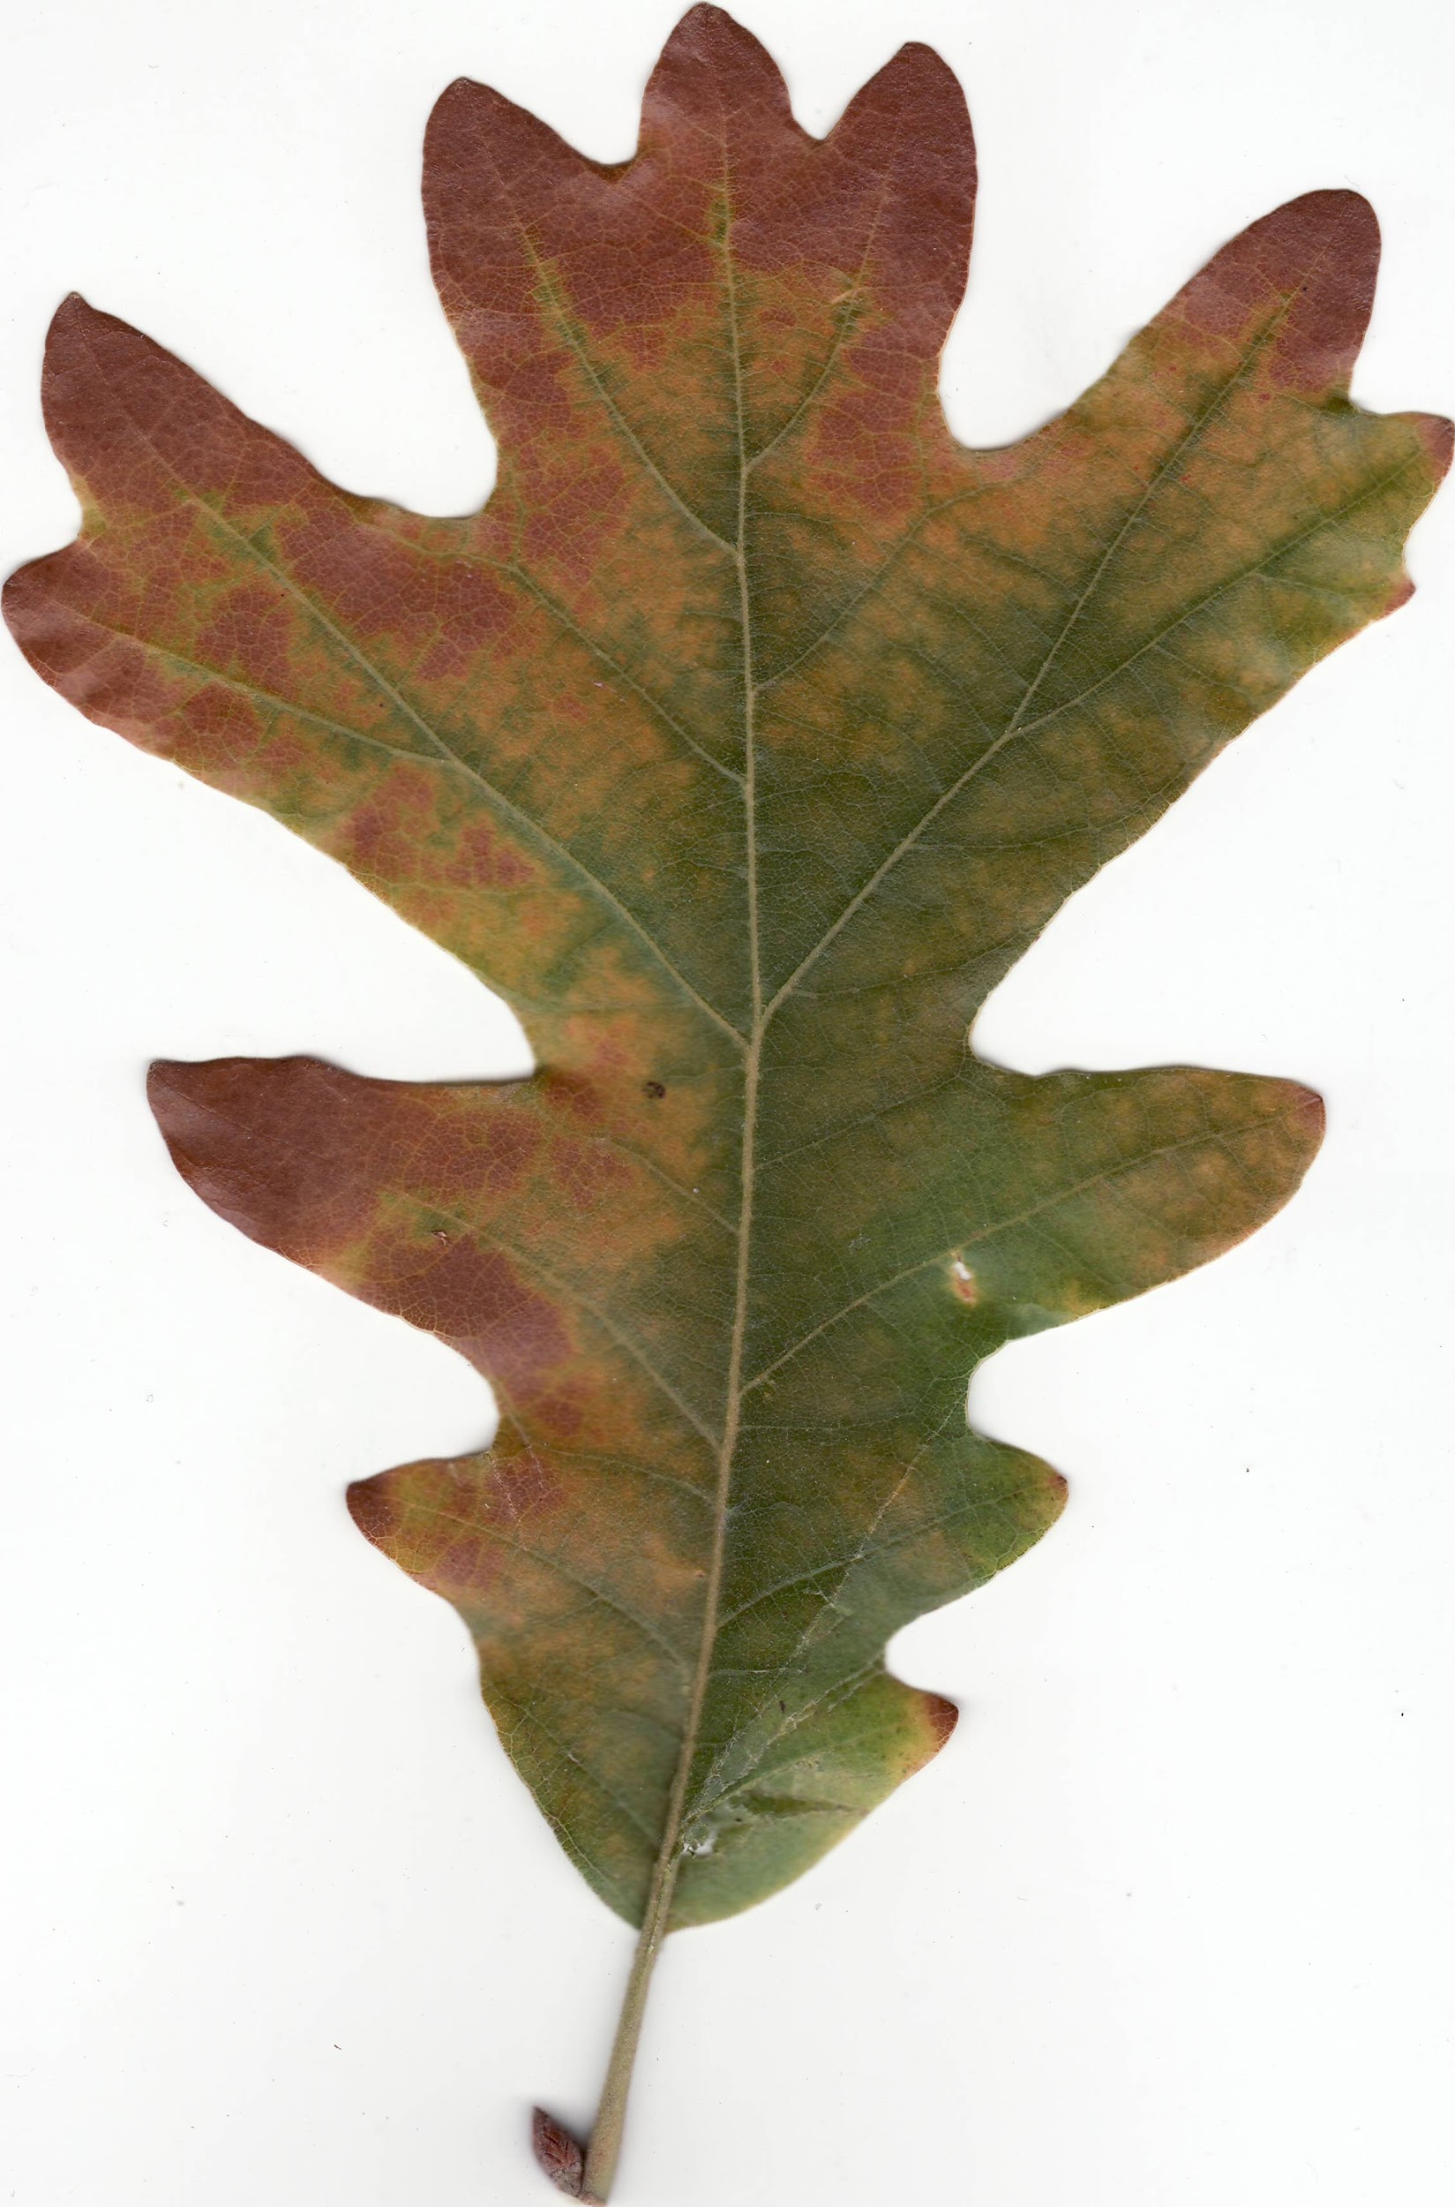
Specimen # 1
Oak leaf: To identify an oak leaf you
Must narrow it down to either a red
Oak or a white oak.Also if it produces
Acorns it’s an oak leaf.If it has round-
-ed lobes it’s a red oak,but if it has
pointed lobes then it’s a white oak.

Slide 3
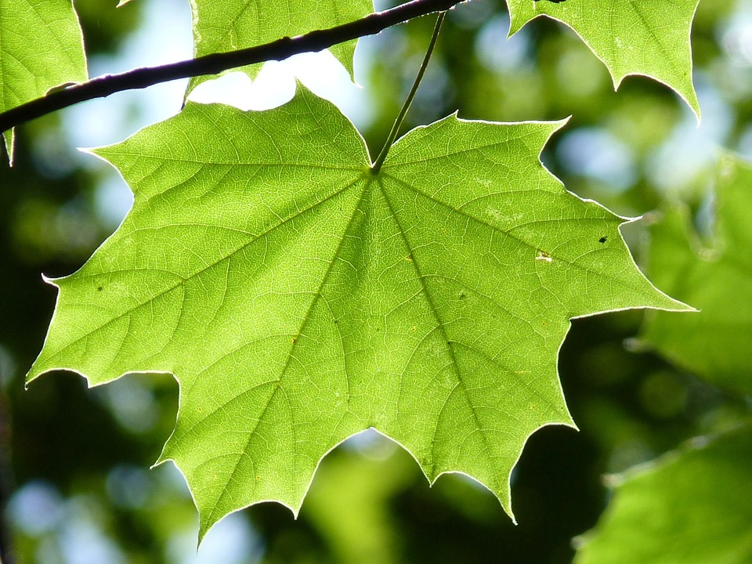
Specimen#2
Maple leaf: maple leaves have a dark green
color on the outside and a lighter green on the
underside. Maple leaves have 5 lobes,3 main
lobes and one small lobe on each side.Maple
leaves have smooth U-shaped margins betw-
-een points.

Slide 4
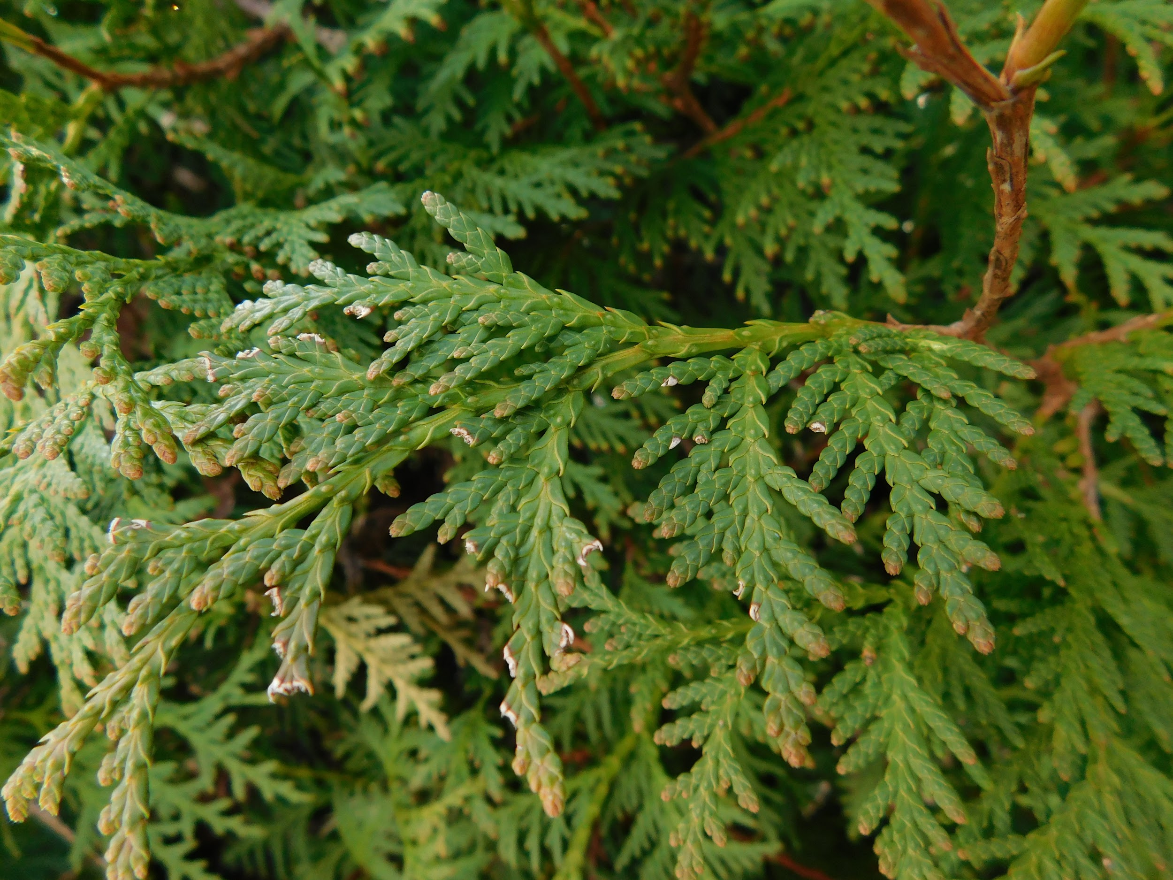
Specimen #3
Conifer pines: Conifers have needle like leaves
that can then be further defined as of how the
Needles are grouped. Also they can be classif-
-ied by the seeds, shape and/or size.

Slide 5
Additional info
Animals supported by oak leaves: Deer,squirrels,chipmunks,and,blue jays.
Animals supported by maple leaves:Turkeys,rabbits,crows,and opossums.
Animals supported by conifers:Raccoons,chipmunks,squirrels,and crows.

Slide 6
Glossary
Acorns- The fruit of the oak, A smooth oval nut in a cuplike base.
Lobes- A roundish or flattish part of something
Margins- The edge or border of something.
Seeds-A flowering plant’s unit of reproduction,capable of developing into another such plant.

